Slide 1
HYFLEX @ LPC
FLEX DAY, MARCH 16, 2023

Slide 2
TODAY’S AGENDA
Pop quiz
Overview of HyFlex
Faculty experiences
Major questions
Student feedback
Student resources
Faculty training
Faculty resources
Classroom technology
Q&A

Slide 3
OVERVIEW OF HYFLEX @ LPC
LPC Distance Education Committee definition: A HyFlex (Hybrid Flexible) course allows students the choice of attending class on campus or online. Online modalities may include synchronous online, and/or asynchronous online instruction.
Student and instructor choices
Face-to-face (f2f) and synchronous online using Zoom
Face-to-face (f2f) and asynchronous online
Face-to-face (f2f) and synchronous online AND asynchronous online
Technology
No matter your content & activities with students in different modalities, all students should be able to achieve the SLOs of the course
Aim for interaction with, and among, all students
Notes:
Students should be able to choose modalities on a session-by-session basis.
Students need to know the modalities prior to registering for classes.

Slide 4
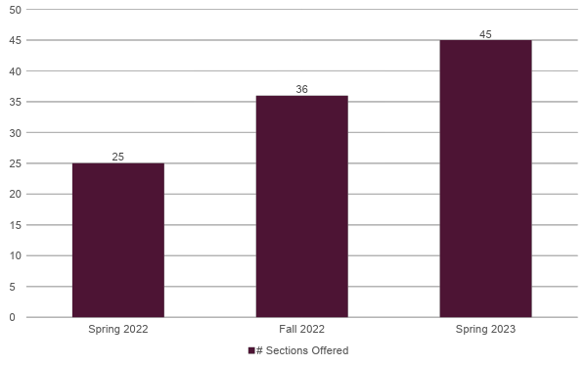
OVERVIEW OF HYFLEX @ LPC: # OF SECTIONS OFFERED

Slide 5
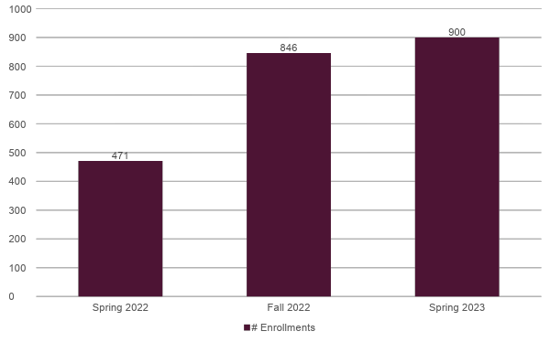
OVERVIEW OF HYFLEX @ LPC: # OF ENROLLMENTS

Slide 6
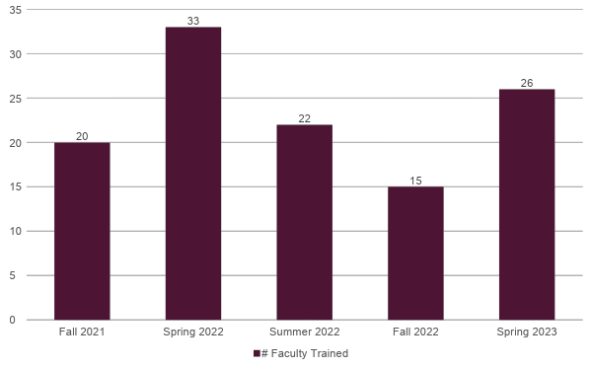
OVERVIEW OF HYFLEX @ LPC: # OF FACULTY TRAINED

Slide 7
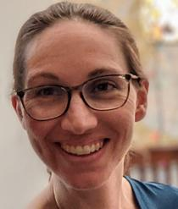
FACULTY PRESENTATIONS

Slide 8
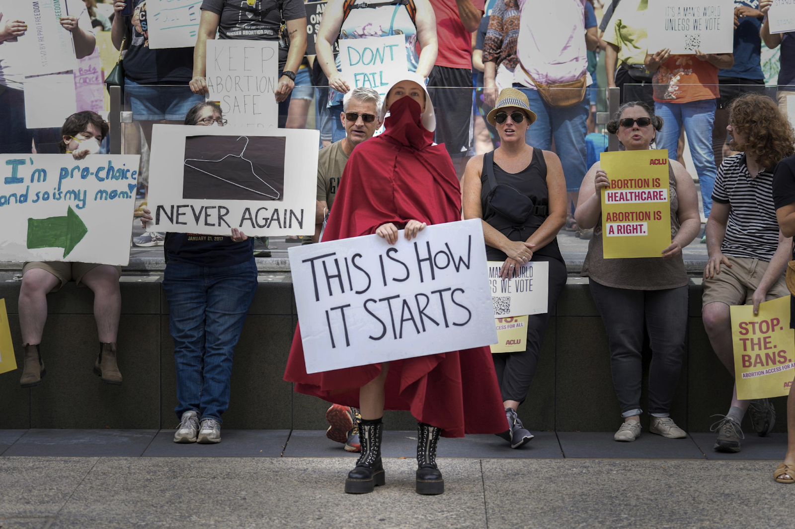
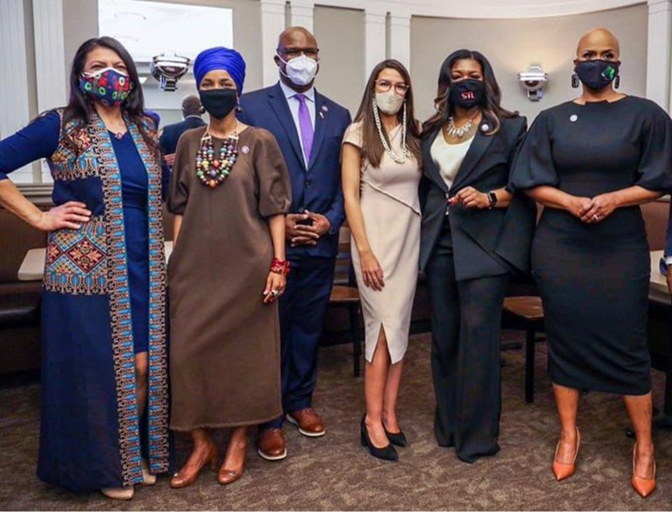
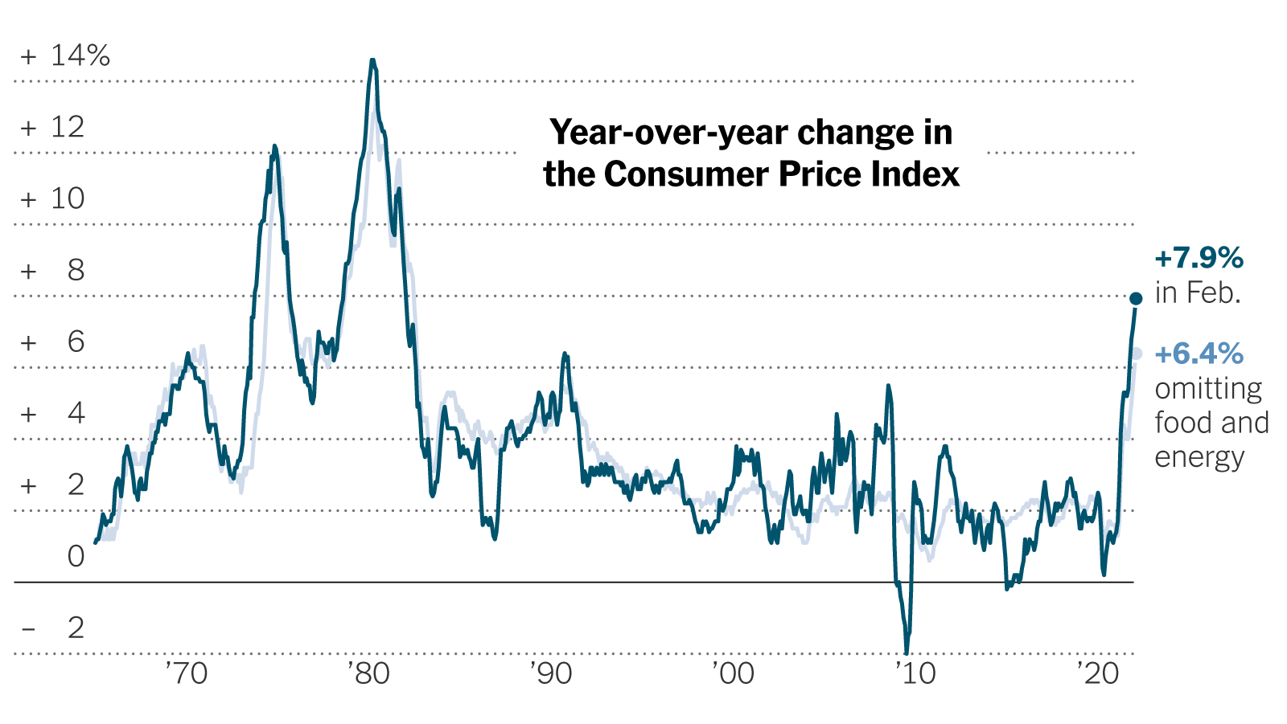
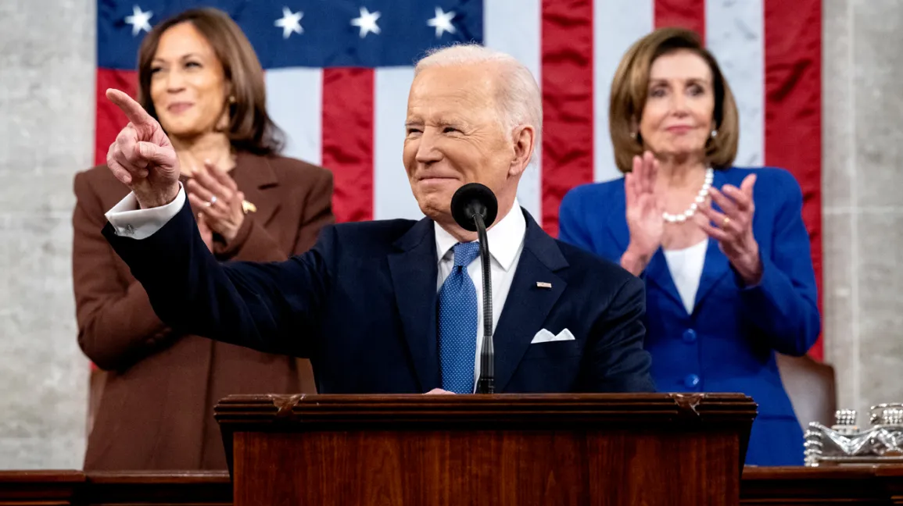
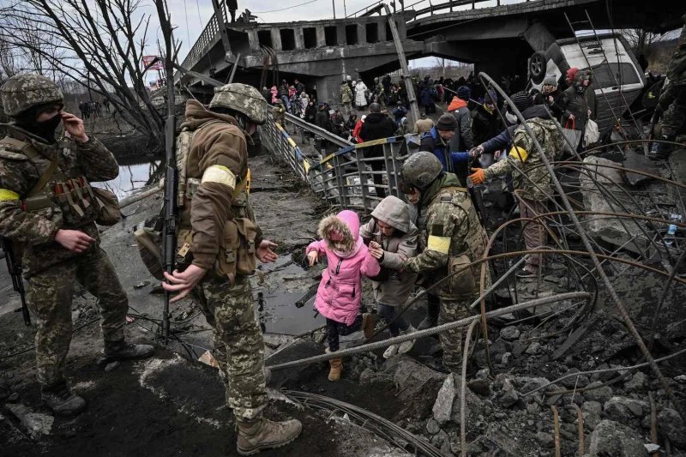
HyFlex Intro to American Government
Joanna Tice Jen
Notes:
~ 10 min presentation +/- individual Q&A:
Why I choose synch+in person only (w/out asynch)
Room 1002

Slide 9
Strategies for maintaining discussion-based/student-centered pedagogy in HyFlex format:
Start off each class session with an “attendance question” that everyone in the class has to participate in orally to get credit (they are required to be engaged and participating right out of the gates
20% of final grade is based on class participation (I keep record of every time a student participates and am not above cold calling)
Incorporate questions into my lecture notes, so I don’t go more than 2-3 minutes without a quick question and answer opportunity
Discussions play a big role in the class
I will periodically remind students that I am keeping tabs on their participation and I give them participation grades for each class day, so they are reminded that they need to participate

Slide 10
AGENDA:
Attendance Question
Continue Congress lecture: Review 6 Jobs -- > Concepts of Representation
Group or Solo work on “The Electoral Connection” Questions
Discuss “The Electoral Connection” Questions
Day in the Life Video 1
Continue Congress lecture
Article I Discussion
Next class
Notes:
Paul will arrive between 2:30 and 2:45. Try to take break around 3 or 3:15, depending on when he arrives
Reminders: Final paper draft due in class a week from today
Professor Paul Torres: student evaluations of course and Prof. Jen
3:00: break
3:20: Review
3:30: Reminders
3:35: Evals:

Slide 11
Examples of different types of attendance questions used:
Opinion-based reaction to information
Short answer on a quote or term

Slide 12
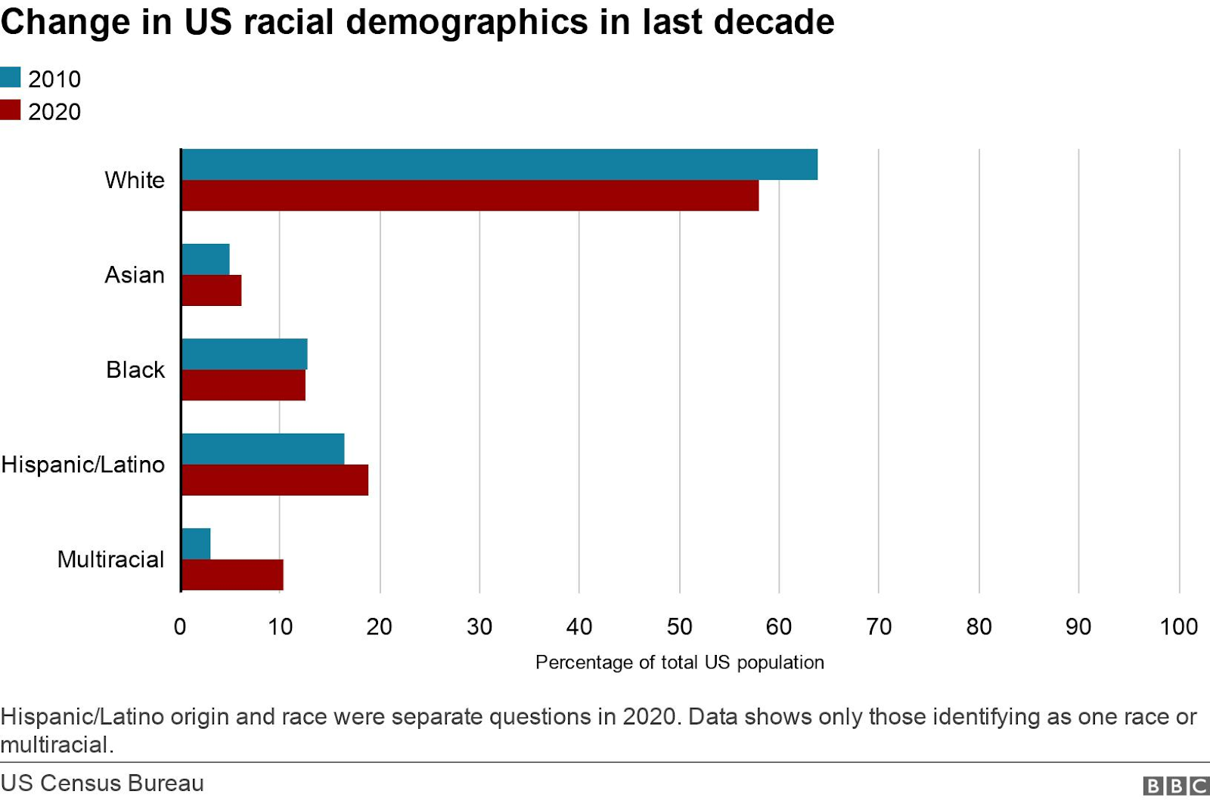

Slide 13
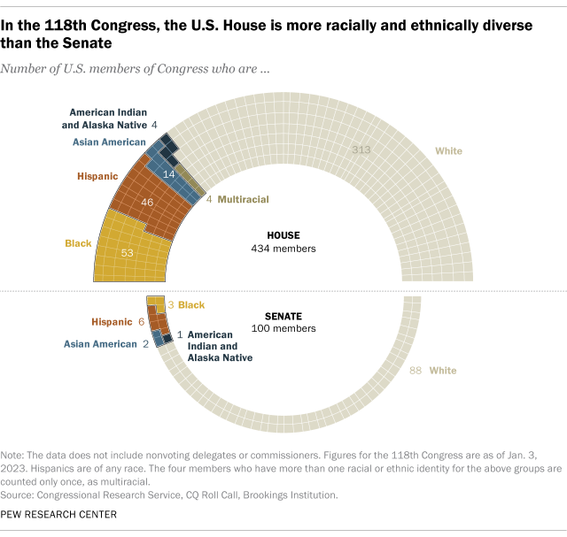

Slide 14
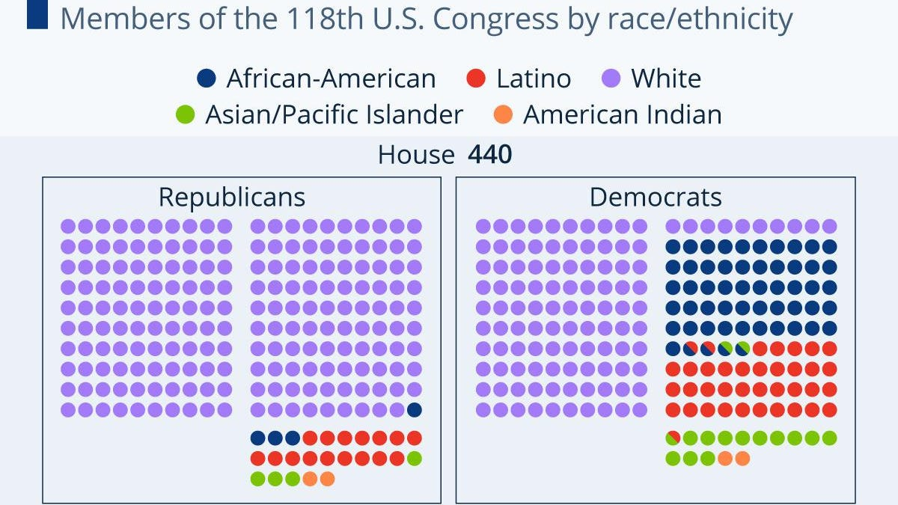
Forbes

Slide 15
Attendance Question 8:
Introduction to Congress
After seeing data comparing demographics in Congress to the American people:
Do you think it’s a problem that Congress does not mirror the population of the U.S. in demographic terms (ethnicity, gender, class, religion, etc)?
Why or why not?

Slide 16
Attendance Question #3: The Founding and the Constitution
Choose 2 of the following quotes.
1. The founders believed that the “interests of ordinary citizens should be represented,” but delegates were concerned that, “ordinary Americans had little knowledge of government and politics, could easily be lead astray by unscrupulous politicians, and should play only a limited role in the nation’s governance” (Lowi et al. 23).
2. “Some of the framers had wanted a multiperson executive or an executive council to avoid the evils that many associated with the monarch. However, Hamilton argued that ‘energy’ required a single, rather than a plural executive” (34).
3. “Competing ideals often reflect competing interests” (Lowi et al. 24).
4. “Each state retains its sovereignty, freedom, and independence, and every power, jurisdiction, and right, which is not by this confederation expressly established to the U.S., in Congress assembled.” (Articles of Confederation, Art II in Lowi et al. 28).
For each answer, briefly restate the meaning of the quotation in your own words and then explain the significance of the quote in light of the author’s theory or the overall meaning of the text. Lastly, state whether the political phenomenon in question is good, bad, or neutral in your view, and why.

Slide 17
Attendance Question 9:
Congress: “The Electoral Connection”
Instructions:
Pick two terms below (one from each column)
Define those two terms in your own words
State the terms significance within the course and/or the text it is drawn from.
Write whether the political phenomenon is good, bad, or neutral in your view, and why.
constituency district descriptive/sociological representation agency representation oversight constituent service Speaker of the House filibuster | delegates trustees bicameral legislature incumbent casework pork-barrel legislation gerrymandering impeachment “The Electoral Connection”

Slide 18
The Electoral Connection Discussion Questions
You will be assigned to two out of the four questions below:
In your own words, what are the two prongs of Mayhew’s argument?
What are the three basic structural units of Congress that Mayhew uses to support his argument, and how does each unit support his argument?
If Mayhew’s theory is correct, why do you think the founders designed Congress to “facilitate re-election pursuits”?
Choose either #1 or #3 of the Discussion Questions at the end of the text and answer it.
Notes:
#3: Founders didn’t design it that way and it wasn’t that way in the beginning, so it’s evolution to aid in re-election pursuits was designed over time by members

Slide 19
HyFlex
Joyce Podevyn

Slide 20
Beginning Spelling for English Language Learners – ESL 100
1 unit skills class
Friday, 12:00 – 12:50 pm
new to HyFlex
taught asynchronously for a few semesters
diverse student body: new to college/US; online only; Chabot students, …
simple and consistent organization necessary

Slide 21
Successes & Challenges
Successes
Challenges
Easy to move from asynchronous to HyFlex
Students like options, and most choose Zoom.
No more absences if you do all three modalities
Student confusion about HyFlex
Some students really need to be in the classroom but don’t come
Teaching to an empty classroom
Editing Studio captions
Technology set-up at beginning of class

Slide 22
Comments
Start small
Start with a class that you know well
Try to get access to the classroom early if possible
It might be easier to try two modalities first (in-person and on Zoom) especially if you don’t already have an asynchronous class developed.
New skill I learned: video and caption editing. Will use this in my asynchronous classes!
Technology is changing and improving.
What I really want: FlexBrid (Scott’s term): combination of Hybrid and HyFlex: Students are required to come to campus three times per semester (Hybrid -- 1st class, midterm, and final exam) and HyFlex for the other class meetings.

Slide 23
THANK YOU! Questions?

Slide 24
MAJOR QUESTIONS
Do I have to come to campus if no students are here?
Can we force students to come on campus?
Why is my student denied enrollment because of an overlap that doesn’t exist?
Is HyFlex extra work?

Slide 25
STUDENT FEEDBACK
Why did you enroll in a HyFlex class? Check all that apply.
Answer choices | Responses
I like the flexibility HyFlex offers. | 71%
No better options were available. | 23%
I wanted to try something different. | 19%
I like the instructor. | 37%
Other | 14%

Slide 26
STUDENT FEEDBACK
Overall, how satisfied are you with your HyFlex class?
Answer choices | Responses
Very satisfied | 52%
Satisfied | 36%
Neither satisfied nor dissatisfied | 9%
Dissatisfied | 3%
Very dissatisfied | 0%

Slide 27
STUDENT FEEDBACK
I would take another HyFlex class at LPC.
Answer choices | Responses
Agree | 87%
Disagree | 5%
No opinion | 8%

Slide 28
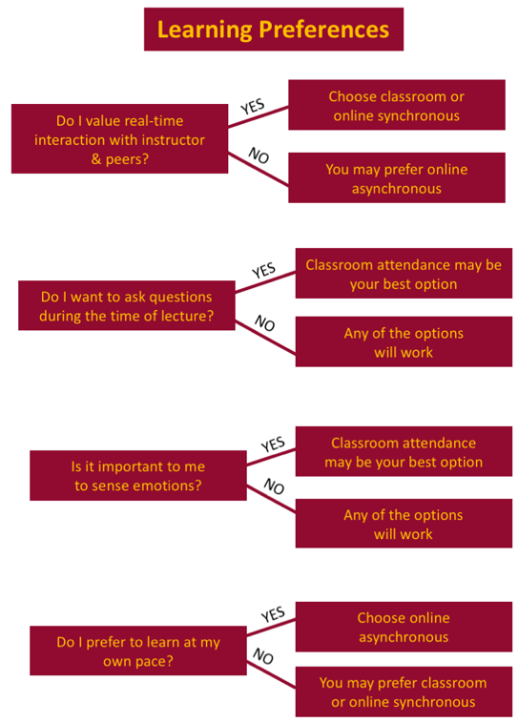
STUDENT RESOURCES
HyFlex learning page
Deciding which HyFlex participation mode to choose
Success tips

Slide 29
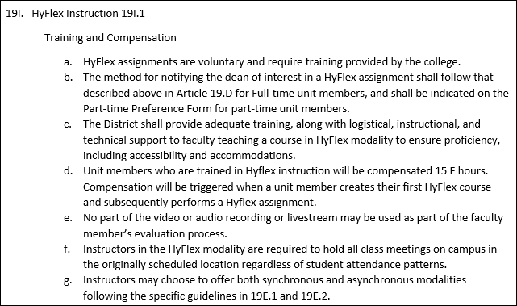
FACULTY TRAINING
Logistics
Contract language
Training course
Award of completion

Slide 30
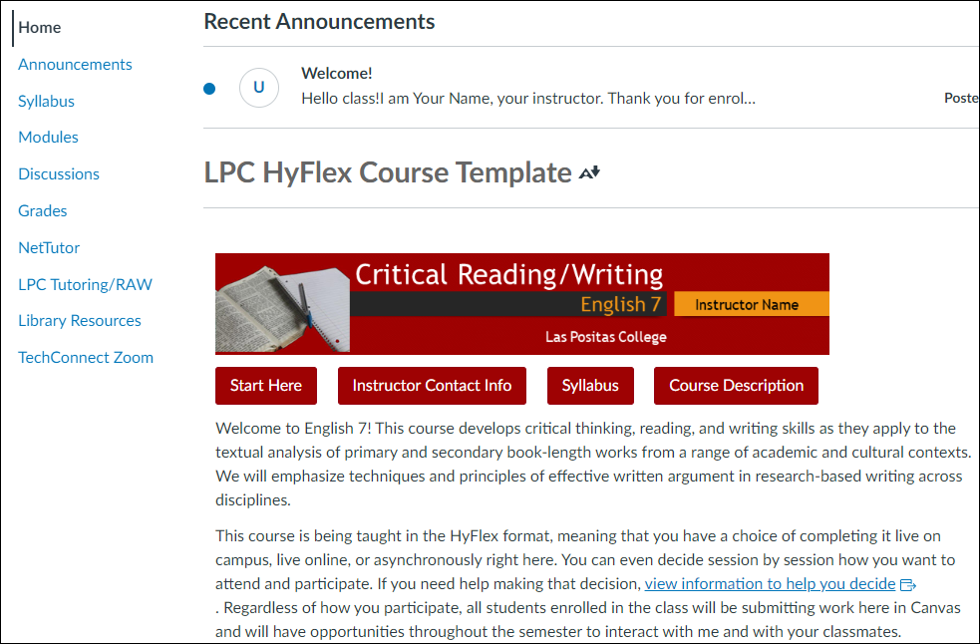
FACULTY RESOURCES
Resources in training course
Available templates
HyFlex Learning Community
HyFlex Collaborative Conference
Online Course Development Program
Technical and instructional help
Community of practice interest?

Slide 31
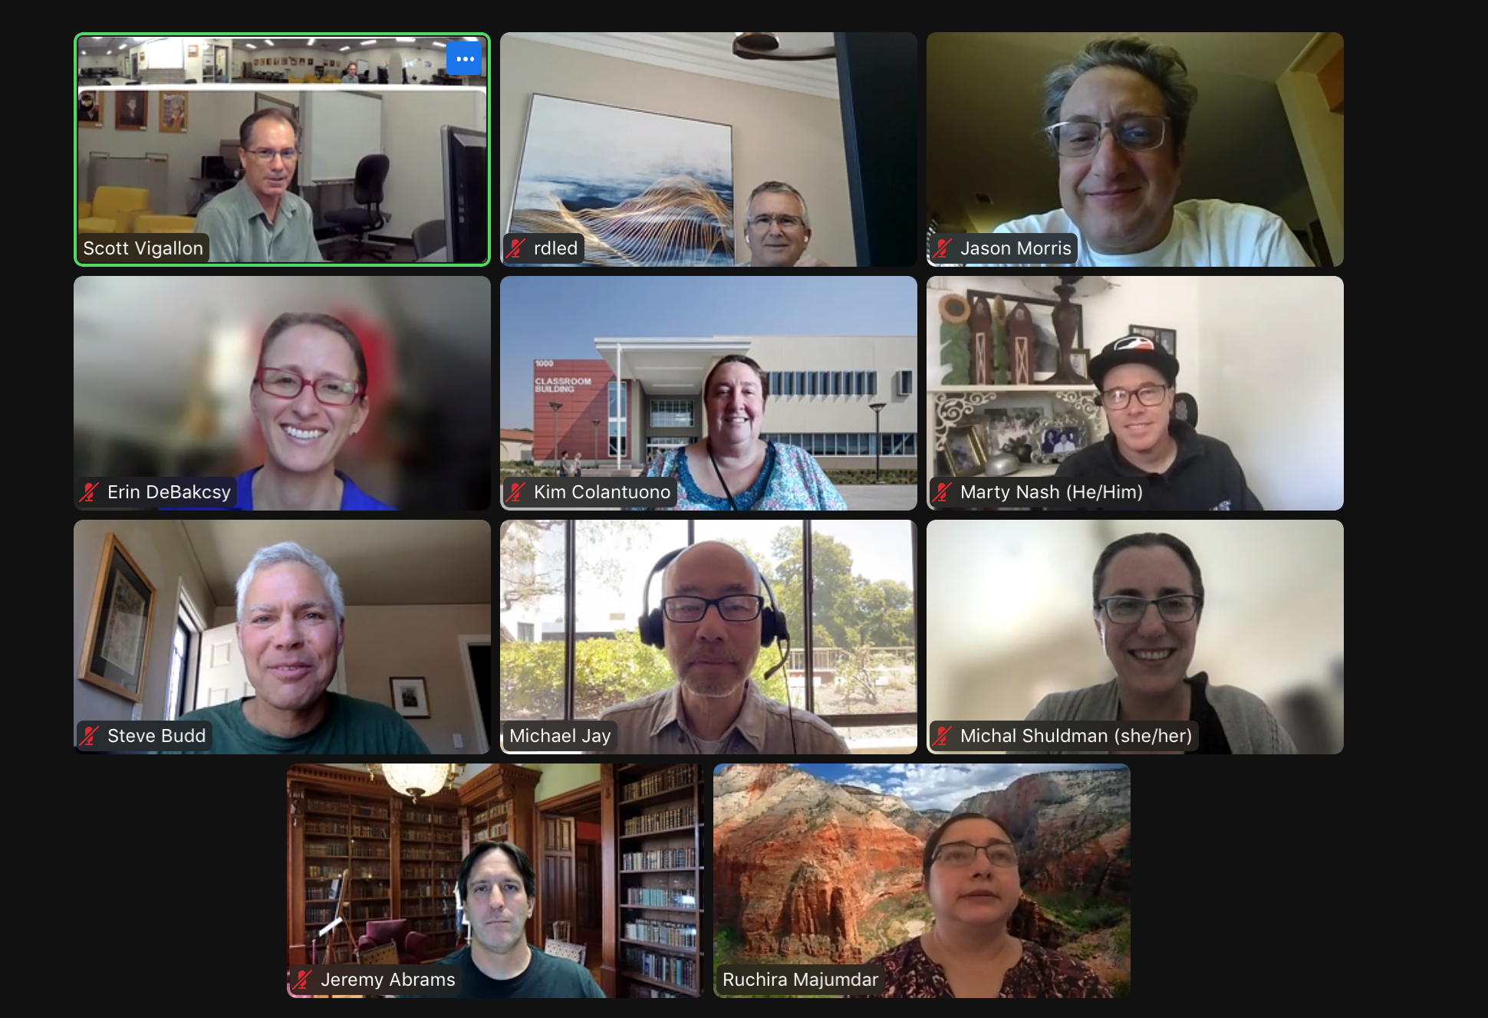
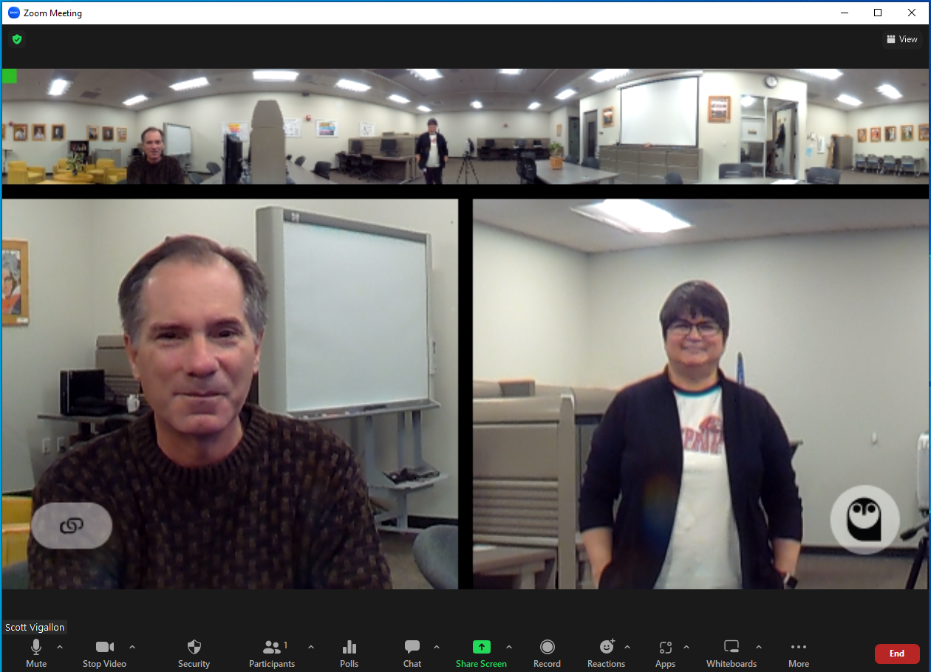
CLASSROOM TECHNOLOGY

Slide 32
Workshop Evaluation

