Slide 1
Meeting Students Where They Are, Post-Pandemic and AB705
AB705 team
Segal Boaz
Joanna Tice Jen
Ashley McHale
Kali Rippel
Flex Day Spring 2023

Slide 2
Changes of AB705 and AB1705
English: With a few exceptions, all students who choose the English path are now placed into transfer English (1A or 1AEX). AB1705 clarifies that students’ first attempt in the discipline *must* be transfer-level. American high school graduates who have been ELL will almost always take English 1A or 1AEX.
In the past, as many as sixty-four percent (2006) of assessed students were placed into basic skills (pretransfer) English. The pretransfer curriculum focused on student skills, reading strategies, grammar, and short personal and academic essays.
Notes:
1 minute

Slide 3
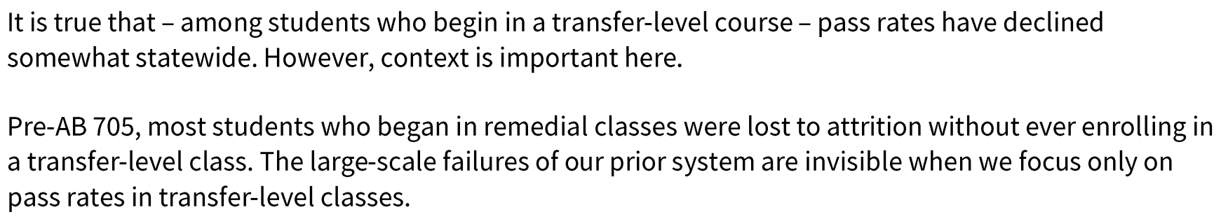
Changes of AB705 and AB1705
Math: All students (except dual enrolled) are now taking transfer-level math courses. Over the next two years, students will start placing directly into math courses that satisfy requirements for their academic goal (including Calc 1)
From the State Chancellor’s Office:
Notes:
1 minute

Slide 4
Ongoing Effects of Pandemic
Challenges with doing reading–sustaining attention, managing length and complexity
Feeling that they don’t have a solid foundation in key concepts and skills even if they passed (this may be especially true of mathematics)
Time management skills and distraction
Attentional issues, mental health challenges
Adjustments to amount of homework considered “normal” or appropriate.
Working in isolation
Financial hardship, difficulty juggling school and work/family commitments
Notes:
2.5 minutes

Slide 5
What are we seeing in our classes?
Notes:
10 minutes

Slide 6
Group feedback
Difference in attendance–also confusing because of different modalities–how does 4 hours/6 cum college policy relate any more? When and why do we drop students?
More hardships keeping students from coming to class–at what point do we have to drop them, though? Especially for a lab that is skills based.
Tardiness
Not turning things in on time–weeks later. Lateness flexibility normalized for students. Smaller number of students not turning in big items like papers. Can’t drop everyone.
Hard emotional/time labor for us to manage all those emails, compensating for students.

Slide 7
Group feedback
Students continually saying that they are sick–do we drop? Will do a little bit.
Transition from high school–could pass/graduate, but this is not that.
Students not following the modules. Start homework w/o engaging in content. (Check box to put Pages on their “to-do” list, do prerequisites, etc.)
Basic math skills lacking in non-math classes–making a percentage, for ex. Students saying they have never done a particular thing–write a whole paper, multiply without a calculator.
Range of students in the class is challenging

Slide 8
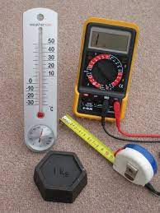



Segal M. Boaz, Biology
Creating a new Lab 1: Introduction to everything (glassware, science, metric system)
  Previously made Smart Shops to fit this need
Research Papers
  New Lab: what are research paper parts
  Scaffolding writing,
    Reinforcing the writing process
    Assign one section at a time
  New Lab: bring in drafts of proposals
    Peer support before 2nd draft
  RAW center/ Writing Smart Shops: extra credit!
Notes:
5 minutes

Slide 9




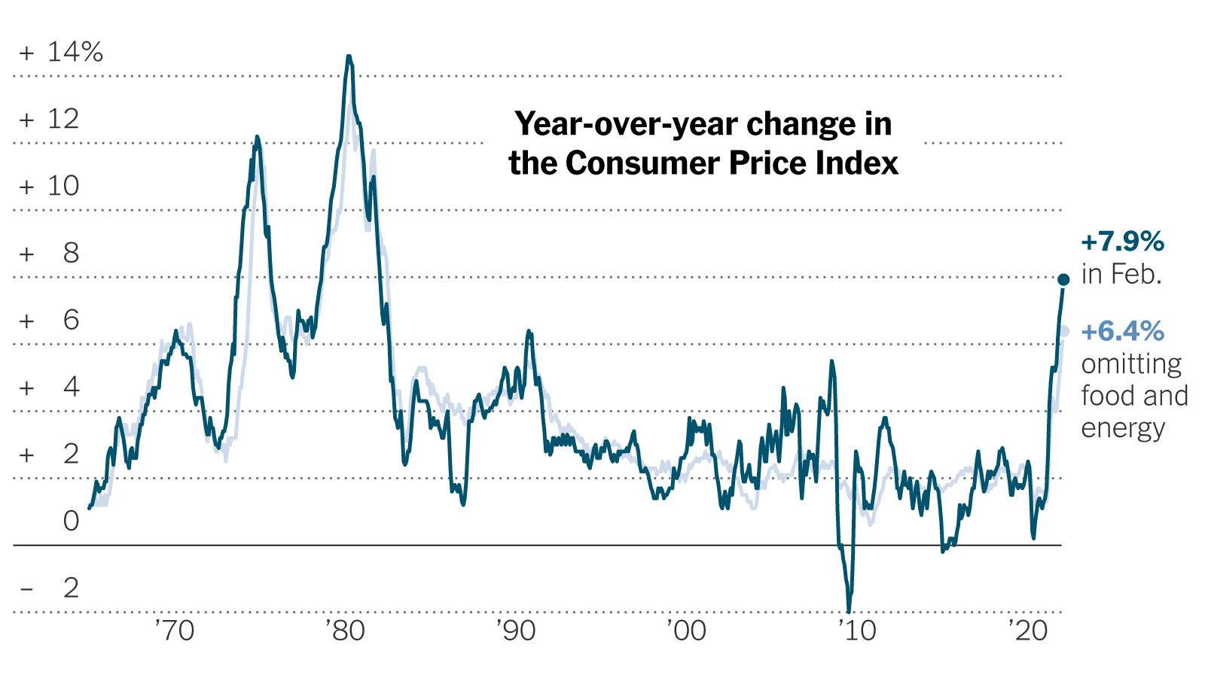

Joanna Tice Jen, Political Science
New: Flexibility
no-lateness penalties 😐
All in-person classes essentially HyFlex
  (provide students w/lecture videos from my online course)
Continued: Reading, writing, and feedback intensive
daily reading and writing for DE, F2F, Hybrid, and HyFlex
All learning is text and discussion based
Scaffolding
  (thesis statement → outline → rough draft → peer review → final draft)
Feedback
  (on thesis statement, outline, final draft:
    marginal comments, feedback letter, shorthand key)
Notes:
5 minutes

Slide 10
Ashley McHale, Math
Read Your
(Math) Book
(slides 10-20)
Notes:
5 minutes

Slide 11
Online Student-to-Student Interaction
Discussion boards
Group projects/group assignments
What else?
Social Annotation!

Slide 12
Read the Book
1

Slide 13
Asynchronous learning is difficult! But annotating the textbook as a class and conversing via discussion
posts are good ways to virtually do collaborative exercises and learning!”

Slide 14
Examples!

Slide 15
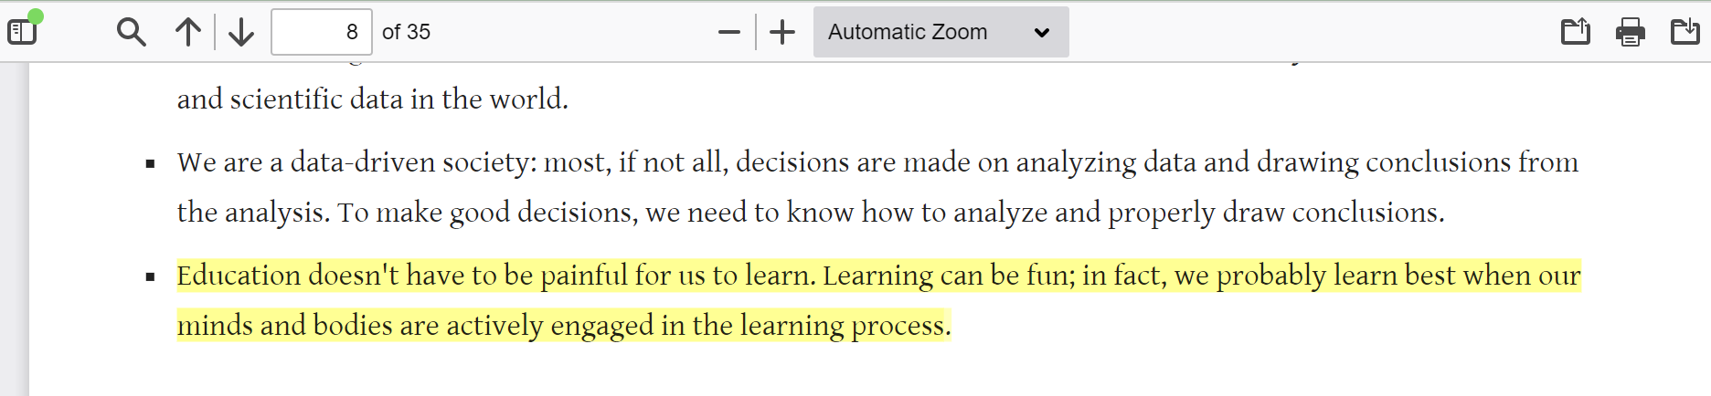
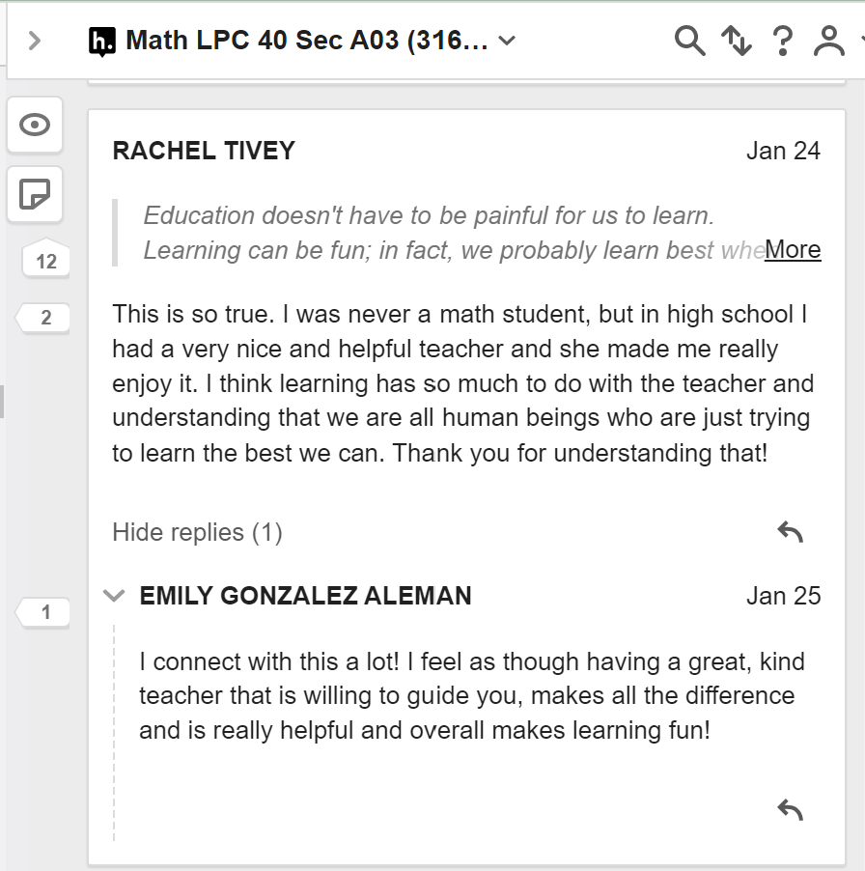

Slide 16
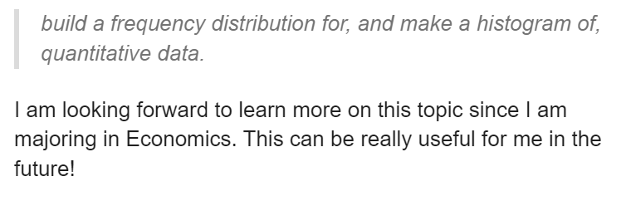
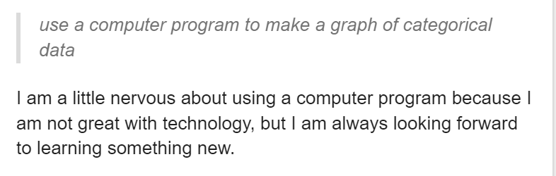

Slide 17
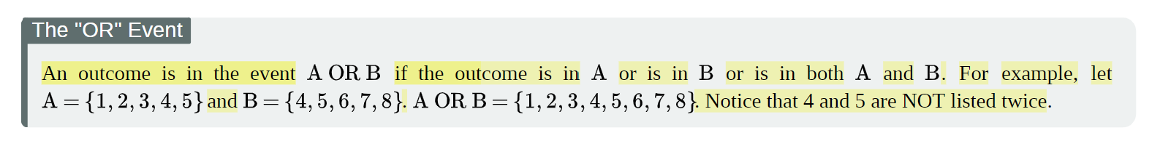
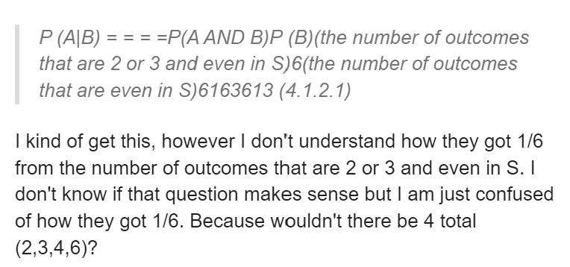
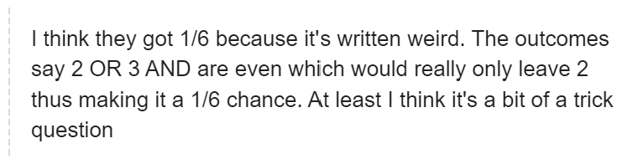

Slide 18
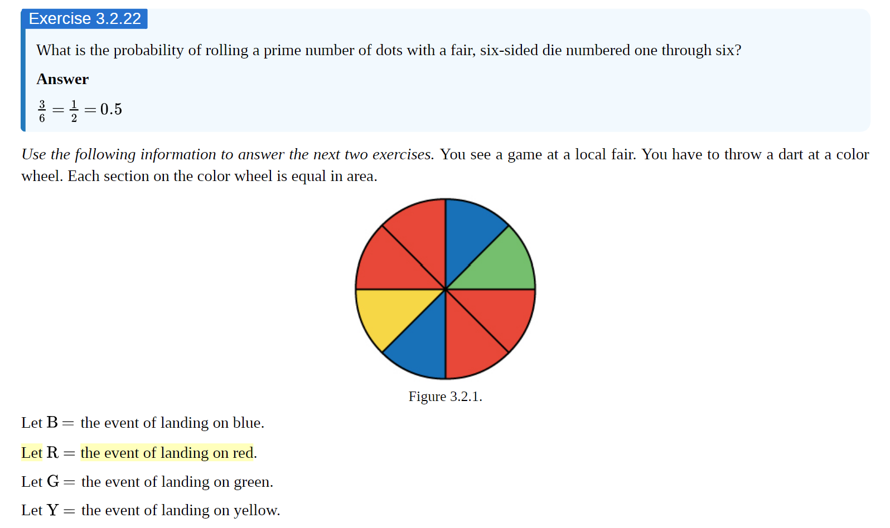
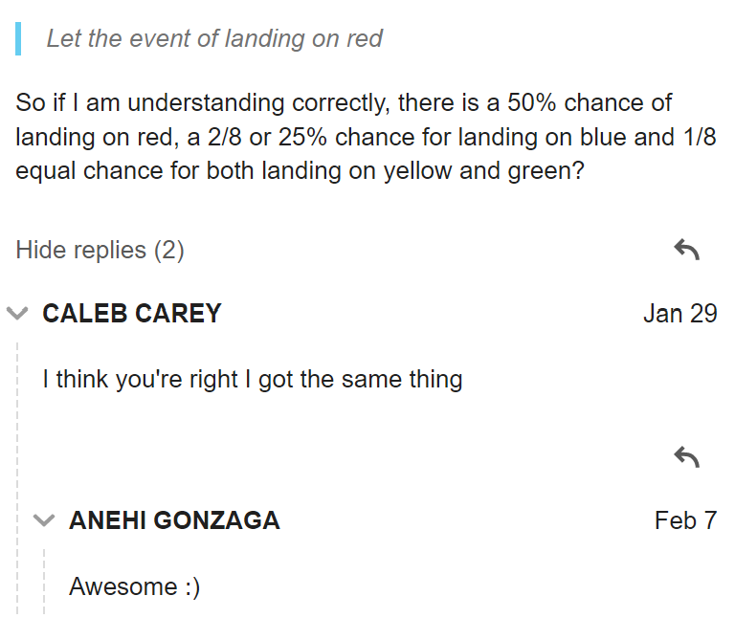

Slide 19
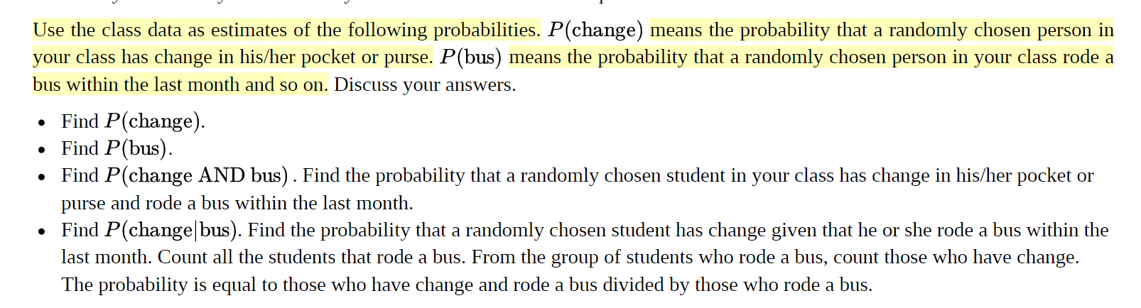
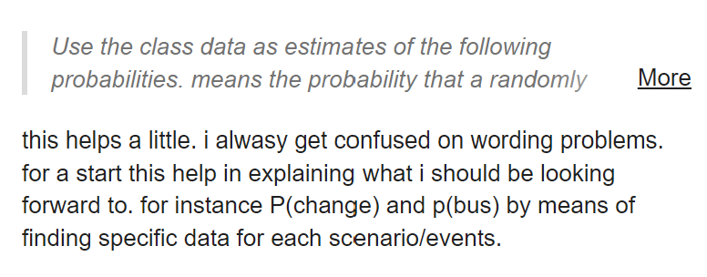

Slide 20
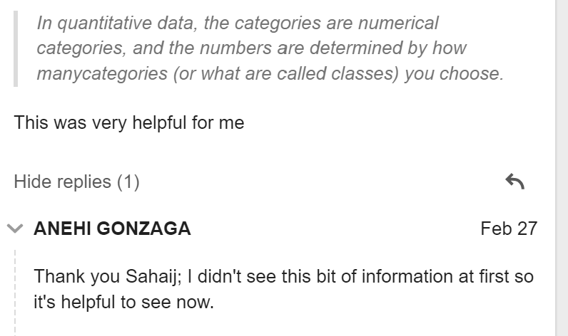

Slide 21
Kali Rippel, Library
Library vibe is quieter, more secluded. Starting to change.
Students need more support navigating processes, spaces, and motivation.
More relationship focused.
Seem to have information skepticism, but needs direction.
Seem to be better organizing online.
Definitely need more flexibility. Want to be on campus, but can’t.
Stepped back to focus on what is most important in the class.
Dumb one, but started doing videos in phone ratio.
Asynchronous orientations in Canvas Quizzes.
Notes:
5 minutes

Slide 22
Brainstorming and Discussion
Notes:
15 minutes

Slide 23
Last ideas?
Changing how we do what we do–trade-offs for better results
Accessibility is here–whether technologically, in terms of flexibility…
Relationships are key–with instructors, between students–and hand-offs
Using technology or assignment design to “see” them learning in new ways–social annotation, quizzes, reading papers out loud–technology forces best practice

Slide 24
Last ideas?
Recognize that students might not be ready and that’s okay? Or find the intervention that will help them do it? (basic needs, etc.)
Best practices for online learning work for in-person as well.
Be careful not to overload oneself, though–give up some things
Campus could do better at addressing overall social/emotional needs of faculty.

Slide 25

Thank you for evaluating our workshop!

