Slide 1
Equity - Environmental Justice Style
First, a few facts:
Burning fossil fuels produces air pollution. (USEPA)
Air pollution from burning fossil fuels increases cases of asthma, heart disease, stroke, and lung cancer. (WHO)
Exposure to air pollution from burning fossil fuels shortens the Global life expectancy by 2.2 years. (WHO)
Unsurprisingly, those most affected by these certainties are in poor communities and the communities of people of color. (USEPA)
In the United States, the difference in the average life expectancy of the poorest and the richest among us is approximately 15 years. (National Library of Medicine)
This sounds bad, but how big could this problem be, really?
Pretty big.

Slide 2
Equity - Environmental Justice Style
As a species:
We burn approximately 100 million barrels of oil,
1.4 million tons of coal,
and 384 billion cubic feet of natural gas…
each day.
Why do we (as a society) burn fossil fuels?
For the energy to run our lives.
Agriculture
Transportation
Lawn care
And yes, home electricity. (Hint, Hint…)

Slide 3
Equity - Environmental Justice Style
Must energy come only from fossil fuels?
Nope. Energy is energy.
We are living in a time where there are multiple (relatively cheap, pollution free) choices as to where we get our energy from.
Solar, for example, is the cheapest source of energy currently available and, once installed, is totally cost and pollution free.
There are also government incentives to further decrease the cost. (IRA)
The upfront cost may appear worrisome, but it can be easily financed leaving a monthly payment that is probably less than you are currently paying to your energy provider.
And this payment is an investment that will pay dividends, not a cost that drains away your wealth.
Producing pollution-free electricity is a way of producing Equity while improving everyone’s lives!

Slide 4
Cost Comparison: Solar vs Not Solar
Average cost per kWh in Bay Area = $0.317 or ~ $317/month or ~$3800/year
- Or $95000 over 25 years (approximate life of a solar panel)
- Increases every 4 years (up 13% from Jan.2022) (Bureau of Labor Statistics)
- Never ends (you will pay every month, forever)
2. Average cost (in California) for a 6kW PV system after 30% federal tax credit
~ $12,000 (Consumer Affairs)
- 1 time investment (or you could finance and not change your budget)
- Panels last >25 years
3. Upshot
- Solar will ultimately decrease your energy cost while simultaneously reducing air pollution and increasing the quality of life for all species

Slide 5
Tax Credits! Rebates! Payments for Excess Energy!
Purchasing Solar Panels, Energy Storage Systems:
Tax Credits - Reduce the amount of federal or state tax you owe. Currently all PV, and, separately, all energy storage systems are eligible for 30% credit from the federal government.
Rebates - Money direct to you. Usually with the idea that you will immediately give it to the company you purchased the system from.
PG&E Self Generation Incentive Program - $250/kWh of battery storage
Payments for excess energy generated - Some energy providers will pay you for the excess energy you generate and export to the grid. PG&E, SCE, SDG&E will pay you between 2-3 cents per kWh through CA - Net Energy Metering (NEM).
This is changing, however. NEM(III) will provide smaller payment for excess electricity as an incentive to purchase energy storage systems to lighten the afternoon/evening load, which is mostly provided by fossil fuels. Additional rebates are going to be offered as further incentive to purchase storage.

Slide 6
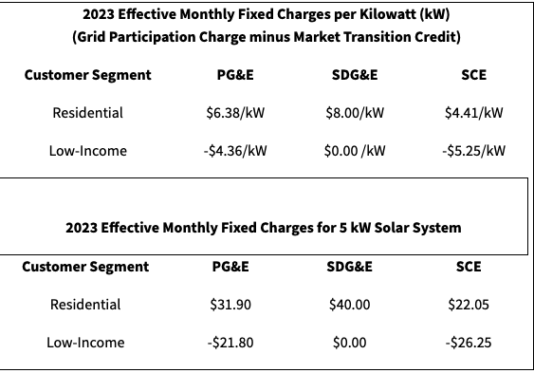
NEM (II) - $10/month Grid Participation Charge

Slide 7
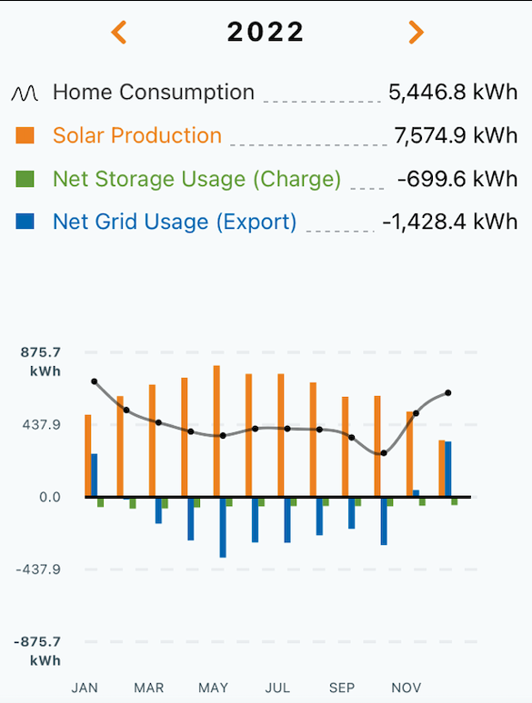
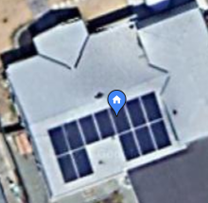
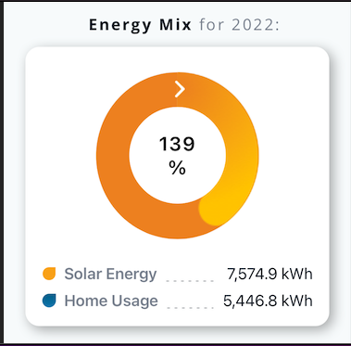
Testimonial Time!
Made $103!

Slide 8
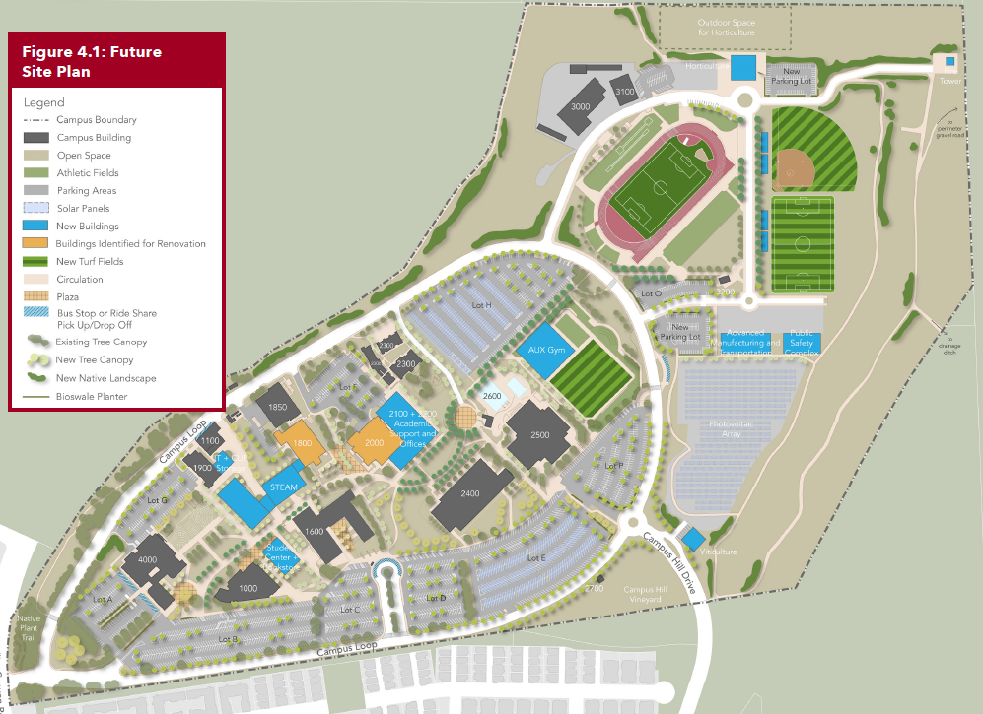
Solar and Batteries for New STEAM building?
Makes building energy self-sufficient
Excess energy can be stored or transferred to the community via PG&E
Energy made and stored can be used to offset operational costs in lean years freeing up funds to assist other programs.
PG&E financially incentivizes electricity generators, further offsetting costs

Slide 9
Steps to calculating the cost of your solar energy system
Calculate your average energy requirement per month over 3 months.
Divide the monthly average by 30 days, then divide by 24 hours to get energy used per hour (kWh/hour)
Ex. Average home use = 900kWh/month x 1month/30days x 1day/24hours = 1.25kWh/hour. Multiply your hourly energy need by 1000 to get watt hours per hour: 1.25kWh/hour x 1000W/1kW = 1250Wh/hour
Assume 5 hours peak sunlight (more or less depending where you live and season)
Ex. 5 hr x 1250Wh/hour = 6250W (size of system needed)
Size of system needed x $2.68/watt = cost for system ($16750 in this case. Or what you would pay for 6 years of energy anyway.)

Slide 10
Steps to calculating the cost of your solar energy system
Subtract 30% tax credit = net cost of system
Solar panels last >25 years. Take your average monthly energy cost from your bills used above.
Multiply that cost by 12 months and then by 25 years. Compare it to the solar cost. Be pleased that you are investing your money wisely by going solar.
Bonus: Assume $15000 for 13kWh storage battery (between $10000 - $20000)
Less 30% Fed. tax credit and 13kWh x $250/kWh rebate from PG&E ~$7250 net battery cost.
12. Rest assured you will never be caught in a blackout again :-)

Slide 11
Steps to calculating the cost of your solar energy system
Worried about the up front costs?
Of course! $12,000 is a lot of scratch to pony up on the fly.
However, these companies know that. And they want your business.
I went with SunPower. I had to put $1000 up front and then didn’t pay a dime until the system was working.
My payments for the system were less than my monthly PG&E payments without the solar panels!
In other words, I actually decreased the amount of money I was spending every month!

Slide 12

Please click this code to evaluate this workshop. Your feedback is valuable!

Slide 13
Is climate change real?
In the last 12 months we have seen:
1. Worst drought in the history of recorded droughts in the Horn of Africa: 3 million starving, 1.3 million farmers displaced (NASA)
2. Worst heat wave England ever had: 638 deaths in one day due to heat exposure (The Guardian)
3. 13% of Pakistan was flooded with 784% more rain than the August average, killing 1,739 people, 1.1million livestock, and incurring $30billion in damages (Wikipedia)
4. China had the worst drought in 60 years, drying up rivers depended upon for hydropower, which caused factories to shut down, which slowed the global supply chain for many goods. (NYT)
5. United States had 14.5million (1 in 10) homes impacted by natural hazards (PBS)

Slide 14
Sustainable - to be able to maintained at a certain rate or level
Fossil fuels -
a. Dead plants and animals from millions of years ago
b. The source of 90% of all energy used by humans Worldwide
c. 100 million barrels of crude oil used every day
d. ~100 barrels produced each year
e. Price (both in dollars and lives) dependent on petro - dictatorships
f. An ecological disaster wherever they are harvested.
g. Their waste products are producing a disaster on an actual Global Scale
h. Have a finite ending, probably sooner than we are preparing for.
In other words, not sustainable
The Sun -
Best estimate will shine for 4 billion years
Shines enough energy on Earth to easily power everything, including plants and animals.
The cost of this energy is nil
The cost of devices that capture this energy (such as solar panels) is, per kwh, cheaper than any other energy source we know of.
Way, way, way fewer ecological disasters than with Fossil Fuels
A. K. A. Sustainable

