Slide 1
What is a Liquid Syllabus?
Christina Lee & Nadiyah Taylor
Spring 2023 Flex Day

Slide 2
AGENDA
Introduction
3 Critical Elements for Equity Success (Linton, 2011)
Who are our students?
Your Teaching Philosophy
What is a Liquid Syllabus

Slide 3
Introduction
Christina Lee
@ONE online course: Equity & Culturally Responsive Teaching
Nadiyah Taylor
Notes:
Outcomes
To successfully complete this course, participants will:
Analyze your assumptions and beliefs about the diverse students served by California community colleges;
Critically interrogate the alignment of your teaching values and teaching practices;
Apply principles of intersectionality, critical race theory, and culturally responsive teaching to your online course(s);
Create an equity-minded course syllabus leveraging peer feedback that welcomes and supports all students;
All images are from @ONE ECRT and are llicensed via a CC attribution only license.

Slide 4
3 Critical Elements for Equity Success
Notes:
As educators, we must address equity at 3 levels: personal, institutional, and professional. The definition of the levels are presented by Charles Linton as follows:
Personal equity guides the process of centering one's self on equity and uncovering one's own biases, stereotypes and privilege.
Institutional equity explores how a school and school system can overcome institutionalized factors that limit student achievement, especially for students of color and those from diverse backgrounds.
Professional equity focuses on how efforts to successfully implement equitable practices can assure individualized support for all students.

Slide 5
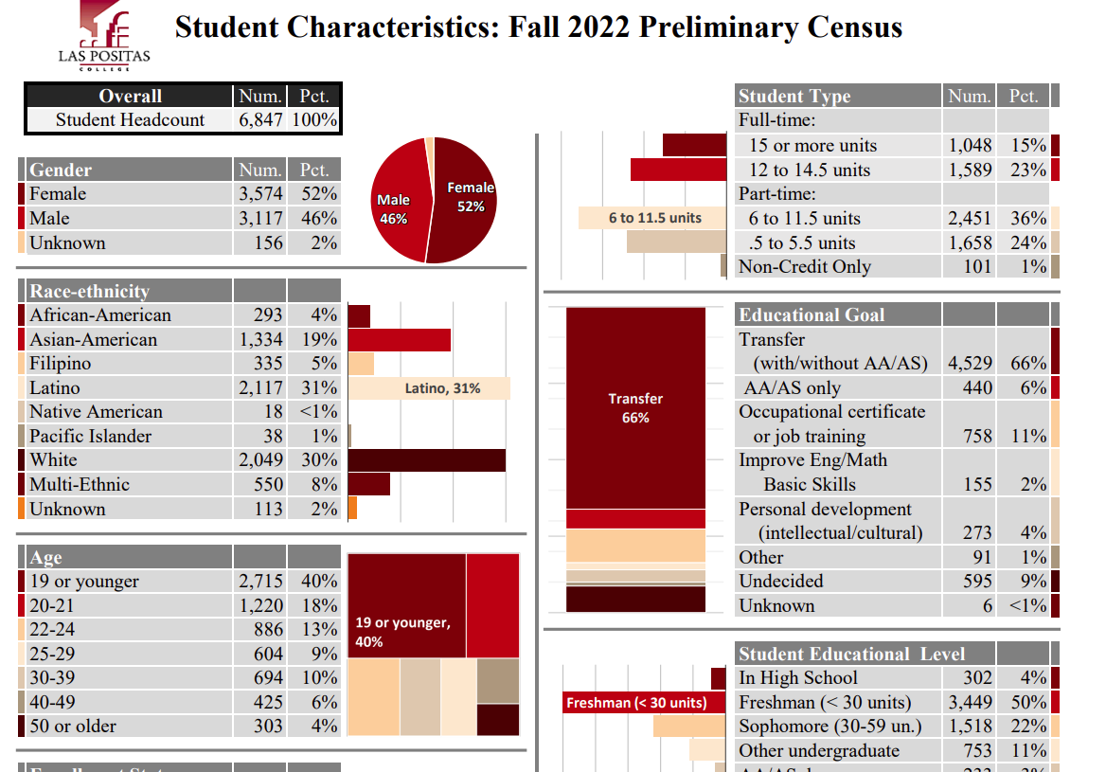
Notes:
Fall 2022 preliminary data (LPC_StCh_F22_C.pdf (laspositascollege.edu)
Future of minority-majority student population
24% from Livermore, 15% from Pleasanton, 14% from Tracy, 11% from Dublin, 5% from San Ramon, etc
Traditionally, marginalized students experience challenges and barriers that result in lower completion rates and inequitable outcomes. A study by the California Community College's RP Group highlights factors our students must constantly rise above.
Those factors include:
financial stress
being a first generation American
negative perceptions of academic potential
lack of helpful guidance and career support
difficulty transitioning into higher ed
lack of familiarity with academic culture and practices
environment is alienating and sometimes hostile
academic systems are not socially neutral
system tends to displace and exclude the cultural knowledges, skills, and capital of certain groups of students

Slide 6
Your Teaching Philosophy
Your WHY?
Why do you teach?
Notes:
Golden Circle Activity Handouts. take a few minutes to create your own golden circle by completing the three rings of the “why, how, and what.” Carefully brainstorm the “why” behind your teaching. Why do you do it? Work your way out through the how and the what.

Slide 7
A Syllabus Redesign Story
Notes:
@ONE –(The Power of an Open Mind – YouTube)
<iframe width="640" height="360" src="https://www.youtube.com/embed/oembX5KveBw" title="The Power of an Open Mind" frameborder="0" allow="accelerometer; autoplay; clipboard-write; encrypted-media; gyroscope; picture-in-picture; web-share" allowfullscreen></iframe>

Slide 8
Using Asset-Based language in syllabi
Your Teaching Philosophy
Welcoming, inclusive, positive language
Personalize the course description
Include photos or images
Notes:
Typical syllabi:
Strict, professorial, cold
From our own college experiences
Might be 8+ printed pages
Seen through Deficit Lens
As you think your syllabus, place yourself in the seat of a student and mentally respond to the following questions.
What does it convey about the culture of the class?
Do you feel welcomed and included as you look at it and read it?
What is your perception of the instructor's teaching style?
What are your perceptions of the instructor's attitudes towards teaching? Does s/he seem to enjoy it?
Would you feel comfortable approaching the instructor and asking for assistance?
Students who perceive their instructor to be approachable tend to be more motivated, engaged, and actively involved in the learning process (Thompson, 2001; Woodside, Wong, & Weist, 1999). Designing your online course in a way that ensures students feel comfortable asking you questions and understand that you are there to support them through the learning process is a critical part of online teaching. Having a warm, caring presence online is an important part of equity-minded, culturally responsive teaching (CRTL) and learning and that presence begins with your syllabus.

Slide 9
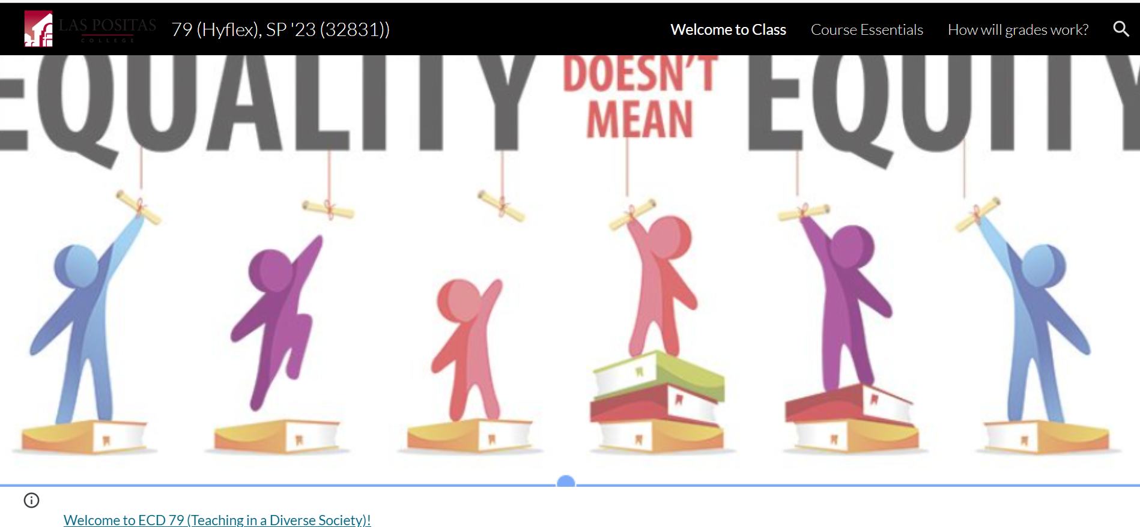
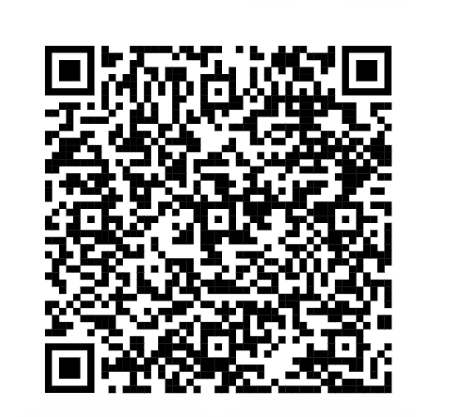
Nadiyah Taylor’s ECE 79 Liquid Syllabus

Slide 10
Christina Lee’s PCN 30 Liquid Syllabus

Slide 11
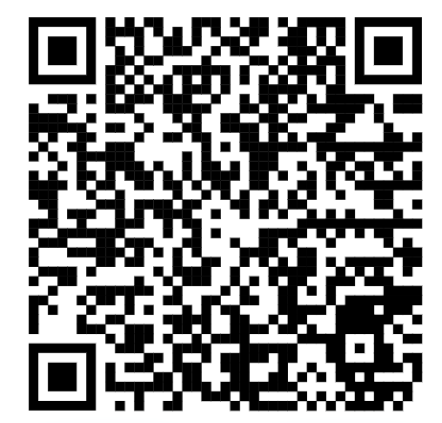
Ashley McHale’s Math 40 Liquid Syllabus

Slide 12
How to get started
Sites.google.com
Requires a gmail account
Unsplash.com for free photos
Provide description & give credit
Take and upload own photos
Consider @ONE Equity & Culturally Responsive Teaching online course

Slide 13
Any Questions?

