Slide 1
Cal-GETC - Overview and Discussion

Slide 2
Traditional Transfer
Lower-Division General Education

Slide 3
Traditional Transfer
Lower-Division General Education
California State University General Education Breadth (CSU GE)

Slide 4
Traditional Transfer
Lower-Division General Education
California State University General Education Breadth (CSU GE)
  39 semester units

Slide 5
Traditional Transfer
Lower-Division General Education
California State University General Education Breadth (CSU GE)
  39 semester units
Intersegmental General Education Transfer Curriculum (IGETC)

Slide 6
Traditional Transfer
Lower-Division General Education
California State University General Education Breadth (CSU GE)
  39 semester units
Intersegmental General Education Transfer Curriculum (IGETC)
  34 semester units for transfer to UC

Slide 7
Traditional Transfer
Lower-Division General Education
California State University General Education Breadth (CSU GE)
  39 semester units
Intersegmental General Education Transfer Curriculum (IGETC)
  34 semester units for transfer to UC
  37 semester units for transfer to CSU

Slide 8
Traditional Transfer
Lower-Division General Education
California State University General Education Breadth (CSU GE)
  39 semester units
Intersegmental General Education Transfer Curriculum (IGETC)
  34 semester units for transfer to UC
  37 semester units for transfer to CSU
  Satisfies lower-division GE for all CSU campuses and at most UC campuses

Slide 9
AB 928

Slide 10
AB 928
Charged the Intersegmental Council of Academic Senates (ICAS) to create a single lower-division general education transfer pattern

Slide 11
AB 928
Charged the Intersegmental Council of Academic Senates (ICAS) to create a single lower-division general education transfer pattern
  Maximum of 34 units to match IGETC

Slide 12
AB 928
Charged the Intersegmental Council of Academic Senates (ICAS) to create a single lower-division general education transfer pattern
  Maximum of 34 units to match IGETC
  Must satisfy all transfer requirements to the CSU and UC system

Slide 13
AB 928
Charged the Intersegmental Council of Academic Senates (ICAS) to create a single lower-division general education transfer pattern
  Maximum of 34 units to match IGETC
  Must satisfy all transfer requirements to the CSU and UC system
  Exact same requirements for CSU and UC transfer students

Slide 14
AB 928
Charged the Intersegmental Council of Academic Senates (ICAS) to create a single lower-division general education transfer pattern
  Maximum of 34 units to match IGETC
  Must satisfy all transfer requirements to the CSU and UC system
  Exact same requirements for CSU and UC transfer students
  No “STEM version” like for a few STEM Associate Degree for Transfer (AD-T) programs (6 less units that must be taken after transfer)

Slide 15
AB 928
Charged the Intersegmental Council of Academic Senates (ICAS) to create a single lower-division general education transfer pattern
  Maximum of 34 units to match IGETC
  Must satisfy all transfer requirements to the CSU and UC system
  Exact same requirements for CSU and UC transfer students
  No “STEM version” like for a few STEM Associate Degree for Transfer (AD-T) programs (6 less units that must be taken after transfer)
  Allows for approved STEM AD-T programs to be up to 66 units

Slide 16
California General Education Transfer
Curriculum (Cal-GETC)

Slide 17
California General Education Transfer
Curriculum (Cal-GETC)
Area 1: English Communication (9 units)

Slide 18
California General Education Transfer
Curriculum (Cal-GETC)
Area 1: English Communication (9 units)
  1A English Composition (3 units)

Slide 19
California General Education Transfer
Curriculum (Cal-GETC)
Area 1: English Communication (9 units)
  1A English Composition (3 units)
  1B Critical Thinking (3 units)

Slide 20
California General Education Transfer
Curriculum (Cal-GETC)
Area 1: English Communication (9 units)
  1A English Composition (3 units)
  1B Critical Thinking (3 units)
  1C Oral Communication (3 units)

Slide 21
California General Education Transfer
Curriculum (Cal-GETC)
Area 1: English Communication (9 units)
  1A English Composition (3 units)
  1B Critical Thinking (3 units)
  1C Oral Communication (3 units)
Area 2: Mathematical Concepts & Quantitative Reasoning (3 units)

Slide 22
California General Education Transfer
Curriculum (Cal-GETC)
Area 1: English Communication (9 units)
  1A English Composition (3 units)
  1B Critical Thinking (3 units)
  1C Oral Communication (3 units)
Area 2: Mathematical Concepts & Quantitative Reasoning (3 units)
Area 3: Arts and Humanities (3 units)

Slide 23
California General Education Transfer
Curriculum (Cal-GETC)
Area 1: English Communication (9 units)
  1A English Composition (3 units)
  1B Critical Thinking (3 units)
  1C Oral Communication (3 units)
Area 2: Mathematical Concepts & Quantitative Reasoning (3 units)
Area 3: Arts and Humanities (3 units)
  3A Arts (3 units)

Slide 24
California General Education Transfer
Curriculum (Cal-GETC)
Area 1: English Communication (9 units)
  1A English Composition (3 units)
  1B Critical Thinking (3 units)
  1C Oral Communication (3 units)
Area 2: Mathematical Concepts & Quantitative Reasoning (3 units)
Area 3: Arts and Humanities (3 units)
  3A Arts (3 units)
  3B Humanities (3 units)

Slide 25
California General Education Transfer
Curriculum (Cal-GETC)
Area 1: English Communication (9 units)
  1A English Composition (3 units)
  1B Critical Thinking (3 units)
  1C Oral Communication (3 units)
Area 2: Mathematical Concepts & Quantitative Reasoning (3 units)
Area 3: Arts and Humanities (3 units)
  3A Arts (3 units)
  3B Humanities (3 units)
Area 4: Social and Behavioral Sciences (6 units)

Slide 26
California General Education Transfer
Curriculum (Cal-GETC)
Area 1: English Communication (9 units)
  1A English Composition (3 units)
  1B Critical Thinking (3 units)
  1C Oral Communication (3 units)
Area 2: Mathematical Concepts & Quantitative Reasoning (3 units)
Area 3: Arts and Humanities (3 units)
  3A Arts (3 units)
  3B Humanities (3 units)
Area 4: Social and Behavioral Sciences (6 units)
  Two academic disciplines required

Slide 27
California General Education Transfer
Curriculum (Cal-GETC)
Area 1: English Communication (9 units)
  1A English Composition (3 units)
  1B Critical Thinking (3 units)
  1C Oral Communication (3 units)
Area 2: Mathematical Concepts & Quantitative Reasoning (3 units)
Area 3: Arts and Humanities (3 units)
  3A Arts (3 units)
  3B Humanities (3 units)
Area 4: Social and Behavioral Sciences (6 units)
  Two academic disciplines required
Area 5: Physical and Biological Sciences (7 units)

Slide 28
California General Education Transfer
Curriculum (Cal-GETC)
Area 1: English Communication (9 units)
  1A English Composition (3 units)
  1B Critical Thinking (3 units)
  1C Oral Communication (3 units)
Area 2: Mathematical Concepts & Quantitative Reasoning (3 units)
Area 3: Arts and Humanities (3 units)
  3A Arts (3 units)
  3B Humanities (3 units)
Area 4: Social and Behavioral Sciences (6 units)
  Two academic disciplines required
Area 5: Physical and Biological Sciences (7 units)
  5A Physical Science (3 units)

Slide 29
California General Education Transfer
Curriculum (Cal-GETC)
Area 1: English Communication (9 units)
  1A English Composition (3 units)
  1B Critical Thinking (3 units)
  1C Oral Communication (3 units)
Area 2: Mathematical Concepts & Quantitative Reasoning (3 units)
Area 3: Arts and Humanities (3 units)
  3A Arts (3 units)
  3B Humanities (3 units)
Area 4: Social and Behavioral Sciences (6 units)
  Two academic disciplines required
Area 5: Physical and Biological Sciences (7 units)
  5A Physical Science (3 units)
  5B Biological Science (3 units)

Slide 30
California General Education Transfer
Curriculum (Cal-GETC)
Area 1: English Communication (9 units)
  1A English Composition (3 units)
  1B Critical Thinking (3 units)
  1C Oral Communication (3 units)
Area 2: Mathematical Concepts & Quantitative Reasoning (3 units)
Area 3: Arts and Humanities (3 units)
  3A Arts (3 units)
  3B Humanities (3 units)
Area 4: Social and Behavioral Sciences (6 units)
  Two academic disciplines required
Area 5: Physical and Biological Sciences (7 units)
  5A Physical Science (3 units)
  5B Biological Science (3 units)
  5C Laboratory (1 unit)

Slide 31
CSU General Education Breadth
Area A: English Language Communication and Critical Thinking (9 units)
  A1 Oral Communication (3 units)
  A2 Written Communication (3 units)
  A3 Critical Thinking (3 units)
Area B: Scientific Inquiry and Quantitative Reasoning (9 units)
  B1 Physical Science (3 units)
  B2 Life Science (3 units)
  B3 Laboratory Activity (0-1 units)
  B4 Mathematics/Quantitative Reasoning (3 units)
Area C: Arts and Humanities (9 units)
  C1 Arts (3 units)
  C2 Humanities (3 units)
  At least one more C1 or C2 (3 units)
Area D: Social Sciences (6 units)
Area E: Lifelong Learning and Self-Development (3 units)
Area F: Ethnic Studies (3 units)

Slide 32
CSU General Education Breadth
Area A: English Language Communication and Critical Thinking (9 units)
  A1 Oral Communication (3 units)
  A2 Written Communication (3 units)
  A3 Critical Thinking (3 units)
Area B: Scientific Inquiry and Quantitative Reasoning (9 10 units)
  B1 Physical Science (3 units)
  B2 Life Science (3 units)
  B3 Laboratory Activity (0-1 units)
  B4 Mathematics/Quantitative Reasoning (3 units)
Area C: Arts and Humanities (9 6 units)
  C1 Arts (3 units)
  C2 Humanities (3 units)
  At least one more C1 or C2 (3 units)
Area D: Social Sciences (6 units)
Area E: Lifelong Learning and Self-Development (3 units)
Area F: Ethnic Studies (3 units)

Slide 33
IGETC
Area 1: English Communication (6-9 units)
  1A English Composition (3 units)
  1B Critical Thinking (3 units)
  1C Oral Communication (3 units) CSU only
Area 2A: Mathematical Concepts and Quantitative Reasoning (3 units)
Area 3: Arts and Humanities (9 units)
  3A Arts (3 units)
  3B Humanities (3 units)
  At least one more 3A or 3B (3 units)
Area 4: Social and Behavioral Sciences (6 units)
  Two academic disciplines required
Area 5: Physical and Biological Sciences (7 units)
  5A Physical Science (3 units)
  5B Biological Science (3 units)
  5C Laboratory Science Requirement (1 unit)
Area 6A: Language Other than English (0 units) UC only
Area 7: Ethnic Studies (3 units)

Slide 34
IGETC
Area 1: English Communication (6-9 units)
  1A English Composition (3 units)
  1B Critical Thinking (3 units)
  1C Oral Communication (3 units) CSU only
Area 2A: Mathematical Concepts and Quantitative Reasoning (3 units)
Area 3: Arts and Humanities (9 6 units)
  3A Arts (3 units)
  3B Humanities (3 units)
  At least one more 3A or 3B (3 units)
Area 4: Social and Behavioral Sciences (6 units)
  Two academic disciplines required
Area 5: Physical and Biological Sciences (7 units)
  5A Physical Science (3 units)
  5B Biological Science (3 units)
  5C Laboratory Science Requirement (1 unit)
Area 6A: Language Other than English (0 units) UC only
Area 7: Ethnic Studies (3 units)

Slide 35
Key Differences

Slide 36
Key Differences
Grading

Slide 37
Key Differences
Grading
  CSUGE: D grades allowed in Areas B1, B2, B3, C, D, E, F.

Slide 38
Key Differences
Grading
  CSUGE: D grades allowed in Areas B1, B2, B3, C, D, E, F.
  IGETC: all grades must be C or higher or “P”

Slide 39
Key Differences
Grading
  CSUGE: D grades allowed in Areas B1, B2, B3, C, D, E, F.
  IGETC: all grades must be C or higher or “P”
  Cal-GETC: all grades must be C or higher or “P”

Slide 40
Key Differences
Grading
  CSUGE: D grades allowed in Areas B1, B2, B3, C, D, E, F.
  IGETC: all grades must be C or higher or “P”
  Cal-GETC: all grades must be C or higher or “P”
Transfer

Slide 41
Key Differences
Grading
  CSUGE: D grades allowed in Areas B1, B2, B3, C, D, E, F.
  IGETC: all grades must be C or higher or “P”
  Cal-GETC: all grades must be C or higher or “P”
Transfer
  CSUGE: course must be baccalaureate level (determined by CCC)

Slide 42
Key Differences
Grading
  CSUGE: D grades allowed in Areas B1, B2, B3, C, D, E, F.
  IGETC: all grades must be C or higher or “P”
  Cal-GETC: all grades must be C or higher or “P”
Transfer
  CSUGE: course must be baccalaureate level (determined by CCC)
  IGETC: courses must be UC transferable (determined by the UC)

Slide 43
Key Differences
Grading
  CSUGE: D grades allowed in Areas B1, B2, B3, C, D, E, F.
  IGETC: all grades must be C or higher or “P”
  Cal-GETC: all grades must be C or higher or “P”
Transfer
  CSUGE: course must be baccalaureate level (determined by CCC)
  IGETC: courses must be UC transferable (determined by the UC)
  Cal-GETC: courses must be UC transferable (determined by the UC)

Slide 44
Key Differences
Grading
  CSUGE: D grades allowed in Areas B1, B2, B3, C, D, E, F.
  IGETC: all grades must be C or higher or “P”
  Cal-GETC: all grades must be C or higher or “P”
Transfer
  CSUGE: course must be baccalaureate level (determined by CCC)
  IGETC: courses must be UC transferable (determined by the UC)
  Cal-GETC: courses must be UC transferable (determined by the UC)
Standards

Slide 45
Key Differences
Grading
  CSUGE: D grades allowed in Areas B1, B2, B3, C, D, E, F.
  IGETC: all grades must be C or higher or “P”
  Cal-GETC: all grades must be C or higher or “P”
Transfer
  CSUGE: course must be baccalaureate level (determined by CCC)
  IGETC: courses must be UC transferable (determined by the UC)
  Cal-GETC: courses must be UC transferable (determined by the UC)
Standards
  Critical Thinking: IGETC requires 5,000 words of writing

Slide 46
Key Differences
Grading
  CSUGE: D grades allowed in Areas B1, B2, B3, C, D, E, F.
  IGETC: all grades must be C or higher or “P”
  Cal-GETC: all grades must be C or higher or “P”
Transfer
  CSUGE: course must be baccalaureate level (determined by CCC)
  IGETC: courses must be UC transferable (determined by the UC)
  Cal-GETC: courses must be UC transferable (determined by the UC)
Standards
  Critical Thinking: IGETC requires 5,000 words of writing
  Mathematics and Quantitative Reasoning: IGETC requires the course to be a baccalaureate level mathematics or statistics course; does not allow Math for Teachers or Trigonometry to count

Slide 47
Key Differences
Grading
  CSUGE: D grades allowed in Areas B1, B2, B3, C, D, E, F.
  IGETC: all grades must be C or higher or “P”
  Cal-GETC: all grades must be C or higher or “P”
Transfer
  CSUGE: course must be baccalaureate level (determined by CCC)
  IGETC: courses must be UC transferable (determined by the UC)
  Cal-GETC: courses must be UC transferable (determined by the UC)
Standards
  Critical Thinking: IGETC requires 5,000 words of writing
  Mathematics and Quantitative Reasoning: IGETC requires the course to be a baccalaureate level mathematics or statistics course; does not allow Math for Teachers or Trigonometry to count
  IGETC does not allow for practical or personal development courses

Slide 48
Key Differences
Grading
  CSUGE: D grades allowed in Areas B1, B2, B3, C, D, E, F.
  IGETC: all grades must be C or higher or “P”
  Cal-GETC: all grades must be C or higher or “P”
Transfer
  CSUGE: course must be baccalaureate level (determined by CCC)
  IGETC: courses must be UC transferable (determined by the UC)
  Cal-GETC: courses must be UC transferable (determined by the UC)
Standards
  Critical Thinking: IGETC requires 5,000 words of writing
  Mathematics and Quantitative Reasoning: IGETC requires the course to be a baccalaureate level mathematics or statistics course; does not allow Math for Teachers or Trigonometry to count
  IGETC does not allow for practical or personal development courses
  Cal-GETC mirrors IGETC Standards

Slide 49
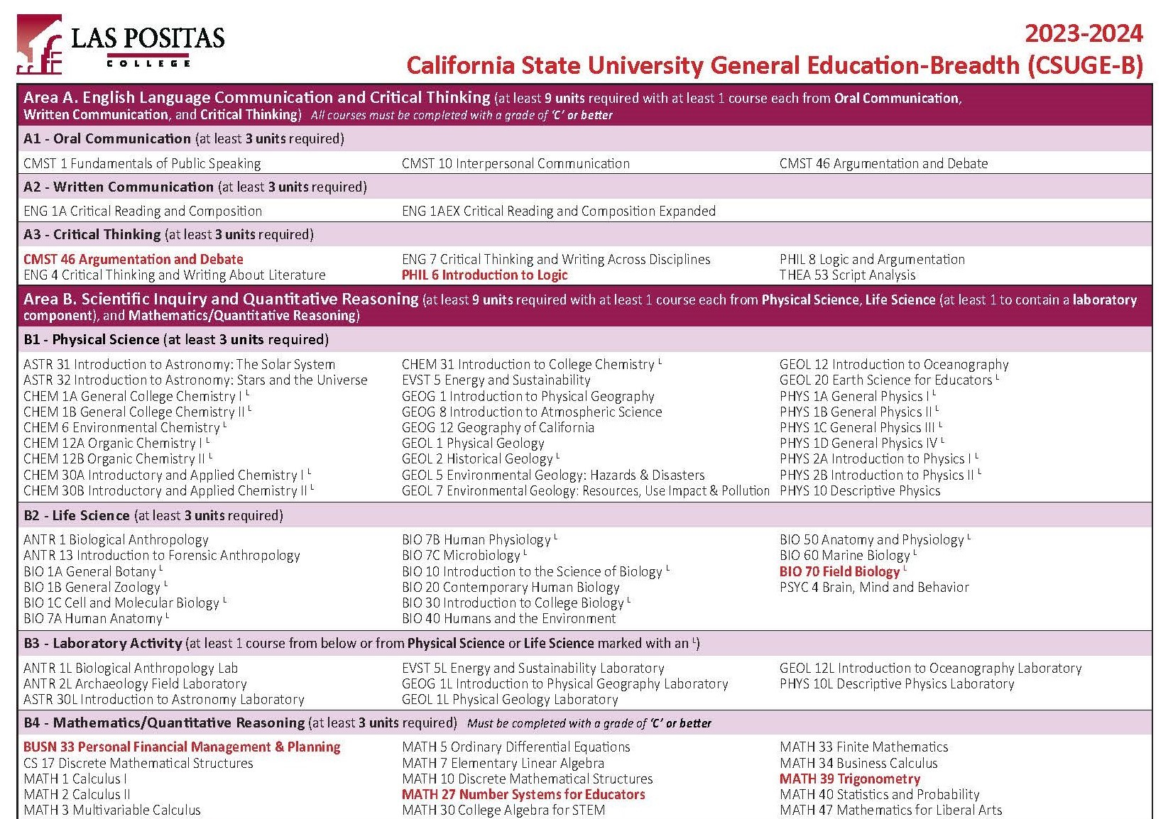

Slide 50
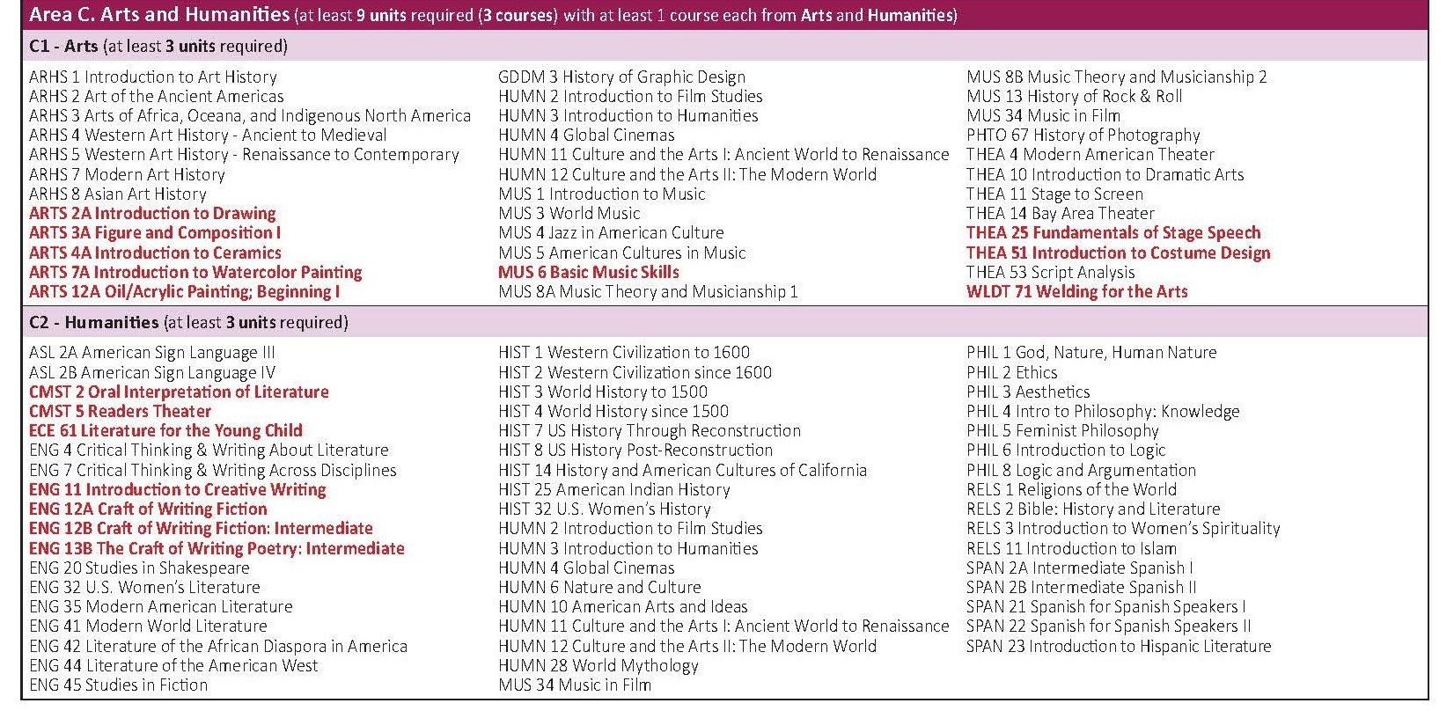

Slide 51
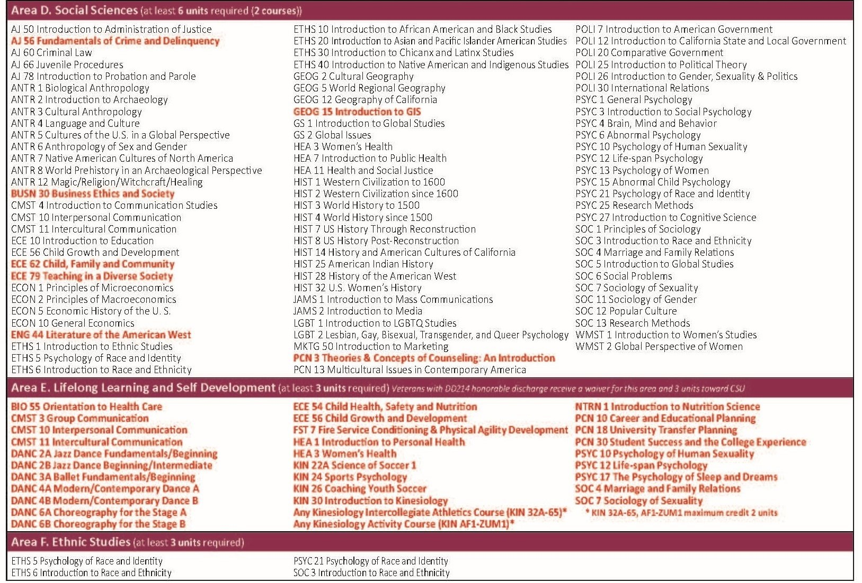

Slide 52


