Slide 1
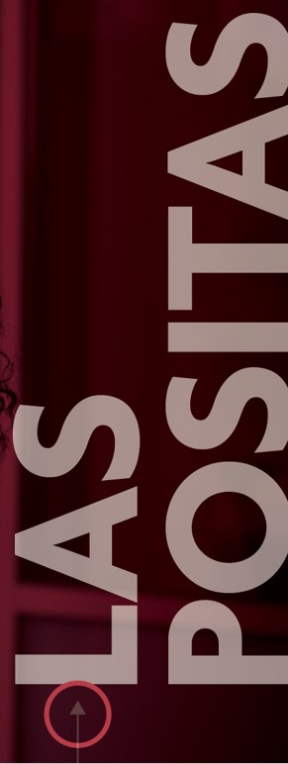
Flex Day
Spring 2024
Credit for Prior Learning Workshop
March 21, 2024

Slide 2
Credit for Prior Learning Workshop
Overview of Session
Credit for Prior Learning Team
Benefits of Credit for Prior Learning
College
Program
Students
Types of Credit for Prior Learning
Exam
Portfolio
Industry Recognized Training/Credentials
Military Joint Service Transcripts
Satisfactory Scoring on AP, IB, CLEP
Faculty Process
How to make your courses eligible for credit for prior learning

Slide 3
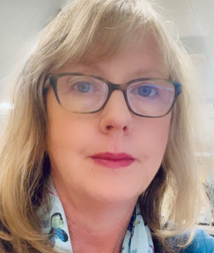
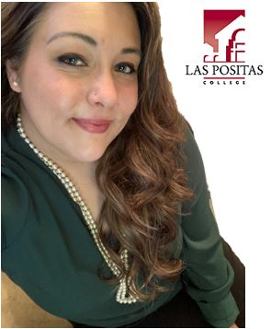
Credit for Prior Learning Workshop
Credit for Prior Learning - Team
Melissa Korber
Credit for Prior Learning Coordinator
Email: mkorber@laspositascollege.edu
Phone: (925) 424-1240
Danielle Bañuelos
Credit for Prior Learning Administrative Assistant
E-mail: dbanuelos@laspositascollege.edu
Phone: (925) 424-1111
Credit for Prior Learning Email
Lpc-priorlearning@laspositascollege.edu
1
Notes:
Thank you, Meghan Swanson for getting us started with CPL

Slide 4
Credit for Prior Learning Workshop
Credit for Prior Learning – Benefits to College
How does this benefit our college?
Respects students and their work as well as our equity focus
Builds enrollment
Opens space for future community and industry partnerships
Research shows that “Students accumulate more credits through coursework at the institution than their counterparts, which translates to increased enrollment for colleges.”
Credit for Prior Learning – Equity
The equity paradox of CPL - it has the greatest potential to increase persistence and degree completion for those least likely to use it.
The Chancellor’s Office encourages all districts to ensure equity in the process of students obtaining credit for prior learning, and quality, integrity and rigor in assessment of prior learning.
The district’s credit for prior learning policy should ensure that all students have equitable access to consistent opportunities to earn credit for prior learning.
2

Slide 5
Credit for Prior Learning Workshop
Credit for Prior Learning – Benefits to Program
How does this benefit your program?
Can bring more students to your program
Can get students to higher levels of your program
3

Slide 6
Credit for Prior Learning Workshop
Credit for Prior Learning – Benefits to Students
How does it support our students?
Validates work and learning already completed
Helps students move through our pathways
Avoids repetition
Benefits the community where they live and work by creating closer communications with industry experts
Helps working adults reskill and achieve quality credentials that increase their economic mobility
Promotes degree completion because students are roughly twice as likely to complete a degree than those who do not have CPL.
Saves students an average of 6-10 months in time to a degree compared to their non-CPL counterparts
4

Slide 7
Credit for Prior Learning Workshop
Credit for Prior Learning - Methods
Definition: Credit for prior learning (CPL) is credit awarded for validated college-level skills and knowledge gained outside of a college classroom—it’s a strategy to grant students credit for what they already know and can do.
Credit for prior learning may be obtained in the following ways:
Credit through satisfactory completion of examination (CBE)
Faculty assessment of a portfolio or documentation of college-level knowledge/skills and/or college-level training not acquired at an institution of higher learning, such as industry recognized credentials or training (IRT)
Evaluation of a Military Joint Service Transcript (MJST)
Achieving a satisfactory score on the Advanced Placement (AP) examination, a high-level International Baccalaureate (IB) examination, and/or on the College Level Examination Program (CLEP).
5

Slide 8
Credit for Prior Learning Workshop
Credit for Prior Learning – Faculty Process
Prior to Step 1, faculty will have decided they want to offer their course as credit for prior learning.
Step 1: Credit for Prior Learning Faculty Request
If you would like to make your course eligible for credit for prior learning, please fill out the CPL faculty request form and email it to the Credit for Prior Learning team at lpc-priorlearning@laspositascollege.edu. This inbox is managed by the CPL Coordinator and administrative assistant. If this request is for a new course, then in addition to submitting this form to the Credit for Prior Learning team, please also include the request for CPL in your new course proposal on CurriQunet.
Step 2: Curriculum Committee Approval
Once the CPL team receives your request, they will communicate the request to the Curriculum Chair and Curriculum Specialist who will then include the request on an upcoming Curriculum Committee (CC) meeting agenda for approval. It will be agendized at one CC meeting for First Reading, and then come back for Voting at a second CC meeting with an immediate effective date upon approval. The requesting faculty must be present at First Reading to discuss their proposal and answer any committee questions.
Step 3: Credit for Prior Learning Documentation/Tracking
Once approved by the Curriculum Committee, the Curriculum Specialist will communicate the course’s approval to the CPL team and document the approval in CurriQunet by uploading an attached file. The CPL team will then work with faculty to support them with next steps specific to the type of CPL they requested and update the student-facing webpage with the newly approved course.
6

Slide 9
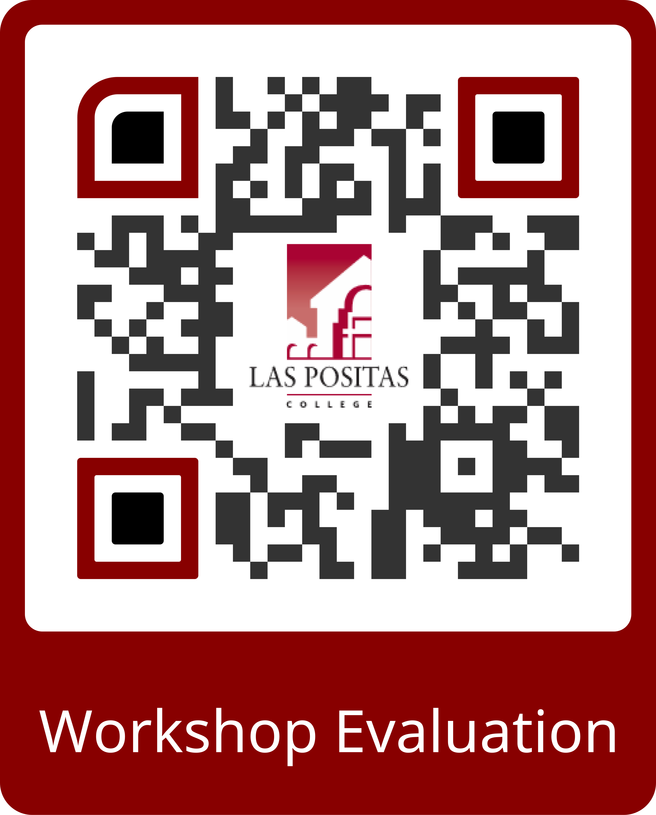
Credit for Prior Learning Workshop
Thank you for attending our session.
Please let us know if you have any questions.
7

