Slide 1
DSPS ACCOMMODATE FOR FACULTY

Slide 2
Agenda
Accommodate Info
Process for DSPS Students
Faculty Log-in
Testing Information
DSPS Q & A

Slide 3
Accommodate
Accommodate is a digital platform used by colleges worldwide for students with disabilities
Simplifies the communication process between DSPS and faculty
Improves confidentiality
Features include exam booking, alternative media checkouts, mass communication, case management

Slide 4
Log-in
MyPortal
Please look for activation email if you haven't activated
Class-web will be replaced by MyPortal!

Slide 6
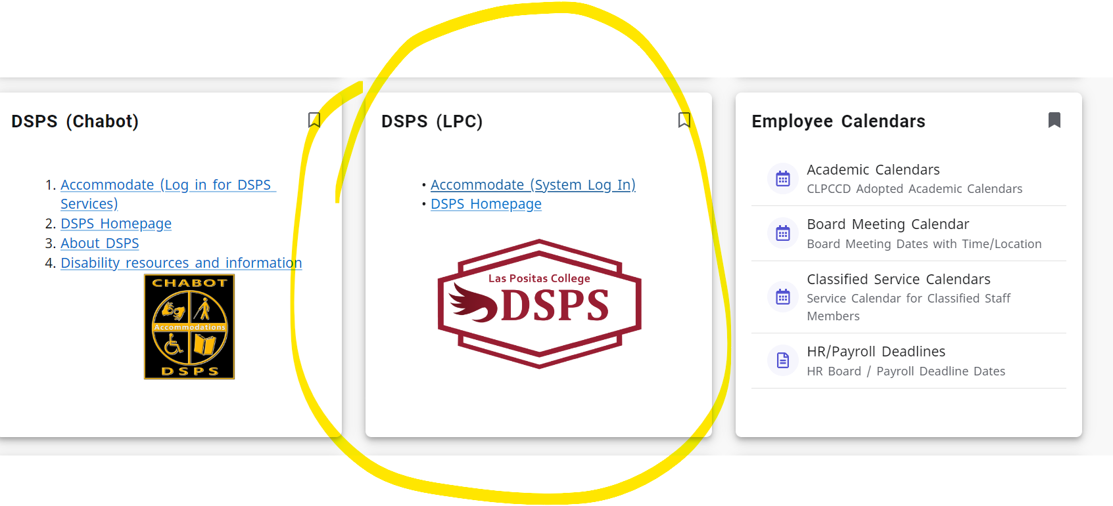
Faculty Log-IN

Slide 7
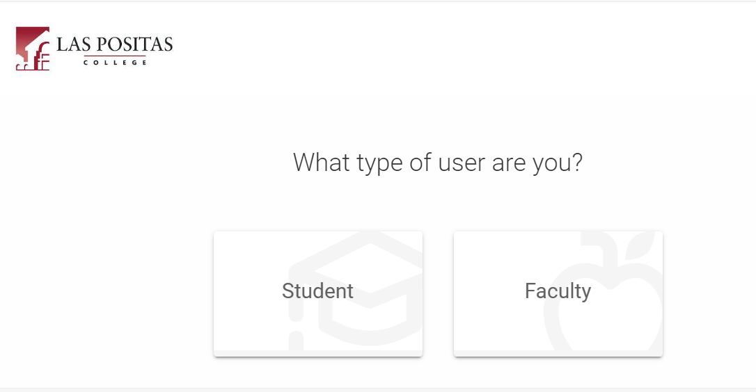

Slide 8
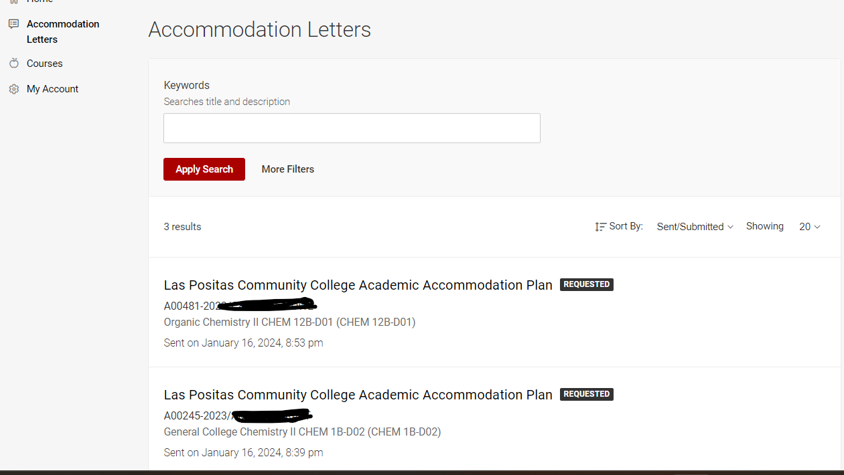

Slide 9
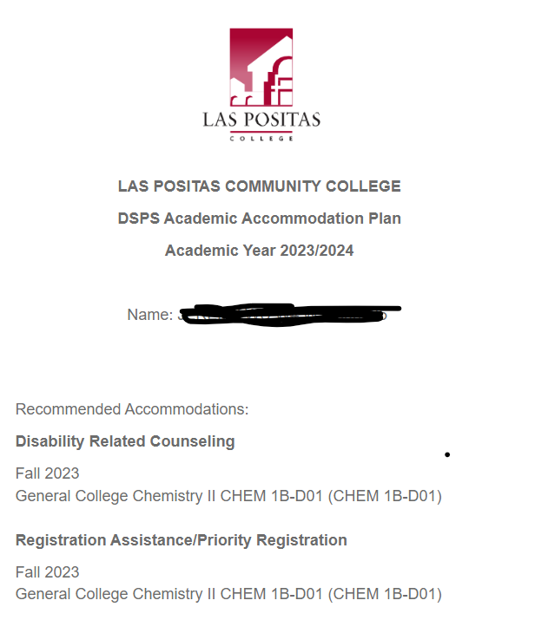
View individual accommodations

Slide 10
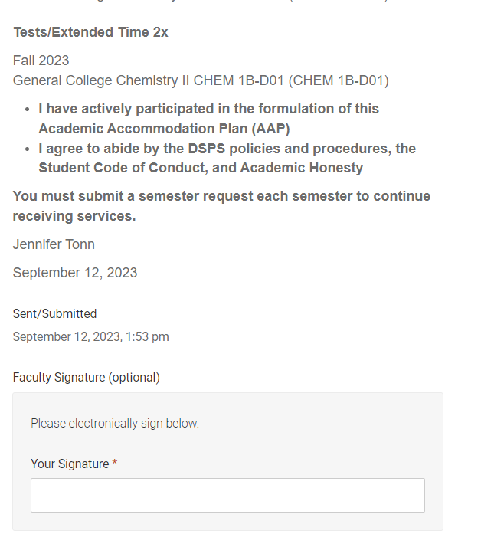
Optional signature from faculty

Slide 11
Viewing DSPS Students
Click courses on menu tab
Enrolled Students
List of accommodations approved for DSPS students

Slide 12
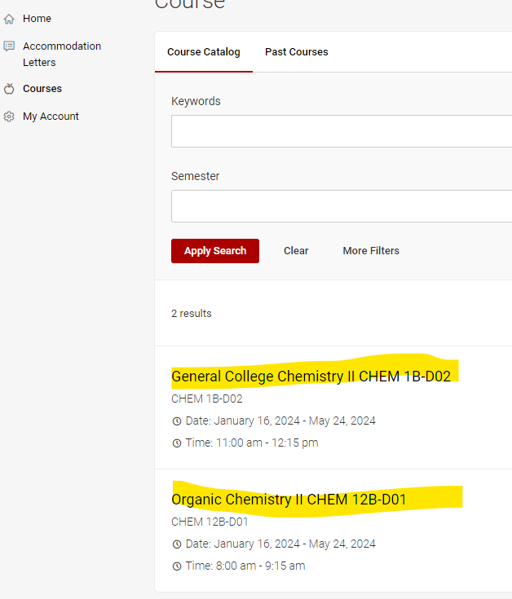
Uploading tests
Click on the course you would like to upload a test to:

Slide 13
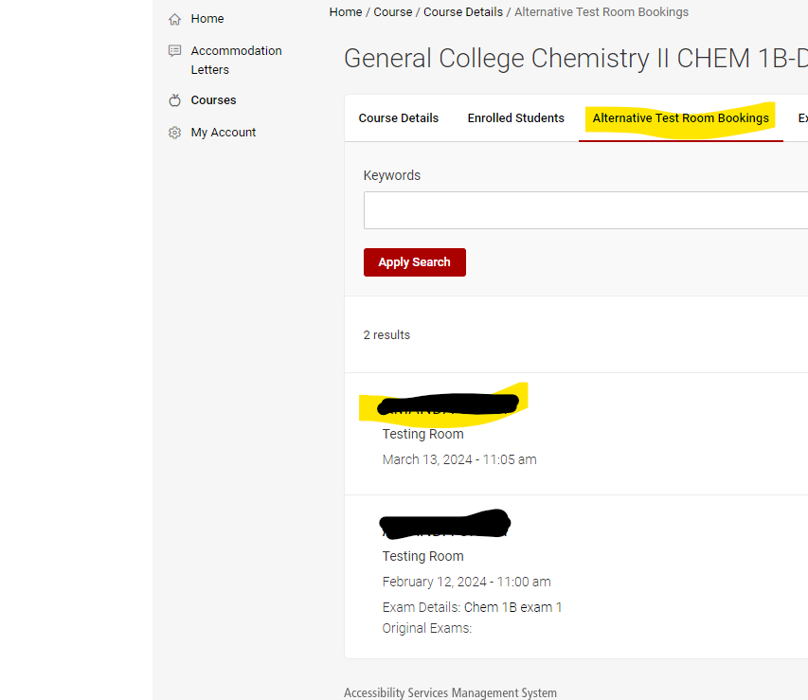
Uploading tests
Choose Alternative Test Room Bookings and from there choose student you would like to upload test for:

Slide 14
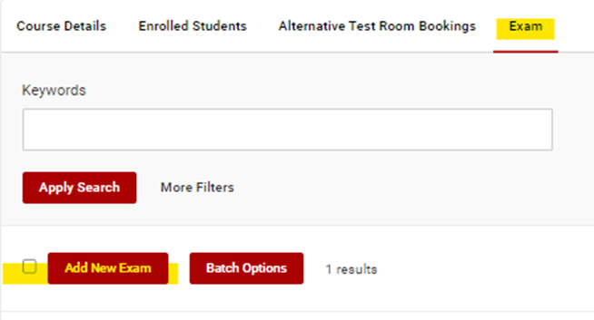
Uploading Tests
From here you can choose to Approve or Deny the request, if you choose yes and want to upload the exam you will go to the Exam Tab

Slide 15
Uploading tests
Last go to the Alterative Test Room Bookings Tab.
Choose to Approve or Deny the request.
If you uploaded the exam in the previous tab then you will go to Exam and select the exam you just uploaded.
Next you will fill out the Complete Exam Form. That is where any directions you have will go.
Last you will click submit button.

Slide 16
Dsps q& a

