Slide 1



INVEST IN YOU
Financial Aid-
LPC Flex Day
Kevin Harral,
Director of Financial Aid

Slide 2








Financial Aid
Tuition and Fees
  Financial aid is money available to assist students with the costs of attending college
  Financial aid comes from the federal and state government, academic institutions and private sources in forms of scholarships
Books and Supplies
Transportation
Housing
Food
Personal/Misc.

Slide 3
Types of Financial Aid
Gift Aid
  Grants, fee waivers, or scholarships that do not need to be repaid
Work Study
  Money earned by the student as payment for a job on or off campus
Loans
  Borrowed money needed to be paid back with interest
Categories of Financial Aid: Need-based aid and
non-need based aid

Slide 4


Cost of Attendance (COA)
  Cost of Attendance is the estimated average amount it will cost to be a student (attend)
  COA is the estimate of
    Tuition and fees
      Direct Cost
    Food and Housing
      Variable Cost
    Books and Supplies
      Variable Cost
    Transportation
      Variable Cost
    Personal Expenses
      Variable Cost

Slide 5

Understanding Financial Aid
  Students and parents are considered the primary sources for funding a college education and are expected to contribute to the extent they are able as determined by the financial aid application
  Financial aid measures a family's ability, not willingness, to pay for a college education

Slide 6
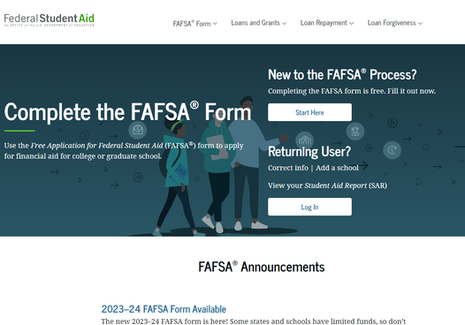
How to Apply for Aid?
Free Application for Federal Student Aid - FAFSA
  School Code: 030357
  Who applies to FAFSA? :
    Citizens
    Eligible non-citizens
    T Visa (human trafficking)

Slide 7
2024-25 FAFSA
Key Features:
  Integration to allow users federal tax information (FTI) to be retrieved and transferred directly into the FAFSA form via IRS direct data exchange
  Dependent students must invite their parent(s) to contribute to their form if parent information is required.
  Independent married students must invite their spouse to contribute to their form if they did not file taxes jointly and information is required.
  Student and contributor(s) must provide consent to retrieve and disclose FTI from the IRS for the student to be eligible for federal student aid.
    REQUIRED consent from everyone who contributes to application.

Slide 8
What is so special about the new FAFSA?
FAFSA vs FAFSA
Old – all information could be entered into the FAFSA application manually and there was an option of going to the IRS to do a partial tax import (Data Retrieval Tool), then that information is editable.
New – The FAFSA is now a compilation of 2-4 ‘sections’ added together
  All questions that do not pertain to taxes – manually entered
  The Federal Tax Information (FTI) from the student
  The Federal Tax Information (FTI) from the contributor(s)

Slide 9
Which Parent Must Complete the FAFSA?
When parents are divorced, separated or never married, and do not live together, only one parent must complete the FAFSA
  The parent who provides more financial support to the student, not the parent that the student lived with the most
    This will often be the person who claimed the student on the taxes
If the parent has remarried as of the date the FAFSA is filed, the stepparent’s income, assets, and dependents must be reported on the FAFSA
  This may require two contributor invites from student

Slide 10
Contributors
A student’s or parent’s answers on the FAFSA form will determine which contributor(s), if any, will be required
to provide information
Contributors must provide personal and financial information in their own sections of the FAFSA form, but they are not financially responsible for the student’s education costs.
Students invite contributors to
complete their portion of the FAFSA form by entering the contributor’s name, date of birth, Social Security Number, and email address,
If the student’s parents are married, remarried, or unmarried and living together, must invite at least one parent as a contributor with the option to invite the other parent as well.

Slide 11
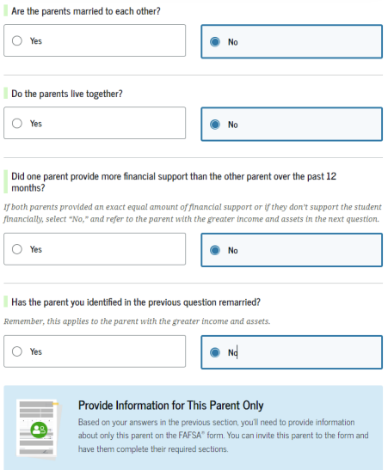
Parent Questions
Are your parents married to each other?
  If yes, provide information about both parents
  If no, next question
Do your parents live together?
  If yes, provide information about both parents
  If no, next question
Did one parent provide more financial support than the other during the past 12 months?
  If both parents provided an exact equal amount of financial support or if they don’t support the student financially, select “No,” and refer to the parent with the greater income and assets in the next question.
  Yes or No, next question
Has the parent you identified in the previous questions remarried?
  If yes, provide information for the parent and stepparent
  If no, provide information about this parent only

Slide 12
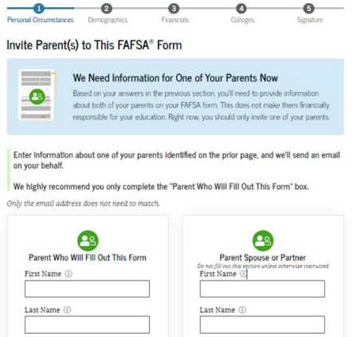
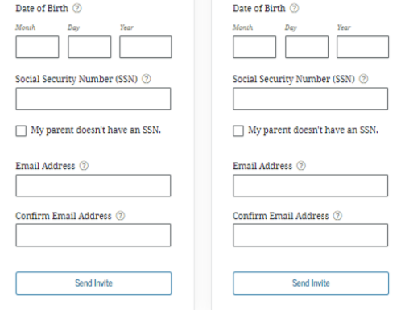
Dependent Students Invite Contributors

Slide 13
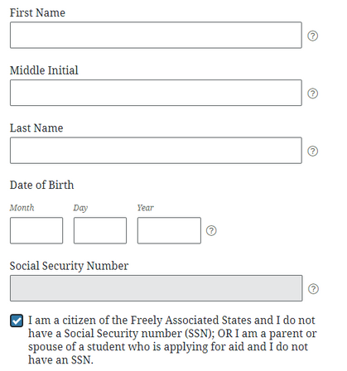
Contributors without a SSN
  Spouses and parents who are undocumented or foreign citizens will be able to obtain an FSA ID even without a Social Security Number (SSN)
  Indicate you don’t have a SSN by clicking the checkbox
  Contributor information is not shared with the Department of Homeland Security (DHS) or immigration enforcement
  If there are problems obtaining an FSA ID, call the Federal Student Aid at 1-800-433-3243 or visit studentaid.gov/fsa-id

Slide 14
Next Steps for Contributors
  Contributor receives email informing them that they’ve been identified as a contributor.
  Contributor creates a FSA ID if they don’t already have one.
  Contributor reviews information about completing their section of the FAFSA
  Contributor provides the required information on the student’s FAFSA form.
If a required contributor refuses to provide their information, it will result in an incomplete FAFSA form, and the student will become ineligible for federal student aid.

Slide 15
Consent and Approval
All students and contributors must provide consent and approval to:
  Have their Federal Tax Information (FTI) transferred directly into the FAFSA form via the Direct Data Exchange (DDX) with the IRS
  Have their federal tax information used to determine the student’s eligibility for federal student aid
  Allow the U.S. Department of Education to share their tax information with postsecondary institutions and state higher education agencies, such as CSAC, for use in awarding and administering financial aid

Slide 16
Independent Students
For the 2024-25 academic year, students are considered independent if they are one of the following:
  Born before Jan. 1, 2001
  Married (and not separated)
  Graduate or professional student
  Veteran
  Member of the armed forces
  Have a court-ordered legal guardianship
  Court-ordered emancipated minor
  Orphan
  Ward of the court
  Foster Care
  Someone with legal dependents other than a spouse
  Homeless or at risk of being homeless

Slide 17
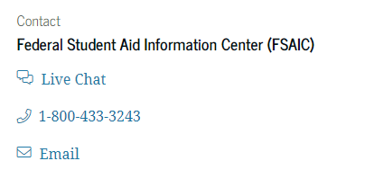
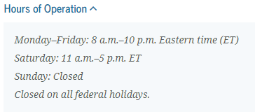
Federal Student Aid Assistance
  Answers to common questions about the FAFSA process
    studentaid.gov/apply-for-aid/fafsa/filling-out/help
  Online assistance and contact information for Federal Student Aid Information Center (FSAIC)
    1-800-433-3243
    studentaid.gov/help-center/contact

Slide 18
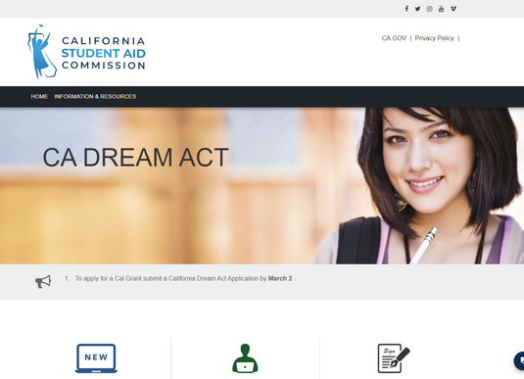
California Dream Act Application - CADAA
  School Code: 030357
  Who applies to CADAA? :
    Undocumented/DACA Students
      With AB 540 Status
    TPS Recipients
    U Visa (certain victims of crime)
  If you apply to CADAA submit "AB 540 California non-resident tuition exemption request" or "AB 540 Affidavit" to A&R
Submit 1 Application Yearly FAFSA OR CADAA

Slide 19
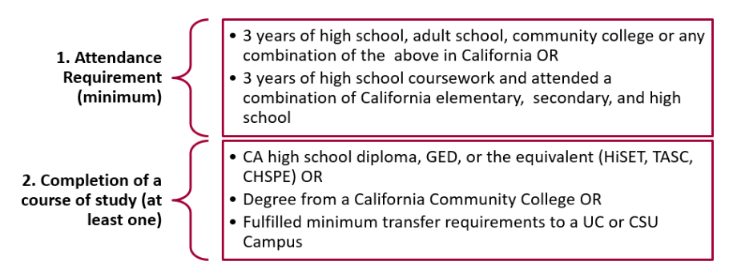
AB 540 Eligibility
To pay in-state tuition under AB 540 status students must meet the following requirements:

Slide 20
Parent Section
ONE parent’s information is needed:
  Student’s parent is not married and not living with the other student’s parent
  Student’s parent is divorced and has not remarried
  Student’s parents are separated and NOT living in the same household
TWO parent’s information is needed:
  Student’s parents are not married, but are living together
  Student’s parents are married to each other
  Student’s parents married/remarried to student’s stepparent

Slide 21

Sources of Financial Aid
STATE FINANCIAL AID
California College Promise Grant Fee Waiver
Cal Grant
Student Success Completion Grant
Chafee Grant
FEDERAL FINANCIAL AID
Pell Grant
Supplemental Educational Opportunity Grant
Federal Work-Study
Student Loans
INSTITUTIONAL AID
LPC Free Tuition Promise
LPC Scholarships

Slide 22

State Financial Aid
California College Promise Grant Fee Waiver
  Waives the $46/unit enrollment fee for California residents with unmet financial need
  No minimum amount of units needed
  Students are automatically screened for the fee waiver when submitting the FAFSA or CADAA

Slide 23

CAL GRANT
Cal Grant A
  For high school seniors and recent high school grads
  at least 3.0 GPA
  For low to middle income students
Cal Grant B*
  For high school seniors and recent high school grads
  at least 2.0 GPA
  For low income students
Cal Grant C*
  For vocational, technical or occupational programs 2-4 semesters in length
  No GPA requirement
*Student Success Completion Grant for 12-14.5 or 15+ unit enrollment.
APPLY THROUGH FAFSA OR CADAA BEFORE APRIL 2ND 2024

Slide 24
CHAFEE GRANT
The California Chafee Grant for Foster Youth awards up to $5,000 a year to eligible foster youth.
Eligibility Requirements:
  Not have reached your 26th birthday as of July 1st of the award year
AND
  Be current or former foster youth who was a dependent or ward of the court, living in an out-of-home foster care placement, between the ages of 16 and 18
OR
  Be a youth who was placed in out-of-home care by a tribe or tribal organization between the ages of 16-18
REQUIRES A SEPARATE APPLICATION

Slide 25
Federal Financial Aid
Federal Pell Grant
  Aid awarded on the basis of financial need and Student Aid Index (SAI)
  Currently for 2023-2024 Max Pell is $7,396/year
    Amount varies with SAI and units the students is enrolled in
    You will receive the same Pell Grant award at any college you attend
  Must apply annually through the FAFSA
FAFSA deadline for federal aid is June 30th of the end of the school year; students can receive retroactive funding if applying late.

Slide 26
Federal SEOG
  Federal financial aid program with limited funds
  Must be a Pell Grant recipient (not just eligible)
  Aid awarded on the basis of financial need and Student Aid Index (SAI)
    Must have an SAI of <=0 (the range is -1500 to 999,999)
    Amount is $300/semester (Fall/Spring) with enrollment at 6+ units
    You may not receive the same amount of SEOG at other colleges
  Must apply annually through the FAFSA

Slide 27
Federal Work-Study
  Federal financial aid program with limited funds
  Money earned through a job that may be on or off campus
  Must have financial need and be enrolled in 6+ units
  Work hours are flexible with student's class schedule
  Each college has its own award policy, pay rates and procedures
  Must apply annually through the FAFSA
http://www.studentaid.gov

Slide 28
Federal Direct Loans
  Money borrowed from Dept. of Education by the student
    Must have financial need for Subsidized (government pays interest while in school)
    May be able to take out an Unsubsidized without financial need (student is responsible for cost of interest while in school)
  Annual and aggregate limits are set by Dept. of Ed, though a college has an ability to award lower dollar amounts, with cause
  6-month grace period after graduation before repayment begins
  Must apply annually through the FAFSA

Slide 29
Institutional Financial Aid
The Las Positas Free Tuition Promise for 2024-2025
Las Positas College now offers free tuition for first-time, full-time students in their 1st year and a 2nd year promise for those who maintain eligibility throughout the fall and spring terms.
Eligible Students
First-time college students that have not attended college before. Students who have earned college credit prior to high school graduation or students enrolled at Las Positas College during the summer immediately prior to fall are eligible.
Must be enrolled in, and must complete, 12 or more units per semester during fall and spring terms.
Must be a California resident or AB 540 student.
Application Process
  Apply to Las Positas College.
  Complete the FAFSA or the CADAA

Slide 30


Scholarships
  Awards may be based on talent, grades, financial need or any criteria determined by the donor and LPC Foundation
  The donor/Foundation decides on the award amount in addition to deadlines and applications requirements
  You may find scholarship opportunities through our webpage, search engines, organizations such as unions, employers, clubs, etc.

Slide 31
Scholarships
  NEVER PAY MONEY TO APPLY FOR A SCHOLARSHIP
  Tips on avoiding scams:
    US Department of Education
      https://studentaid.gov/resources/scams
    Federal Trade Commission
      https://consumer.ftc.gov/scams
    Scholarship Searches
      FinAid
        https://finaid.org/
      Big Future by The College Board
        https://bigfuture.collegeboard.org/
    Hint: use a separate dedicated email address when using scholarship search programs to avoid spam

Slide 32

Summary of the Financial Aid Process
  Apply for financial aid annually
  Keep a copy of all forms submitted
  Review your application
  Communicate with the college Fin Aid Office

Slide 33

Questions?

Slide 34





Thank you!
FINANCIAL AID OFFICE
Website: laspositascollege.edu/financialaid/
Email: lpcfinaid@laspositascollege.edu
Phone Number: (925) 424-1580
Follow LPC on social media!

