Slide 1
2025 INDIVIDUAL INCOME TAX LAW CHANGES, 403B, 457, CALSTRS

Slide 2
STANDARD DEDUCTION, CREDITS
2025
2024
Standard Single/ MFS deduction: $15,750
MFJ Standard deduction: $31,500
HOH Standard deduction: $23,625
OVER 65+ (2025-28) Additional $6,000 per qualified individual (phase out limits)
Standard Single/ MFS deduction: $14,600
MFJ Standard deduction: $29,200
HOH Standard deduction: $21,900

Slide 3
ITEMIZED DEDUCTIONS, SALT
2025
2024
MFJ: $40,000
MFS $20,000
HOH $40,000
(INCOME PHASE OUT BASED ON MAGI OF > $500,000
MFJ: $10,000
MFS $5,000

Slide 4
HUGE, SALT IMPLICATIONS
2025
2024
Income before SALT: $125,000
SALT DED: $25,000
Taxable income: $100,000
Income tax: 22% = $22,000
Tax savings = $3,500
Income before SALT: $125,000
SALT DED: $10,000
Taxable income: $115,000
Income tax: 22% = $25,300

Slide 5
CHARITABLE DEDUCTIONS, EDUCATION CREDIT, 529 & EMPLOYEE EDUCATION
CHARITABLE DED 2025: Only for itemizers. Cares act above the line deductions in applicable.
Up to 60% of AGI for Cash contributions
Up to 50% of non-cash items
Up to 30% of highly appreciated items like stocks, real estate, gold, diamonds, platinum etc
CHARITABLE DED 2026: Non itemizers cash only, Single $1,000 MFJ $2,000
EDUCATION DONATION CREDIT: Non refundable credit up to $1,700 contributed to a tax-exempt scholarship granting organization. Each state has a list of SGO’s
529 TAX FREE WITHDRAWALS: Can be used for home schooling, elementary/secondary education (K-12) and other education related expenses.
EMPLOYER PROVIDED EDUCATION: Tax free up to $5,250 per employee

Slide 6
CHARITABLE DEDUCTIONS STRATEGIES 2025
2025:
General donation: Use appreciated stocks or assets to donate to a DAF and then use that money to make a contribution
Donation to a SGO: Sell the stocks (investments), it triggers Capital Gains tax, however use up to $1,700 (SINGLE) or 3,400 (MFJ) as a non-refundable tax credit to offset income taxes
If Single or MFJ (non itemizer), defer cash contribution till 2026
Defer charitable deductions till 2026 to meet .05% AGI floor applicable to total cash + non-cash contributions . Bunch your donations. Example: if your AGI is $200,000 x .05 = first 1000 is non deductible.

Slide 7
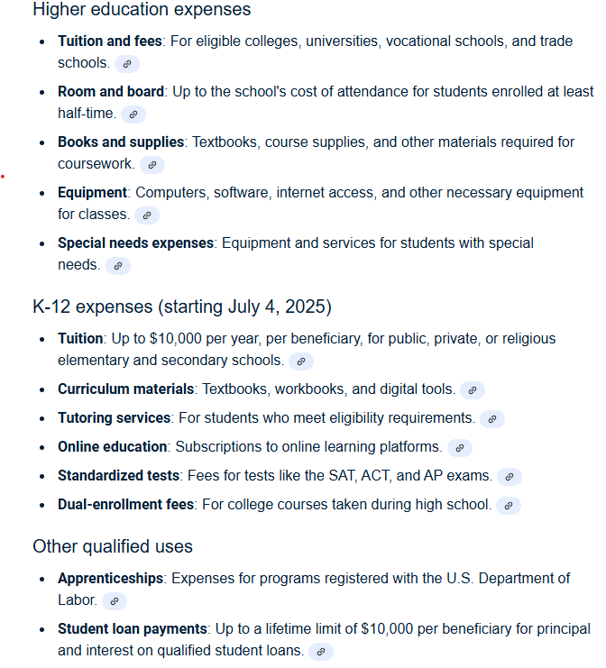
529 FUNDS QUALIFIED USE

Slide 8
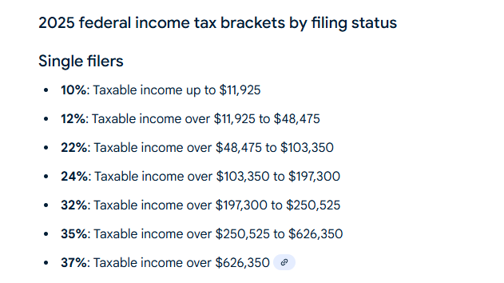
SINGLE FILERS TAX BRACKETS

Slide 9
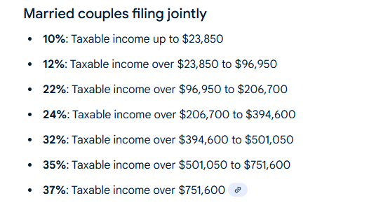

Slide 10
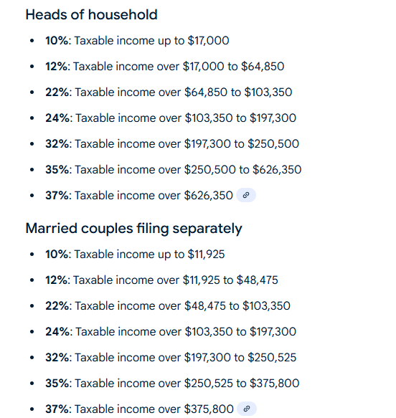

Slide 11
OTHER CREDITS
CHILD TAX CREDIT (CTC): $2,200 per qualifying child, 16 yrs or younger. Partially refundable (up to $1,700)
OTHER DEPENDENT CREDIT (ODC): Non refundable $500 per dependent, relationship test and income test
ADOPTION CREDIT: Up to $5,000, max $17,280
CHILD DEPENDENT CARE CREDIT (CDCTC): Non refundable, $3,000 per qualifying child, $6,000 for two or more children
Expenses credit from 20% - 35% of income based on AGI
FSA will reduce amount of credit
2026: Additional exclusion for employer provided or cafeteria plan $7,500 MFJ

Slide 12
401k, 403B (CALSTRS PENSION II), 457 limits
$23,500 Annually in addition to pension contributions
Catch up aged 50 & above $7,500, total $31,000
Special catch up, Age 60-63 $11,250
Traditional IRA, $7,000 (Income limitations apply)
ROTH IRA, 403 B, 457 (OPTIONAL)
ENVOY PLAN CLPCCD FOR 403B & 457
ENVOY PAGE LINK: https://districtazure.clpccd.org/business/guide/payroll.php
CLIENT RESOURCE: CENTER, CA, ALAMEDA COUNTY, CLPCCD
SALARY REDUCTION FORM: https://districtazure.clpccd.org/business/guide/payroll.php

Slide 13
ENVOY 403B, 457 CLPCCD
SEARCH CLPCCD
PAYROLL
(SCROLL DOWN TO) 403B AND 457 PLANS
SELECT ENVOY PLAN SERVICES
403 B MANAGED BY CALSTRS OR USE A DIFFERENT PROVIDER
457 MANGED BY CALPERS OR USE A DIFFERENT PROVIDER

Slide 14
WHY SHOULD YOU CONSIDER CONTRIBUTING TO 403B AND OR 457?
IMMEDIATE TAX RELIEF AND EXCELLENT RATE OF RETURN THE FIRST YEAR
EXAMPLE:
CONTRIBUTION AMOUNT $10,000
TAX BRACKET = 25%
TAX BENEFIT = $2,500, YOU EARNED 25% GROWTH IN THE FIRST YEAR
SCENARIO 1(AGE 40):
TIME 25 YRS, 6% COMPOUNDED ANNUALLY
FV 0F $500/ MO
$347,299.00
Tax benefit =1500/yr
FV 0F $750/ MO
$520,948.00
Tax benefit = 2750/yr
FV 0F $1000/ MO
$694,598.00
Tax benefit =3000/yr
FV 0F $1500/ MO
$1041,898.00
Tax benefit =4500/yr

Slide 15
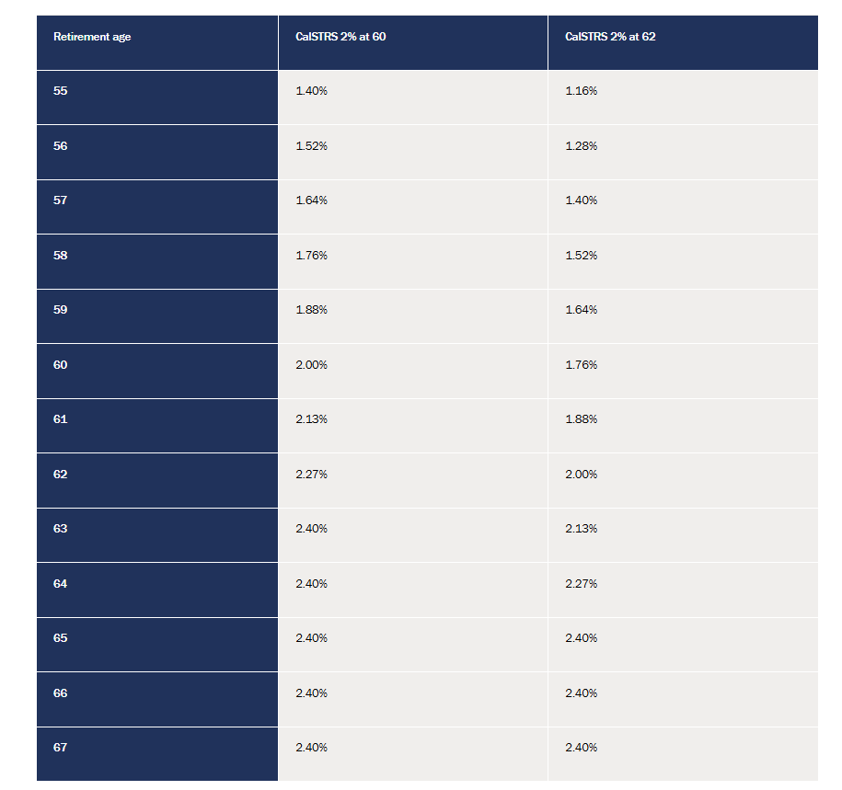
CALSTRS RETIREMENT FORMULA (ESTIMATE)
#YRS x AGE FACTOR x 3 YR AV SALARY
#20 x .0240 x 15,000 = $7,200 per month
USING CALSTRS WEBSITE

Slide 16


