Slide 1
Academic Senate 101
An Introduction to
the Las Positas College Academic Senate

Slide 2
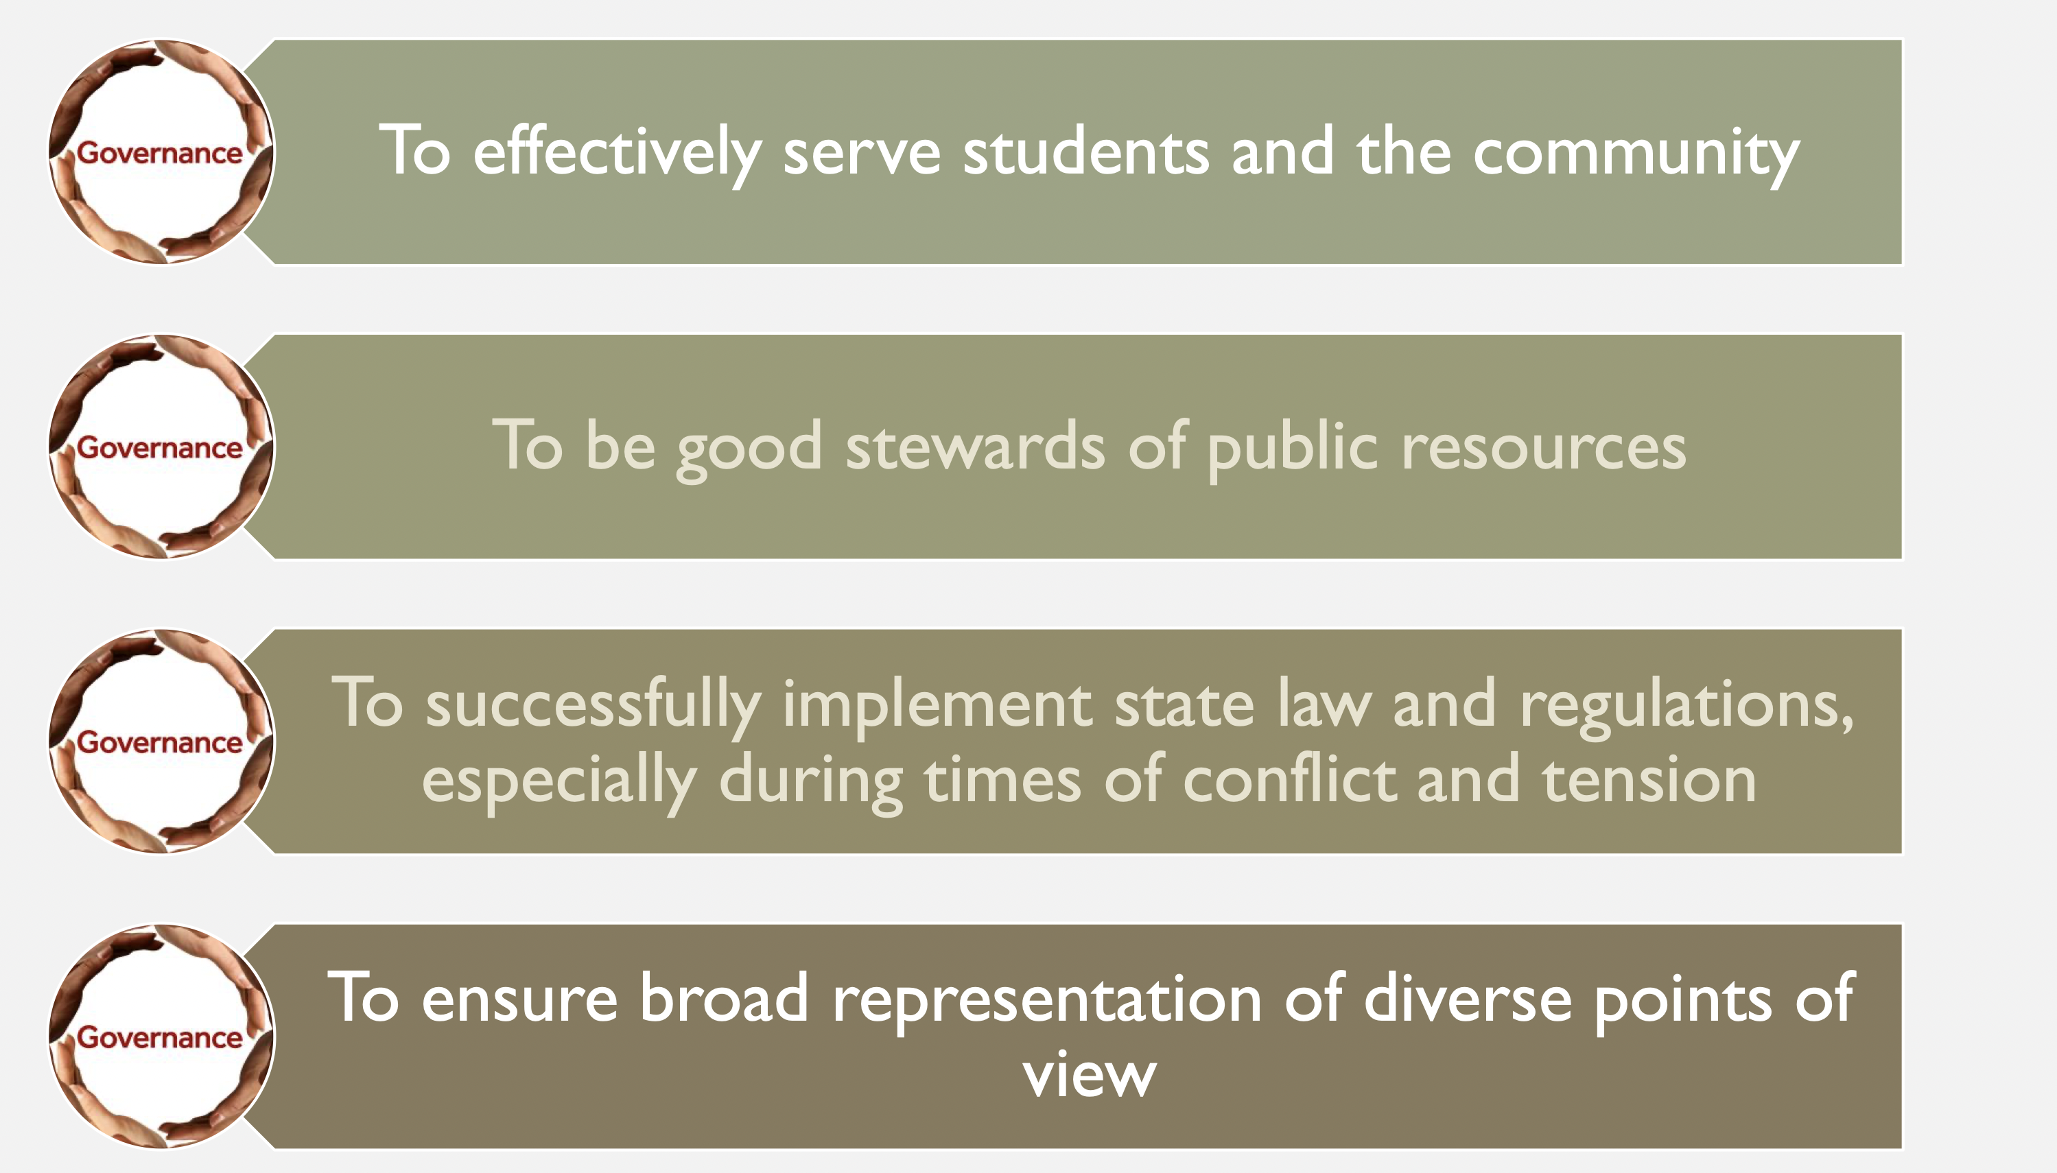
Shared governance Structure

Slide 3
The Shared Governance Structure
California
Education Code
TITLE V
Chabot-Las Positas Board of Trustees Policy

Slide 4
The California Education Code
Laws which can only be changed through legislative action, such as AA-T, AS-T degrees

Slide 5
Ed Code 87359 (B)
No later than July 1, 1990, hiring criteria, policies, and procedures for new faculty members shall be developed and agreed upon jointly by representatives of the governing board, and the academic senate, and approved by the governing board.

Slide 6
TITLE V
The Statewide Board of Governors’interpretations of California Ed Code and subsequent policies for its implementation
They have the force of law, although they are occasionally modified by the BOG – e.g. “W” policies

Slide 7
Title V Section 53200
Academic Senate means an organization whose primary function is to make recommendations with respect to academic and professional matters.

Slide 8
Representation
The Academic Senate represents the faculty
on all non-collective bargaining matters, in
collegial consultation related to certain
academic and professional matters as defined
in Title V of the Ed Code.

Slide 9
“Academic and Professional matters” (or 10+1) means the following policy development and implementation matters:
Curriculum, including establishing prerequisites and placing courses within disciplines
Degree and certificate requirements
Grading policies
Educational program development
Standards or policies regarding student preparation and success

Slide 10
District and college governance structures, as related to faculty roles
Faculty roles and involvement in accreditation processes, including self-study and annual reports
Policies for faculty professional development activities
Processes for program review
Processes for institutional planning and budget development
Other academic and professional matters mutually agreed upon between the governing board and the academic senate

Slide 11
Consult Collegially
Rely primarily upon (the recommendations of the Academic Senate)
or
Mutually agree (the Board or its designee and the academic senate shall reach mutual agreement by written resolution, regulation, or policy effectuating such recommendations)

Slide 12
Chabot-LPC Board Policy
The Board will rely primarily upon the Academic Senate for:
Curriculum, including establishing pre-requisites and placing courses in disciplines.
Degree and certificate requirements.
Grading policies.
Faculty roles and involvement in the accreditation process, including self-study and annual reports.
Ed Code Section 53201 and Board Policy 2015

Slide 13
Chabot-LPC Board Policy
The Board will reach mutual agreement with the Academic Senate regarding:
  Educational program development
  Standards and policies regarding student success
  District and college governance structures as related to faculty roles
  Policies for faculty professional development activities
  Process for program review
  Process for institutional planning and budget development

Slide 14
LPC Academic Senate
Meetings: 2nd and 4th Wednesday at 2:30 p.m. in 1687
Non-Voting Members:
President: Sarah Thompson
Student Government: Lara Weidemeier
Faculty Association: Heike Gecox
Admin.: Rifka Several
Voting Members:
Vice President: Collin Thormoto
Secretary: Dave Wagner
Treasurer: Ashley Young
BSSL: Robin Roy, Daniel Cearley
A & H: John Kelly, Peter Kuo, Kisha Quesada Turner, Katie Eagan
STEM: Michael Peterson, Ashley McHale
PATH:
Student Services: Christina Lee, Jill Oliveira
Part Time Representatives: Jeff Judd

Slide 15
Academic Senate subcommittees
Curriculum
Guided Pathways
Program Review
Distance Education
Faculty Hiring and Prioritization
Student Equity and Achievement (SEA)
Student Learning Outcomes (SLO)
Professional Development
Career Technical Education

Slide 16
COLLABORATION WITH PARTICIPATORY GOVERNANCE COMMITTEES
Chancellor’s Council
College Council
College and District Enrollment Management
Planning & Budget

Slide 17
2022 SENATE GOALS
1) Enrollment Decline (20% down)
2) Process to support students with potential passing of AB1705
3) Why Students Should Come to LPC; destination campus
4) Maximizing our Budget/Resources as a Community
5) Implementation of Senate Resolution Changing Student Forms & Procedures

Slide 18
The Brown Act
The Keys
  Commitment to openness and transparency
  Commitment to public access to information (not mere compliance with the law)
18
Notes:
18

Slide 19
What does the Brown Act cover?
The Brown Act applies to meetings of all legislative bodies (GC 54952), including:
  The Board of Trustees
  Any subcommittee or task force created by the Board with a majority of Board members serving on the group
  Any subcommittee or task force created by the Board which has defined, ongoing charge (either decision-making or advisory) OR has a regular meeting schedule set by the Board, regardless of Board membership
19
Notes:
19

Slide 20
What does the Brown Act cover?
A meeting of a legislative body (GC 54952.2) occurs whenever a majority of members gather to discuss business with their charge.
A majority can meet at the following provided they do not discuss any business within their charge among themselves:
  Attendance at a conference
  An open meeting of some other group to address local issues
  Social gatherings
20
Notes:
20

Slide 21
Does the Brown Act apply to local academic senates?
YES!!!!
21
Notes:
21

