Slide 1
Student Incident
Referrals and Reports

Slide 2

Referral and Reporting System
Incident Referral Form - allows Las Positas College to record, track, and report information as it pertains to the following:
Academic Integrity
Student Discipline
Student Grievance
Student Mental Health, and
Student Title IX
Employees and students can electronically submit concerns/complaints.

Slide 3
Types of Student Incident
Referrals and Reports
Five types of referrals and reports:
Academic Integrity – i.e. Cheating or plagiarism
Student Discipline – i.e Disruptive behavior or violations of the Code of Conduct
Student Grievance – i.e. A high level complaint impacting a students rights
Student Mental Health – i.e. A request for campus response to the mental health needs of a student
Student Title IX – i.e. reporting of sexual harassment, misconduct or violence within the campus community

Slide 4
Academic Integrity
Catalog Language:
Any form of academic dishonesty, whether cheating or plagiarism, undermines the value of grades for the entire student body and the College as a whole….
For these reasons, the College does not tolerate any form of academic dishonesty…
The actions taken against the student will be permanently entered into the student's educational record in the case of repeated, flagrant, or serious incidents.
-LPC College Catalog (pg. 34)
Please use the LPC Academic Integrity Incident Referral Form

Slide 5
Academic Integrity
Getting ahead of academic dishonesty:
Clearly stated policy in your syllabus, including use of AI
Discuss academic integrity with your class
What that means in your field (e.g. art vs. math vs. English)
Consider AI (LPC Faculty AI Resource Page)
You suspect a student of academic dishonesty:
Notify student of the suspected violation
Speak with the student directly
Violation confirmed? Determine next steps
(e.g. allowing re-do or not, warning, reporting)
Subsequent Violations:
Increased sanction severity
Submit additional report
Recommend drop from class or suspension

Slide 6

Academic Integrity
Reporting:
Student demographic info
Type of violation
e.g. Cheating, plagiarism, forgery
Description of the incident
Students response to alleged violation
Acknowledged vs denied
Preferably not “unaware of violation”
Action taken by faculty
Request for additional college action
Supporting documentation
Plagiarized assignment, communication with student, etc.

Slide 7
Academic Integrity
College Response
Dear Faculty:
Thank you for submitting this incident report. We’ll be investigating this case and processing it at an institutional level, which considers any prior or co-occurring violation. I encourage you to hold the student to full account at the course level as well. I’ll reach out if I need additional information.
Sincerely, Joel
First violation vs Subsequent violations

Slide 8

Student Discipline
Addressing Disruptive Behavior
Low level (eating in class, profanity, cell phone use)
High Level (threatening behavior, outbursts)
Crisis? Call Campus Safety (925) 424-1699
Procedures for formal hearing
Sanctions
Warning, Suspension, Expulsion

Slide 9
Handling Misconduct
FIRST INCIDENT
*Asks the student to stop.
SECOND INCIDENT
Issues verbal AND written warning, and consults with Division Dean.
THIRD INCIDENT
Removes student for the remainder of the session and at the individual’s discretion, the following session.
*Depending on the severity of the misconduct, you may remove a student at any point.
To report student discipline, please use the LPC Student Discipline Incident Referral Form

Slide 10

Student Grievance
Student only process/form
Grievances may be against another student or an employee
Students have the right to learn and participate
Prioritize lowest level resolution
Grievance encouraged when a student reasonably believes a college action has adversely affected their rights as a student.

Slide 11

Student Grievance
Course Grades:
Grades are determined by the instructor.
Determination of the student’s grade by the instructor, in the absence of mistake, fraud, bad faith, or incompetency, shall be final.
Exemptions:
The following are not grievable:
Standards of student conduct
Sexual misconduct
Financial aid actions
Parking tickets

Slide 12
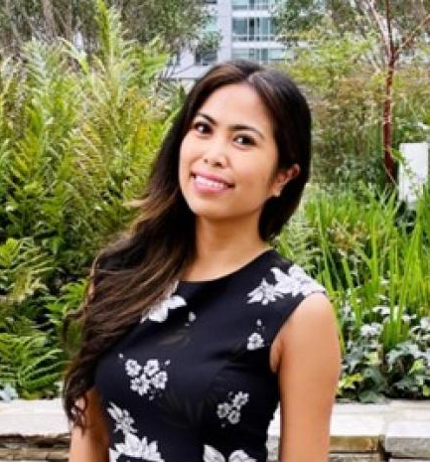
Student Grievance
Informal Resolution –
Students shall make a reasonable effort to resolve the matter on an informal basis prior to requesting a grievance hearing, and shall attempt to solve the problem with the person with whom the student has the grievance, that person’s immediate supervisor, or the local college administration.
What happens if student grieves you?
Students reporting a grievance will use the LPC Student Grievance Form

Slide 13
Student Mental Health
Please refer students who may be experiencing or expressing distress.
Steps to take:
Talk with student privately or confidentially
Express concern
Inform student about available assistance through the Health Center
Consult BIRT Team member if need be
Make a direct referral
In case of an emergency, please call 911 to solicit first responders (fire, paramedics, or police).
To refer a student to mental health services, please use the LPC Student Mental Health Incident Referral Form

Slide 14

Student Title IX
All college employees are mandatory reporters which requires them to report all allegations or knowledge of sexual misconduct that involves students.
Reportable offenses include:
Sexual harassment
Sexual misconduct
Stalking
Dating violence
Discrimination based on sex /
sexual orientation
To report a student Title IX violation,
please use the LPC Student Title IX Incident Referral Form

Slide 15
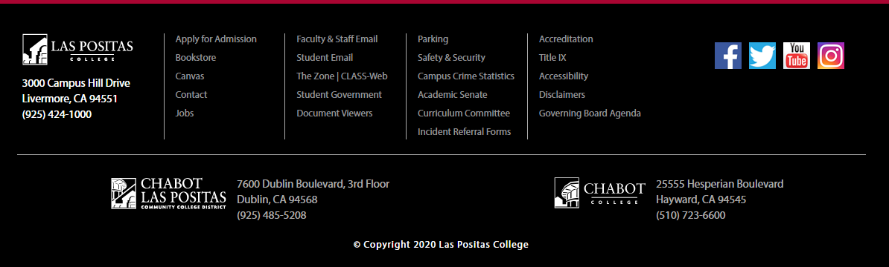
Online Forms
Las Positas College – Homepage
www.laspositascollege.edu

Slide 16

CLPCCD
Policies & Procedures
Chabot-Las Positas Community College District
Board Policies and Administrative Procedures
CLPCCD BP & AP 3540
Sexual and Other Assaults On Campus
CLPCCD BP & AP 5500
Standards of Student Conduct
CLPCCD BP & AP 5530
Student Rights and Grievances

Slide 17
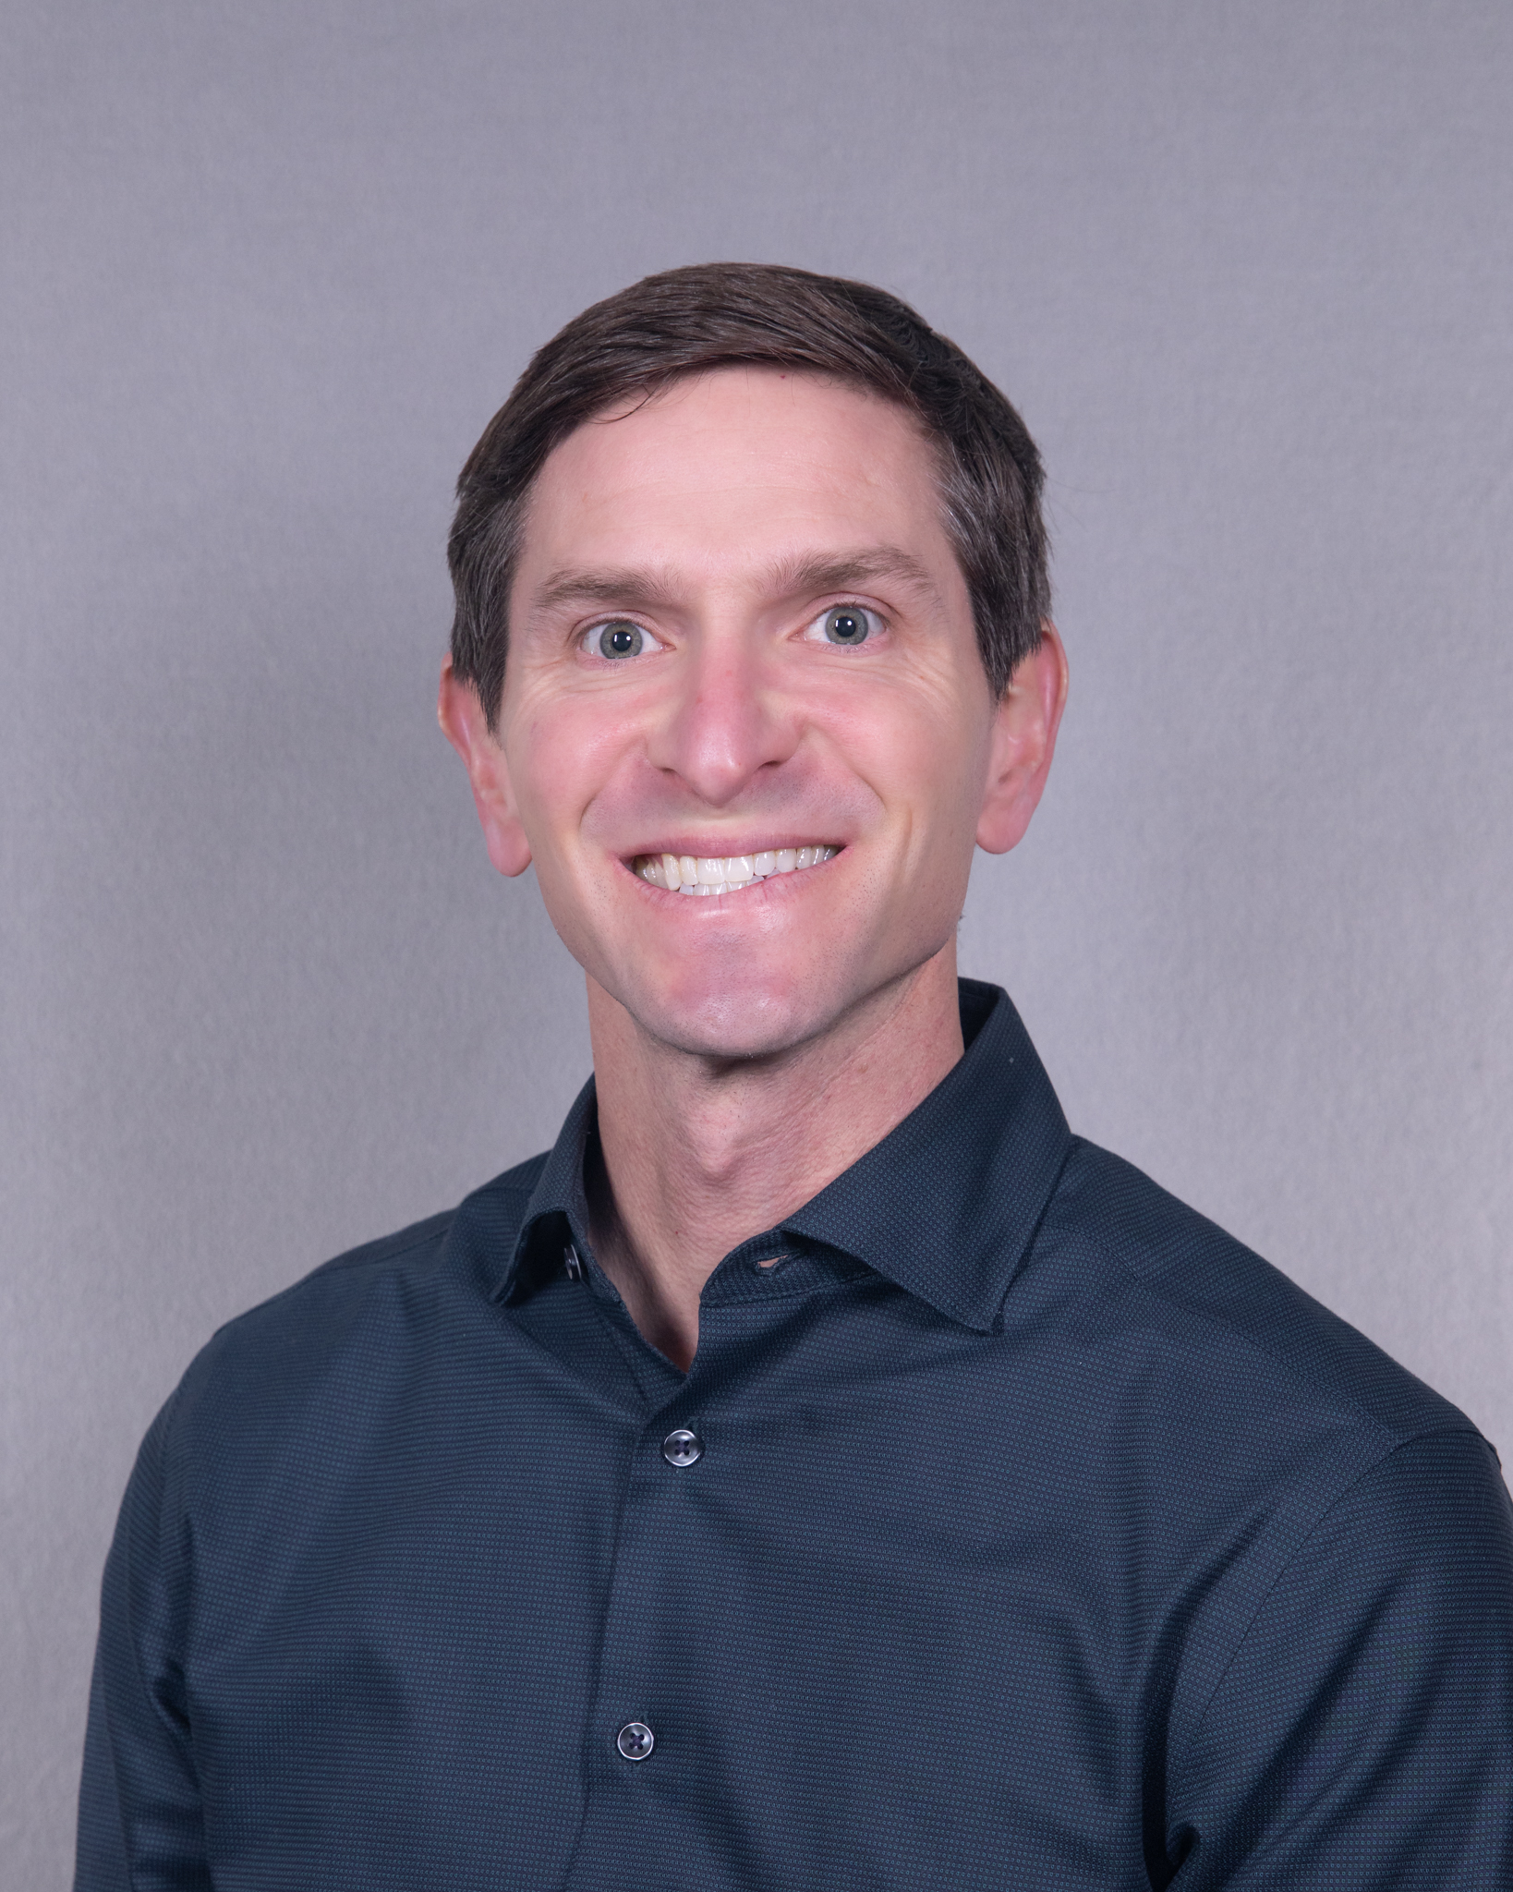
Questions
Not sure what to do?
Contact the Office of the Dean of Student Services
Joel Gagnon, Dean of Student Services
jgagnon@laspositascollege.edu
(925) 424-1420

Slide 18

Thank you for your cooperation and for your support.
Amy Mattern – Dean of Arts & Humanities
Joel Gagnon – Dean of Student Services

