Slide 1
Student Incident
Referrals and Reports

Slide 2

Referral and Reporting System
Incident Referral Form –
LPC uses a software program (Maxient) to record and track :
  Academic Integrity
  Student Discipline
  Student Grievance
  Student Mental Health, and
  Student Title IX
Employees and students can submit reports online

Slide 3

Types of Student Incident
Referrals and Reports
Five types of referrals and reports:
  Academic Integrity – Cheating or plagiarism
  Student Discipline – Disruptive behavior or Conduct Violations
  Student Grievance – Complaints involving students rights
  Student Mental Health – Students needing support
  Student Title IX – Sexual harassment or misconduct

Slide 4
Academic Integrity
From the College Catalog (p.34):
  Academic dishonesty, whether cheating or plagiarism, undermines the value of grades for the entire student body and the College as a whole….
  For these reasons, the College does not tolerate any form of academic dishonesty…
  The actions taken against the student will be permanently entered into the student's educational record in the case of repeated, flagrant, or serious incidents.
Please use the LPC Academic Integrity Incident Referral Form

Slide 5
Academic Integrity
Getting ahead of academic dishonesty:
Clearly stated policy in your syllabus, including use of AI
Discuss integrity expectations with your class
  What that means in your discipline (e.g. art vs. math vs. English)
Consider AI (LPC Faculty AI Resource Page)
When you suspect a violation:
Notify student of the suspected violation
Speak with the student directly
Violation confirmed? Determine next steps
  (e.g. allowing re-do or not, warning, reporting)
Subsequent Violations:
Increased sanction severity
Submit additional report
Recommend drop from class or suspension

Slide 6

Academic Integrity
Include in your report:
Student information
Type of violation
  e.g. Cheating, plagiarism, forgery
Incident descriptions
Students response
  Acknowledged vs denied
  Preferably not “unaware of violation”
Action taken
Requested college action
Supporting documentation
  Plagiarized assignment, communication with student, etc.

Slide 7

Academic Integrity
College Response
  Dear Faculty:
  Thank you for submitting this incident report. We’ll be investigating this case and processing it at an institutional level, which considers any prior or co-occurring violation. I encourage you to hold the student to full account at the course level as well. I’ll reach out if I need additional information.
  Sincerely, Joel
Course level consequences = Faculty
College leave review / sanctions = Dean
  First violations vs Repeated violations

Slide 8

Student Discipline
Addressing Disruptive Behavior
Low level (eating in class, profanity, cell phone use)
High Level (threatening behavior, outbursts)
  Crisis? Call Campus Safety (925) 424-1699
Procedures for formal hearing
Sanctions
  Warning, Suspension, Expulsion

Slide 9
Handling Misconduct
FIRST INCIDENT
Asks the student to stop
  Serious misconduct, you may remove a student at any point.
SECOND INCIDENT
Issues verbal AND written warning
  Consult your Division Dean
THIRD INCIDENT
Remove student for the remainder of class, and the next session
To report student discipline, please use the LPC Student Discipline Incident Referral Form

Slide 10

Student Grievance
Student only process/form
Grievances may be against another student or an employee
Students have the right to learn and participate
Prioritize lowest level resolution
Grievance encouraged when a student reasonably believes a college action has adversely affected their rights as a student.

Slide 11

Student Grievance
Course Grades:
  Grades are determined by the instructor.
  Determination of the student’s grade by the instructor, in the absence of mistake, fraud, bad faith, or incompetency, shall be final.
Exemptions:
  The following are not grievable:
  Standards of student conduct
  Sexual misconduct
  Financial aid actions
  Parking tickets

Slide 12

Student Grievance
Informal Resolution –
Students should first attempt to resolve concerns with the individual involved, their supervisor, or college administration.
Unresolved?
Students use the LPC Student Grievance Form
What if a student files a grievance against you?

Slide 13
Student Mental Health
Please refer students who may be experiencing or expressing distress.
Steps to take:
Talk with student privately or confidentially
Express concern
Share Health Center / Mental Health resources
Consult BIRT Team member if need be
Submit a mental health referral
Emergency? , please call 911 (fire, paramedics, or police).
Use the LPC Student Mental Health Incident Referral Form

Slide 14

Student Title IX
All college employees are mandatory reporters which requires them to report all allegations or knowledge of sexual misconduct that involves students.
Reportable offenses include:
Sexual harassment
Sexual misconduct
Stalking
Dating violence
Discrimination based on sex /
sexual orientation
To report a student Title IX violation,
please use the LPC Student Title IX Incident Referral Form
Joel Gagnon
Title IX Coordinator

Slide 15
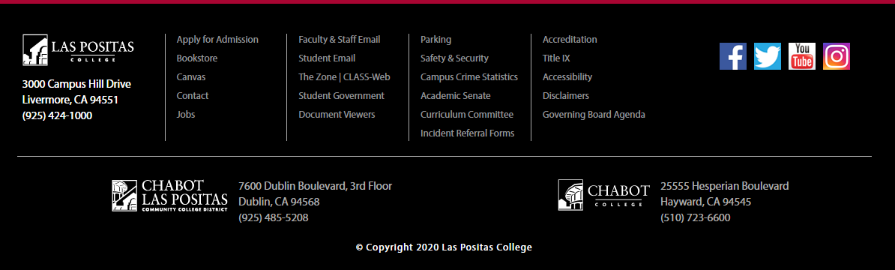
Online Forms
Las Positas College – Homepage
www.laspositascollege.edu

Slide 16

CLPCCD
Policies & Procedures
Chabot-Las Positas Community College District
Board Policies and Administrative Procedures
CLPCCD BP & AP 3540
Sexual and Other Assaults On Campus
CLPCCD BP & AP 5500
Standards of Student Conduct
CLPCCD BP & AP 5530
Student Rights and Grievances

Slide 17
Questions
Not sure what to do?
Contact the Vice President of Student Services
Joel Gagnon, IVP of Student Services
jgagnon@laspositascollege.edu
(925) 424-1405

Slide 18

Thank you for your cooperation and for your support.
Amy Mattern – Dean of Arts & Humanities

