Slide 1

Testimonials from 2014 Presentation

Slide 2
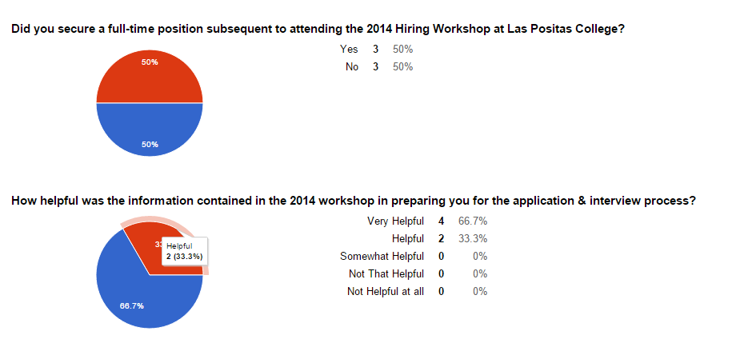

Slide 3
Testimonials
“At the time I attended, I was in the process of finishing my Master's degree. Since that time I have secured an Adjunct Counseling position, and am now ready to prpep myself to apply for full time positions. I think that the information that you are presenting is very helpful.”

Slide 4
Testimonials
“But the reason I wouldn't attend another [workshop] is because I plan to hold on to my full time job. :)”

Slide 5
Testimonials
“My ‘maybe’ in the previous question [on the survey] is because I've already secured a full time job. I might be willing to return for another one to help give some advice.”

Slide 6
Testimonials
“Thank you for this workshop and please keep offering this to part time instructors seeking for full time employment.”

Slide 7
Advice from 2014 Attendees
“Put a lot of thought into your teaching demonstration and practice until comfortable. If you make it to the second round research the president and the other administrators you will be interviewing with. Think about how your experience and strengths will help the college move forward in the direction it is heading.”

Slide 8
Advice from 2014 Attendees
“You have to love what you do as a teacher. This will show during your interview and the other instructors at your current job will take notice of this too. I think part of the reason I got hired is that I was able to build a good reputation as a part time instructor.”

Slide 9
Advice from 2014 Attendees
“They want a good colleague too, be yourself. Relax. Enjoy yourself.”

