Slide 1
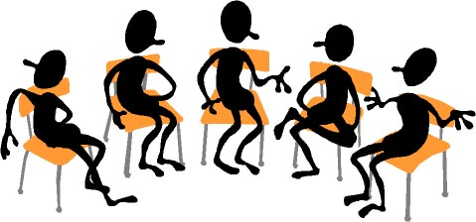

Working Together: Education in a Post-Election Culture
FLEX Day – February 21, 2017
10:00 AM – 11:50 AM
Room 2470
Organized by Howard Blumenfeld, Steve Chiolis,
Marty Nash, and Marsha Vernoga with special guests Elena Cole and Frances Hui

Slide 2
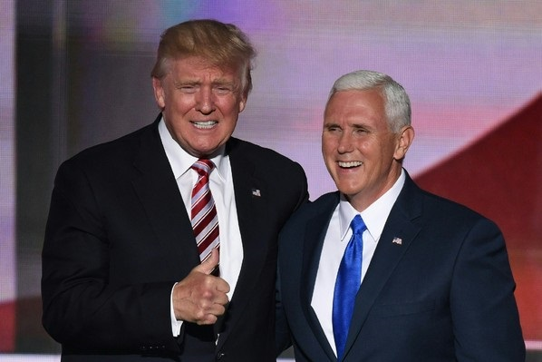
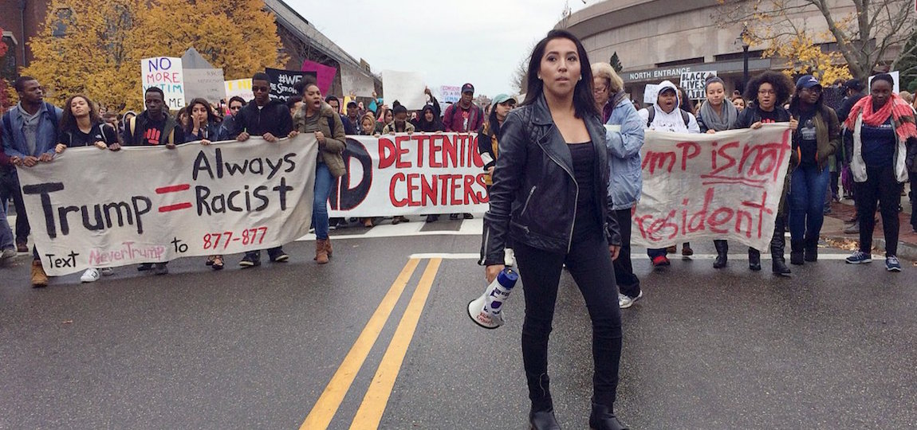
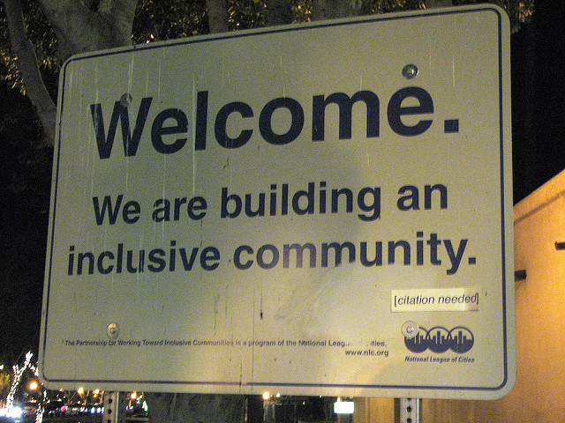

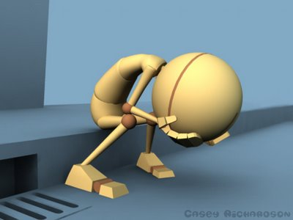


Slide 3

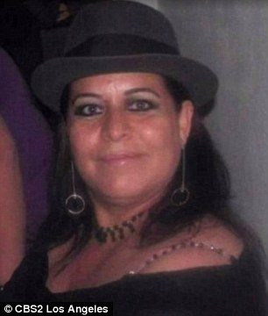
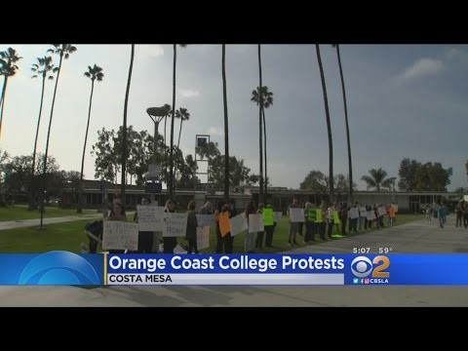
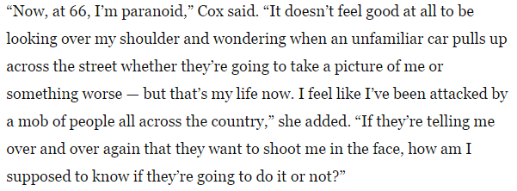
The New McCarthyism
An Orange Coast Community College Professor, Olga Perez Stable Cox, was secretly video-recorded by a student while she was lecturing about calling the Trump Election “an act of terrorism.” Ever since that incident, she has received numerous death threats and harassing communications making her the victim of terrorism in an ironic twist of fate.

Slide 4
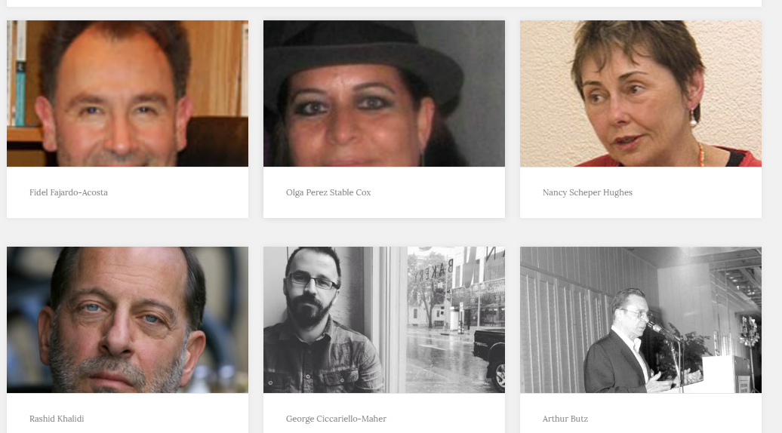


The Professor Watchlist
A “Professor Watchlist” was created to alert students to college faculty who purportedly profess a “radical agenda” in their lectures, blogs, or other forms of communication.

Slide 5

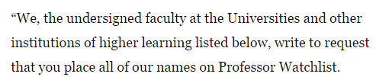
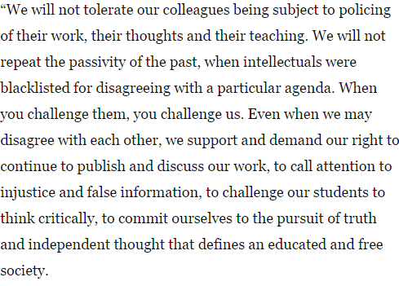
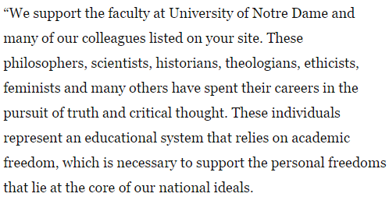
The Professor Watchlist

Slide 6
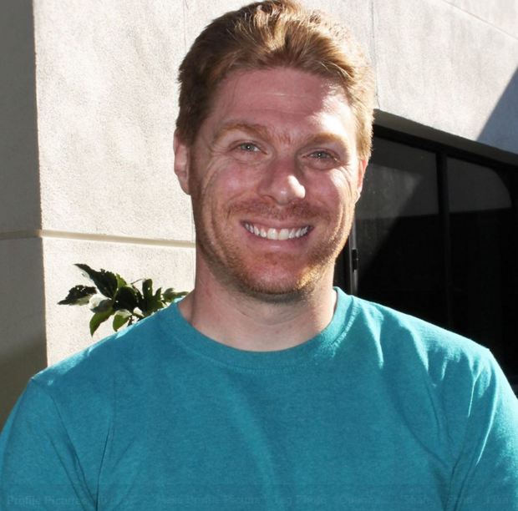

Hated in the Classroom
(Howard Blumenfeld)
“Hated in the Nation” is from Season 3, Episode 6 of the Netflix Original Series “Black Mirror.” This episode focuses on a hacker who hacked into ADI (drone) honeybees and programmed them to go after and kill the most hated person in England each day (determined by the greatest number of #DeathTo hashtags given each day to a hated individual from the country).

Slide 7
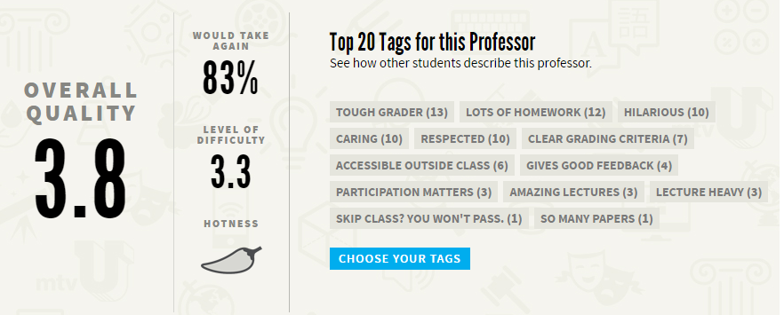
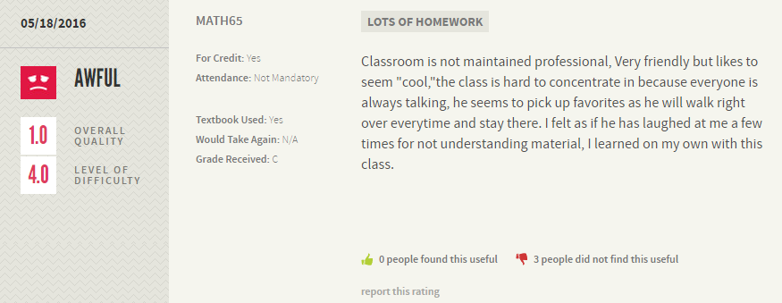


Hated in the Classroom
(Howard Blumenfeld)
Teacher turned reality star (nope, not me!)
Anything written here is a matter of public record
Fear of a Professor Watchlist
Is social media a friend or an enemy?
The quest for a red hot chili pepper

Slide 8
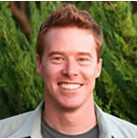
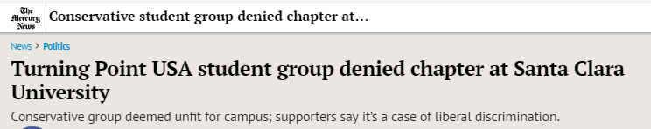
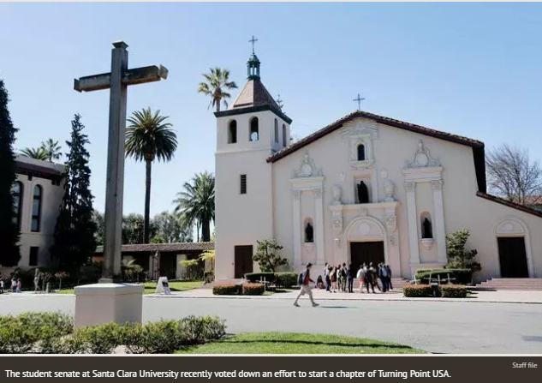
Free Speech vs. Hate Speech (Marty Nash)
A chapter of Turning Point USA was denied official recognition by student leaders at SCU, which resulted in a heated debate over their rights to free speech.
Known for bringing alt-right figure Milo Yiannopolous to campuses.
Turning Point’s stated mission is to “identify, educate, train, and organize students to promote the principles of fiscal responsibility, free markets, and limited government.”

Slide 9
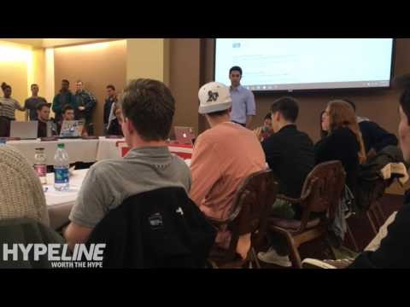
Free Speech vs. Hate Speech (Marty Nash)

Slide 10
If not here, then where?
Avoiding Conflict: I don't want to offend anyone...
"I want to teach English, but I'm afraid I won't be taken seriously, or even get hired."
Missed opportunity
Would I handle it differently now?

Slide 11
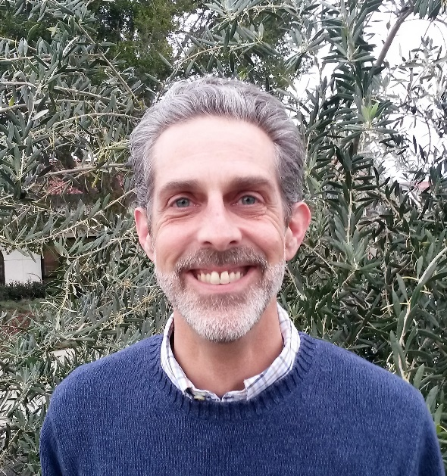

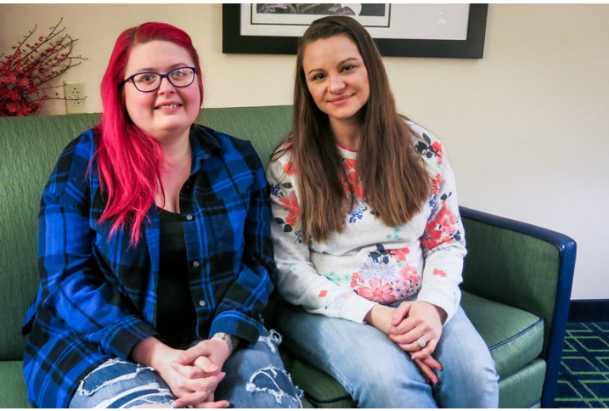


What is
Inclusion for? (Steve Chiolis)

Slide 12
What is Inclusion for? (Steve Chiolis)
The Explosive Student
Inclusion: Means and Ends
Relevant vs. Irrelevant Inclusion?
Safe spaces vs. Comfort zones
What to do with the energy after the explosion?

Slide 13
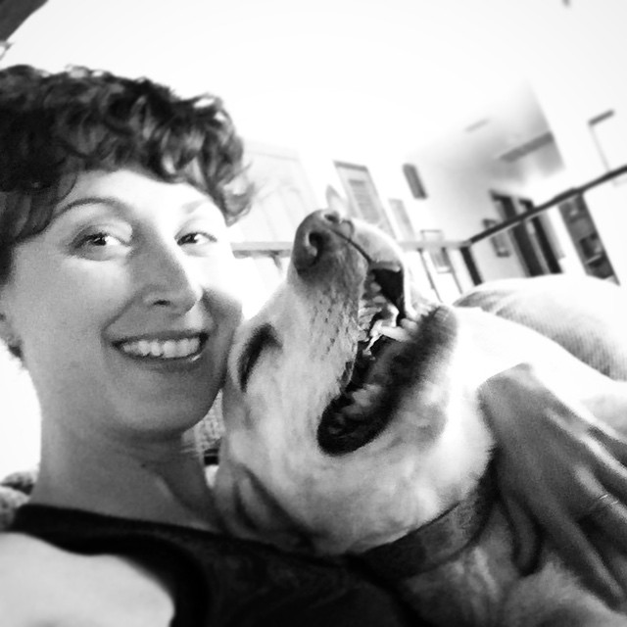
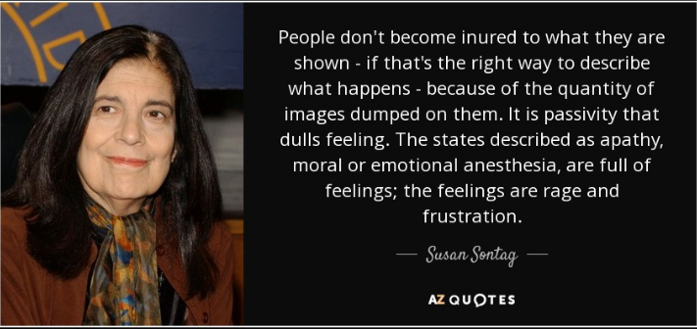
Apathy into Empathy
(Marsha Vernoga)

Slide 14
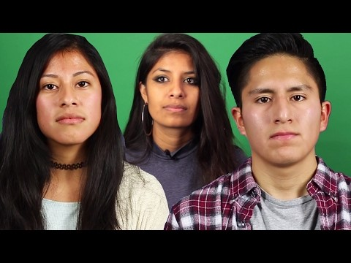
Apathy into Empathy
(Marsha Vernoga)

Slide 15
Apathy into Empathy
(Marsha Vernoga)
I stand for compassion. Will you stand with me?
Is it possible to turn apathy into empathy?
So, I question...Are these conversations helping or hindering the issues at heart?

Slide 16
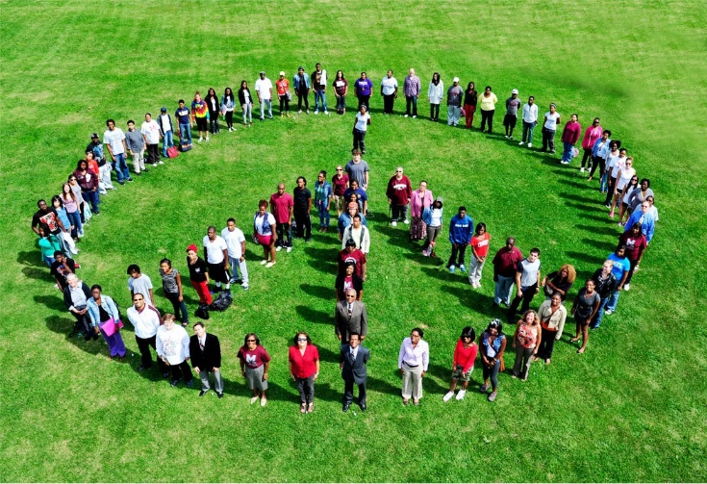

Small Group Breakout Sessions
Group breakout session facilitators:
  Marty Nash & Howard Blumenfeld
  Marsha Vernoga & Steve Chiolis
  Elena Cole & Frances Hui

Slide 17

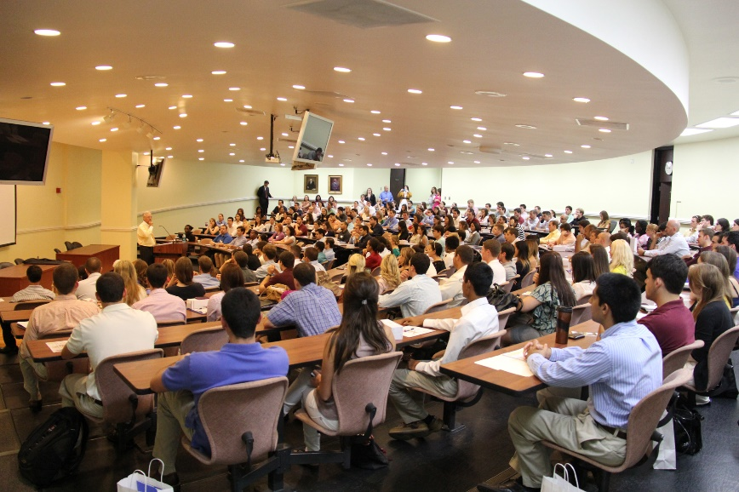
Questions to answer in groups
  Was there Post-Election conversation in your classroom? How did you handle it?
  How do students know they are truly in an inclusive classroom?
  How do Faculty and Staff know they are truly in an inclusive institution?

Slide 18


Large Group Reflections
  Discuss what you learned in your
  small group discussion and what
  you can take away with you for
  future reference or use in your
  professional or personal life.

Slide 19

Where do we go from here?
Can join “secret” Facebook group
by invitation (send Howard an email (hblumenfeld@laspositascollege.edu) if you would like to be added to the group).
The Teaching Institute (Elena)
Campus Change Network (CCN) (Elena)

Slide 20
Future “Working Together” Topics
You can find out more about future “Working Together” topics by visiting our website at http://www.laspositascollege.edu/staffdevelopment/workingtogether.php#Meetings
ASCCC Conference on March 17
Hand out surveys

