Slide 1
Working Together March 2016 Meeting
Howard Blumenfeld, Marsha Vernoga, Steve Chiolis

Slide 2
Reflections from FLEX Day Activity
Let’s hear from each of us individually about our small group experiences as well as the overall impression of our FLEX Day activity.
I will hand back posterboards to each of you to assist you in describing your experiences.

Slide 3
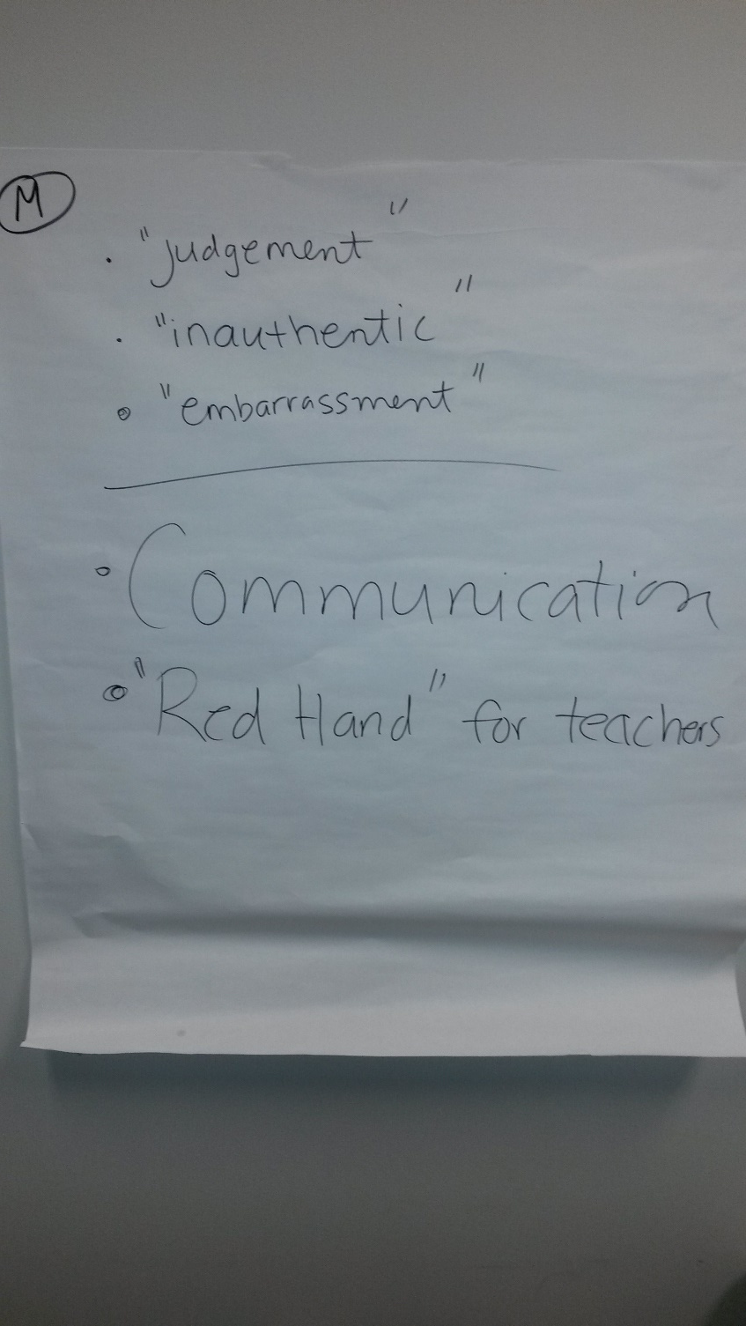
Future Topics for Discussion
Notes:
Red hand for teachers – faculty could go to anothers’ office and discuss issues with confidentiality.

Slide 4
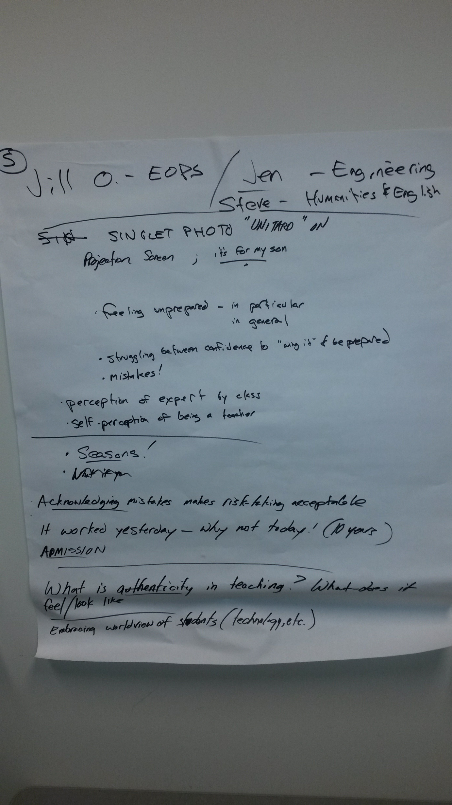
Future Topics for Discussion
Notes:
Feeling unprepared, feeling vulernable bc of perception by students, burden of being seen as the expert, self-perception, making mistakes, noticing seasons in teaching (fluctuations in energy levels), acknowledging mistakes makes risk taking acceptable, embracing worldview of students

Slide 5
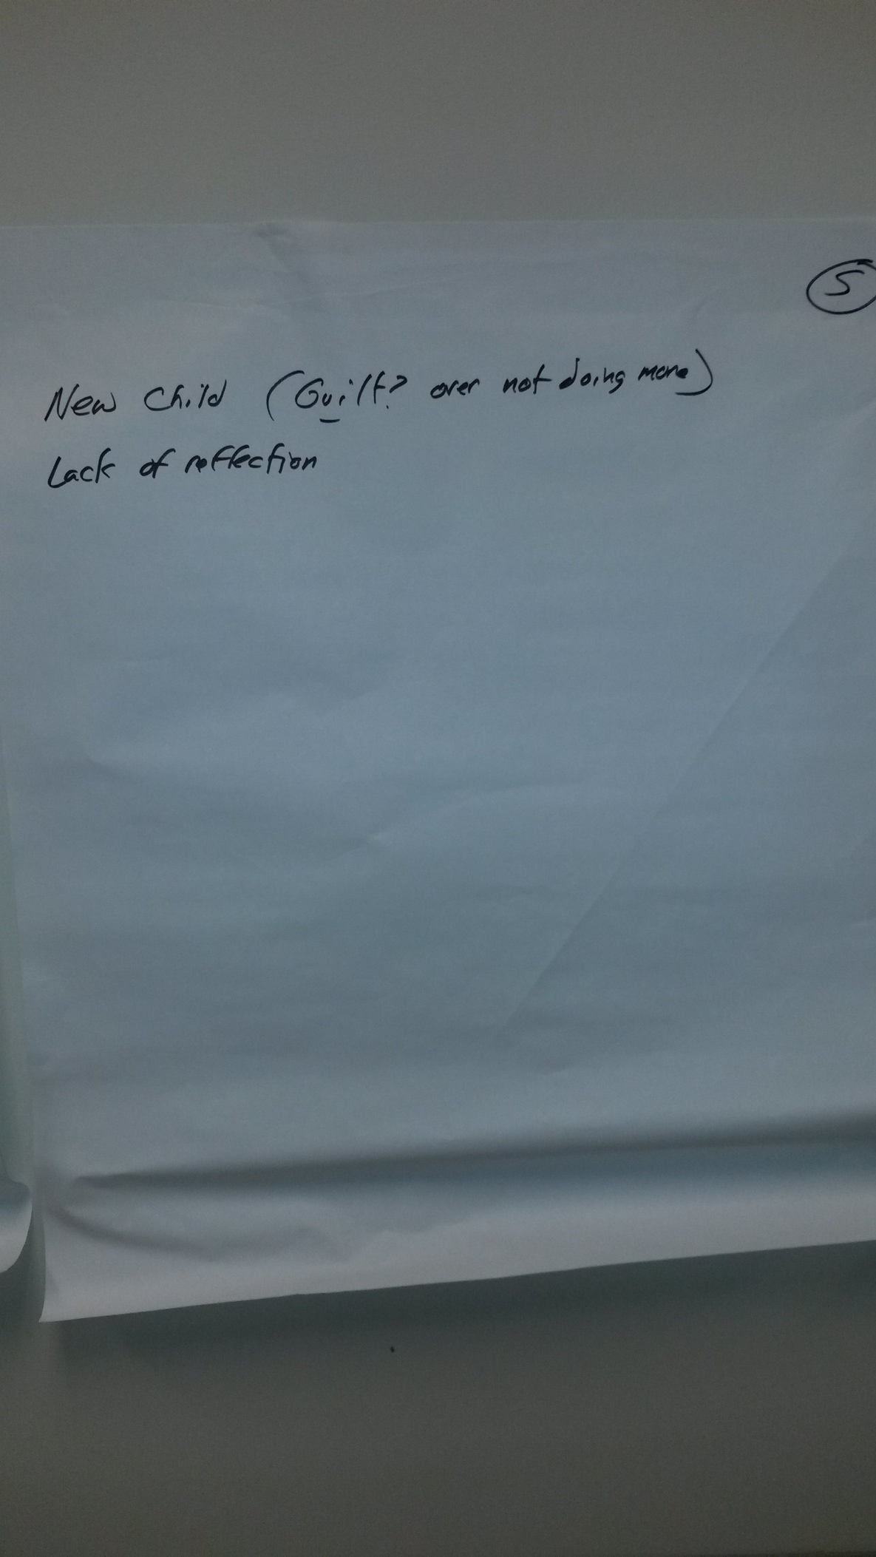
Future Topics for Discussion
Notes:
Work/life balance (guilt of not doing more), no chance to reflect

Slide 6
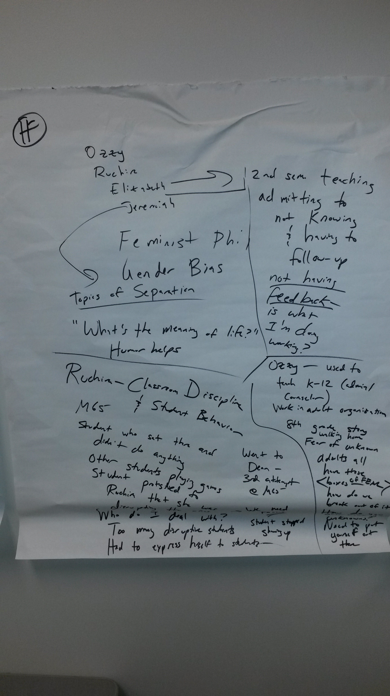
Future Topics for Discussion
Notes:
Difficulty teaching contentious classes (humor helps), not having regular & consistent feedback, disruptive students, boxes of fear

Slide 7
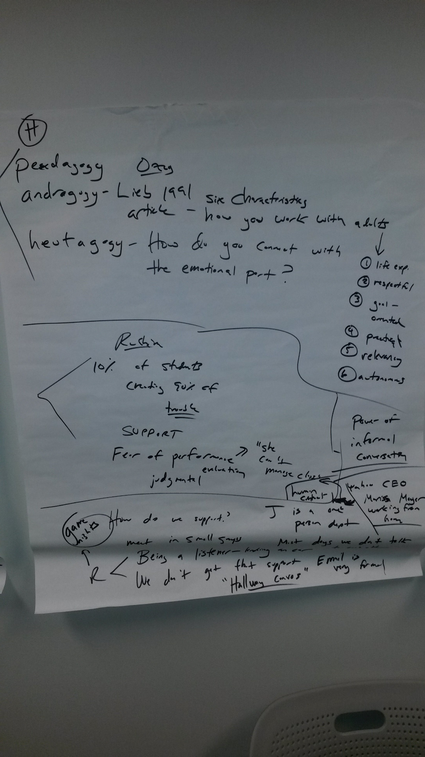
Future Topics for Discussion

Slide 8
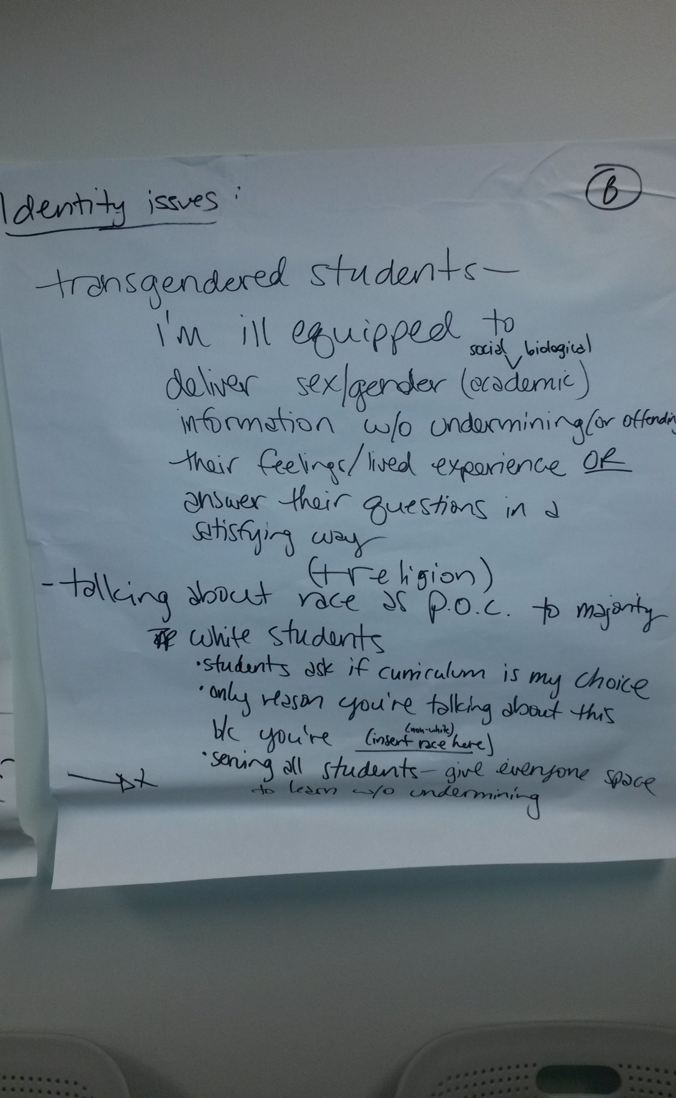
Future Topics for Discussion
Notes:
Diversity issues

Slide 9
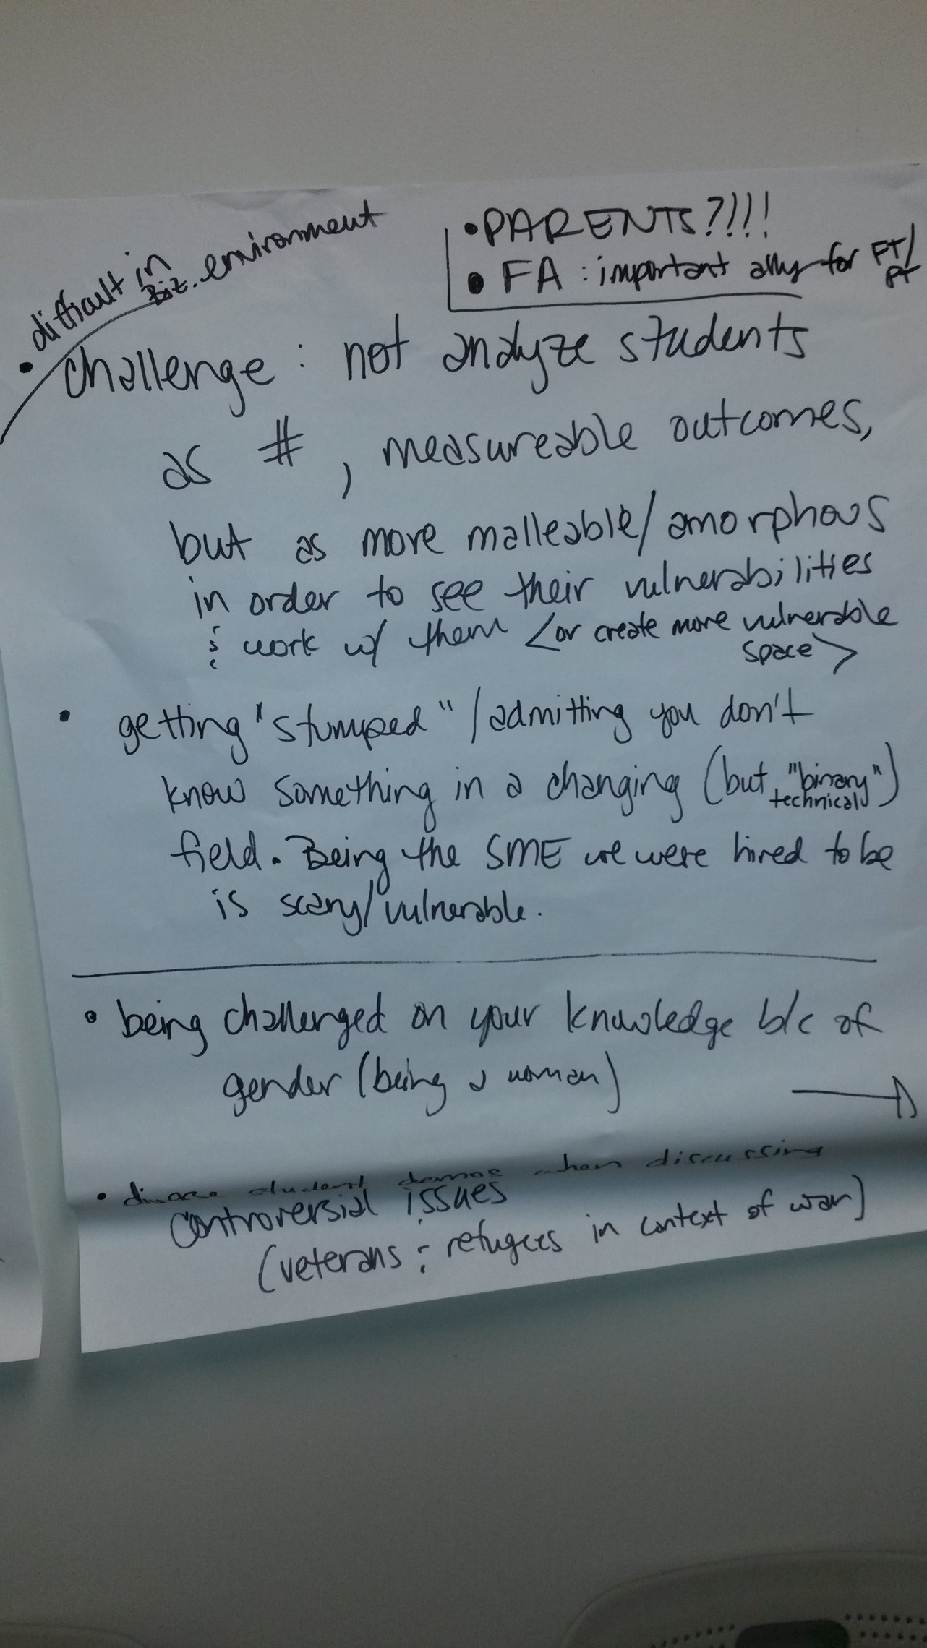
Future Topics for Discussion
Notes:
Being challenged on your knowledge bc of gender/race/etc.

Slide 10
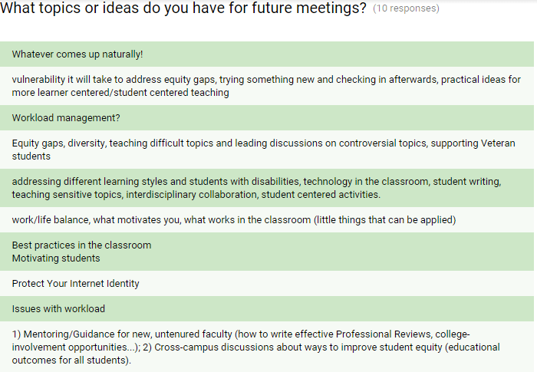
Future Topics for Discussion (Survey)
Notes:
Work-life balance, teaching feedback and growth (inc. diversity, technology, etc.)

Slide 11
Small Groups
We need to look over the survey data and break ourselves into three small groups based on times.
I have tentatively broken down the groups for us, but we can change them as we see fit.

Slide 12
Howard’s Group
Based on Thursday availability
  Jennifer Decker (jdecker@laspositascollege.edu)
  Nadiyah Taylor
  (ntaylor@laspositascollege.edu)
  Frances Hui (fhui@laspositascollege.edu)
  Michelle Zapata (mzapata@laspositascollege.edu)
  Amanda Ingold (aingold@laspositascollege.edu)
  Saleem Admassu (salemadmassu@gmail.com)

Slide 13
Steve’s Group
Based on Monday afternoon availability
  Katie Eagan (ceagan@laspositascollege.edu)
  Melissa Korber (mkorber@laspositascollege.edu)
  Mark Tarte (mtarte@laspositascollege.edu)
  Kristi Vanderhoof (kvanderhoof@laspositascollege.edu)
  Candy Klaschus (cklaschus@laspositascollege.edu)
  Elizabeth Owens (eowens@laspositascollege.edu)

Slide 14
Marsha’s Group
Based on Wednesday afternoon availability
  Patricia Stokke
  (pstokke@laspositascollege.edu)
  Seth Lavender
  (slavender@laspositascollege.edu)
  Antonella Vitale (antvitale74@gmail.com)
  Marty Nash (mnash@laspositascollege.edu)
  Willy Kwong (wkwong@laspositascollege.edu)
  Moh Daoud (mdaoud@laspositascollege.edu)

Slide 15
People interested in being organizers
  Yes: Patricia Stokke, Antonella Vitale, Marty Nash
  Maybe: Katie Eagen, Willy Kwong, Kristi Vanderhoof, Mark Tarte, Moh Daoud, Saleem Admassu, Michelle Zapata

Slide 16
Our First Small Group Meeting
Should we look over the group members’ individual surveys and select a topic from the survey to start off our conversation?
First small group meeting ideally before Spring Break (week of 3/21-3/25)
Reconvene for moderator discussion on Friday, April 15 from 3-4:30 PM in TLC?
First topic to discuss: Work/life balance& personal life/professional life sharing balance

Slide 17
Our First Small Group Meeting
Send out email to entire campus with three meeting times.
Howard, Thursday, March 24 (2pm, Study Room F)
Marsha, Wednesday, March 23 (2:30pm, Study Room F)
Steve, Monday, March 21 (2:30pm, Study Room F)

