Slide 1
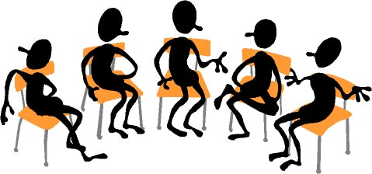

Working Together: Sensitive Situations
FLEX Day – September 27, 2016
1:30 PM – 3:20 PM
Room 2470
Organized by Howard Blumenfeld, Steve Chiolis,
Marty Nash, and Marsha Vernoga

Slide 2
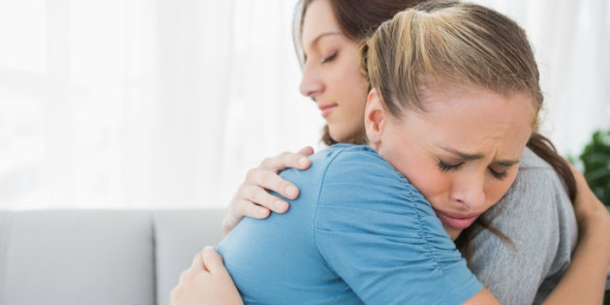
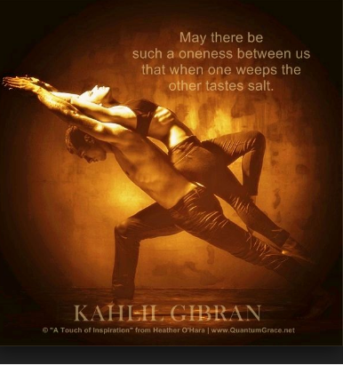
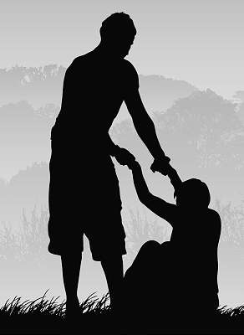
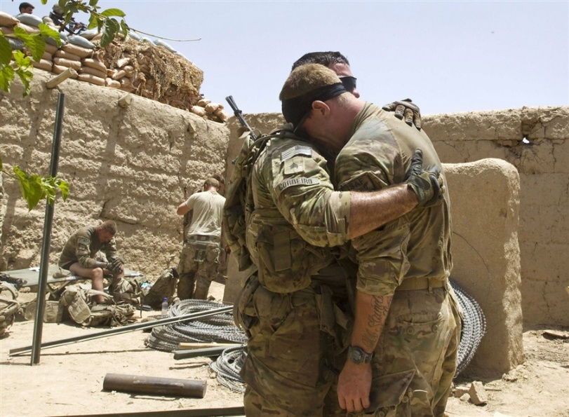

Slide 3


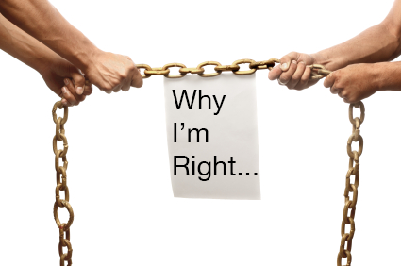
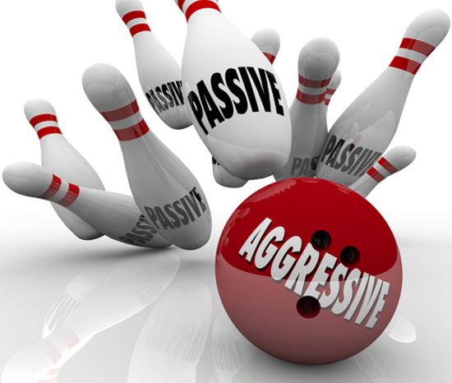
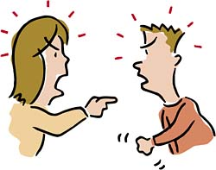
Our Own Sensitive Situations
Notes:
This is where each of us will tell our 3-4 minute anecdote. If you wish to include additional slides with your anecdote, you may do so here, or you can just send them to me and I will insert them into the presentation.

Slide 4
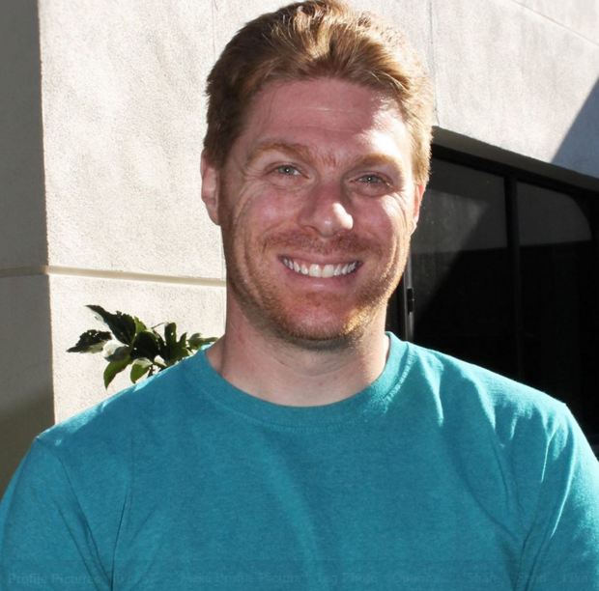
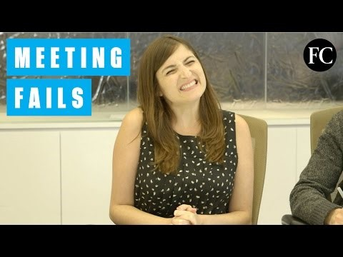
The Math Department Roundtable (Howard Blumenfeld)

Slide 5

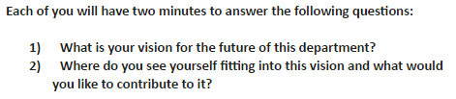
The Math Department Roundtable (Howard Blumenfeld)
Meetings, meetings, meetings
Arguments and hurt feelings
The silent ones
Everyone must have a voice

Slide 6
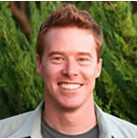

The Power of the Anecdote: A Student in Need (Marty Nash)

Slide 7
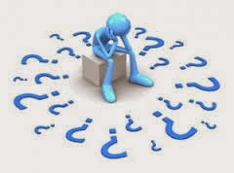
The Power of the Anecdote: A Student in Need (Marty Nash)
The unexpected: "I have no expertise in this."
Do something, now: How an anecdote gave direction
A simple conversation and story
The follow-up: Little things make a difference

Slide 8
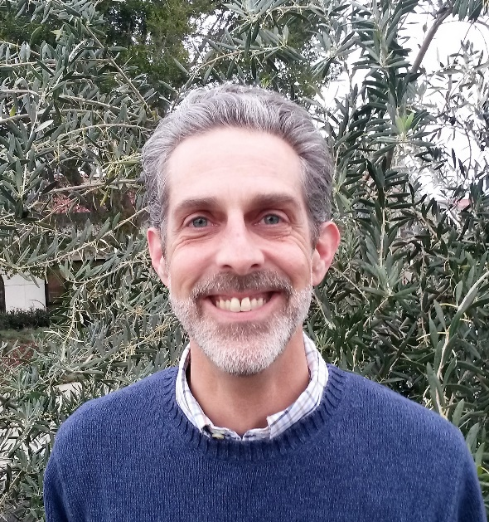

The Psychic Sounds of Silence: Why Must We Always Be Talking?

Slide 9

The Psychic Sounds of Silence: Why Must We Always Be Talking?
Silence Is Not an Educational Abyss
A Space for Speech and Silence
Staying in the Sensitive Space & Welcoming Silence
Misinterpreting Silence
"Silence gives us a chance to reflect on what we have said and heard, and silence itself can be a sort of speech, emerging from the deepest parts of ourselves, of others,of the world"
--Parker J.Palmer, The Courage to Teach (77).

Slide 10
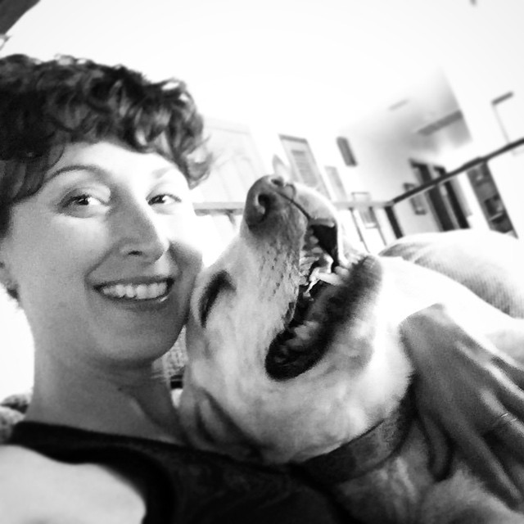
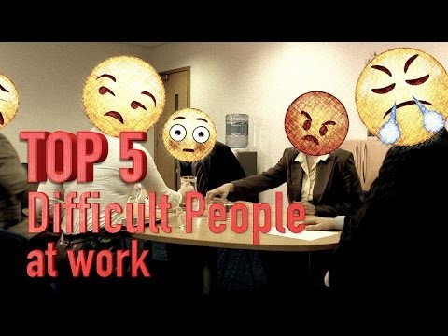
Dealing with Difficult People

Slide 11


Taking the Bull by the Horns.
Unrequited request
How can someone avoid so much?
Lesson: I create my own angst and suffering. Learning to react.

Slide 12
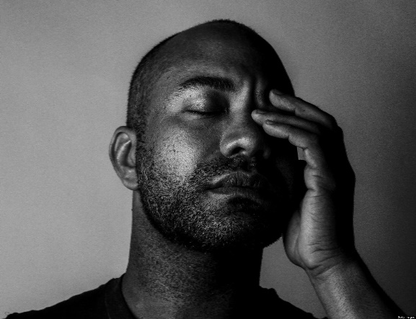
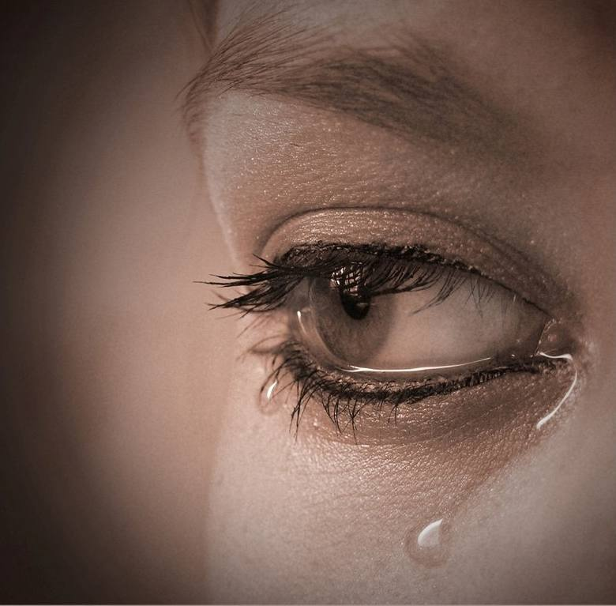
Your Sensitive Situations
Group breakout session facilitators:
  Marty Nash & Marsha Vernoga
  Howard Blumenfeld & Steve Chiolis

Slide 13
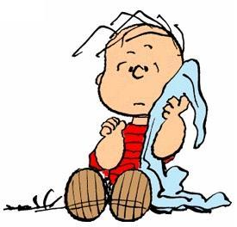
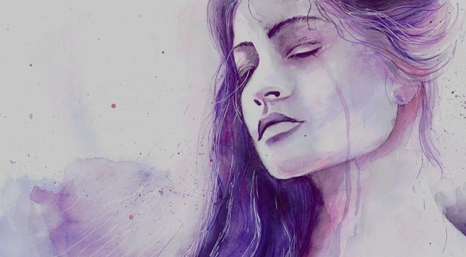
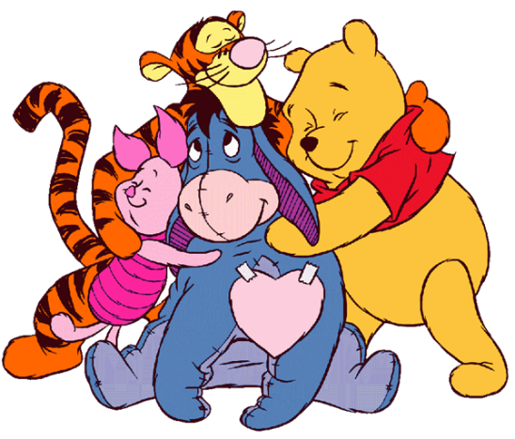
Questions to answer in groups
  What is one of your most personally frustrating experiences you have had to deal with in this profession?
  Describe your experience teaching a sensitive topic or leading a sensitive discussion in the classroom.
  How can we best support our colleagues who are going through their own sensitive situations?

Slide 14


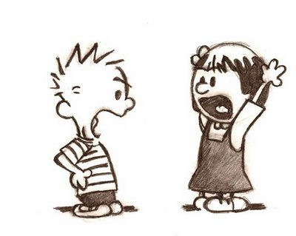

Other Sensitive Situations
We are going to show four video clips. Can you relate?

Slide 15
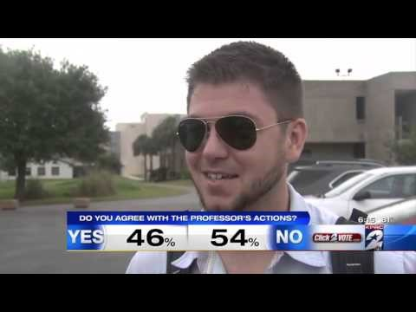
Grading Controversies

Slide 16
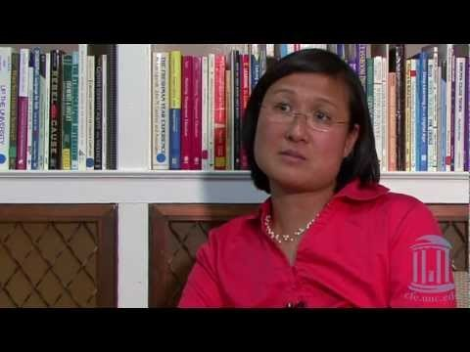
Teaching Controversial Topics

Slide 17
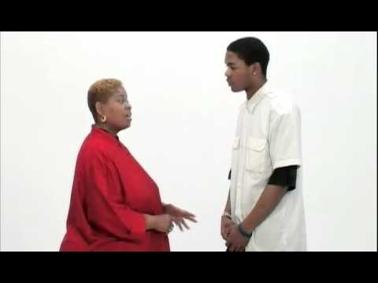
Dealing with Disruptive Students

Slide 18
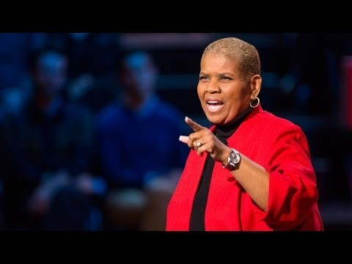
Every kid needs a champion

Slide 19


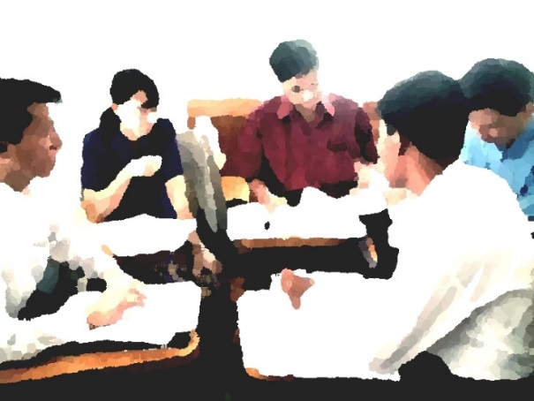
Pair Share
What video did you resonate most with and why? What video surprised you the most?
How did you feel about the information presented in the videos?
How may these videos be applicable to your life either personally or professionally?

Slide 20

Where do we go from here?
Monthly small group conversations or campus activities
Next “Working Together” conversations will be held on Monday, October 24 (3:30-5) and Wednesday, October 26 (2:30-4)
Details will be emailed out to the campus

