Slide 1
Tuberculosis (TB) Testing and Health Insurance
New International Student Orientation Spring 2018

Slide 2
Tuberculosis (TB) Requirement
All International students must show proof that they are free of active Tuberculosis.
Must be submitted to ISP by Wednesday, January 31, 2018.

Slide 3
What is Tuberculosis (TB) ?
Tuberculosis (TB) is an infectious disease that usually infects the lungs, but can attack almost any part of the body.
Tuberculosis is spread from person to person through the air.

Slide 4
Tuberculosis (TB)
Highly contagious!
TB can be fatal!
Can be treated and cured with medicine
Active vs. Latent

Slide 5
TB test vs Vaccine shot
Bacille Calmette Guerin (BCG) shot
TB vaccine
many people living outside of the U.S. receive

Slide 6
TB Tests
Skin Test (Mantoux tuberculin, Purified Protein Derivative (PPD)
Blood Test (Inferon Gamma Release Assay)
  QuantiFERON TB Gold In-Tube test
  Recommended for those who have had BCG
Chest X Ray

Slide 7
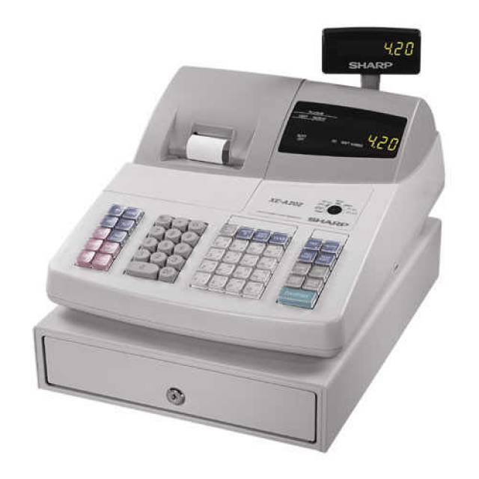
TB Test Costs
Skin Test - FREE
QuantiFERON Blood Test - $56.50
Chest X-Ray - $66.10 + $37 (reading)

Slide 8

TB Test at Student Health Center
Complete a question and answer screening form.
Students with identifiable risk will be tested.
Countries visited is one identifiable risk factor.
Tested by Nurse Practitioner (NP) – Ms. Dayna Barbero

Slide 9
Skin TB Test
Skin Test is FREE
Make an appointment at the Student Health and Wellness Center (Building # 1700).
2 appointments necessary (with one day in between)
1st appointment for injection, 2nd for “reading”

Slide 10
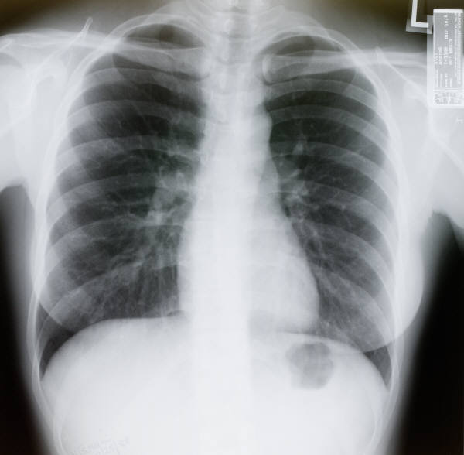

TB Chest X-ray
Positive Skin test = exposure
Chest X-ray necessary
Valley Care Hospital
(555 West Las Positas Blvd, Pleasanton)

Slide 11
TB Test Result
Bring copy of TB test result (Skin test or Chest X-ray test) to the ISP Office in Building #1600 by January 31, 2018.

Slide 12

Health Insurance

Slide 13
Health Insurance Requirements
Continuous Health Insurance coverage throughout each semester at LPC
Must be purchased and shown to ISP Office by January 31, 2018
Must include repatriation and medical evacuation

Slide 14
Health Insurance Requirements
Repatriation
  The return of your bodily remains or ashes in case of death to your home country.
Medical evacuation
  Coverage for a medical condition that warrants immediate transportation to another adequate medical facility.

Slide 15
Why Health Insurance is Important?
Health care in the U.S. is very good, but most expensive in the world
Can not predict a serious illness or accident
Large, unpaid medicals bills will seriously effect your financial status and ability to continue studying
U.S. Government support agencies will not assist with payment

Slide 16

Example Costs
(local averages without insurance)
Hospital Room =
$7,385 per day
Doctor visits =
$163
Emergency Room =
$957
Ambulance =
$2,000
Maternity =
$23,590

Slide 17
Important Definitions
Premium – the amount you pay for insurance each month/term
Deductible – This is the amount of money you have to pay toward a medical bill before the insurance company pays
Co-pay – the specific amount which you must pay to a provider or pharmacy at the time of service
Co-insurance – the amount you pay after you have paid your deductible for any illness or injury. Usually given as a percentage, such as 80%

Slide 18
Important Definitions continued
Exclusions – illness, injuries, or medical conditions that the insurance does not cover.
Provider Network – Doctors, hospitals, and other health care providers who have contracted to provide specific medical care at negotiated prices

Slide 19
Recommended Levels of Coverage
Provides a minimum of $100,000 for each accident and illness
Repatriation of remains of $25,000
Medical evacuation expenses of $50,000
Has a deductible of $500 or less per illness

Slide 20
Insurance Coverage
Comprehensive Health Insurance
Limited Health Insurance

Slide 21
Things to consider when purchasing Health Insurance
Premium and Deductible Costs The higher the deductible, the lower the premium
Co-pay costs
Maximum Benefits
Exclusions
Age-Based Premiums
Provider Network
Prescription Coverage

Slide 22

Insurance Costs
Chabot-Las Positas College
Anthem Blue Cross High HMO - $1,028.34 per month
(Employee pays $85 per month)
+ $62.88 Dental per month
+ $11.71 Vision per month
Discounted Premiums for International Students
Range from $29 to $112 per month for students 24 & under
Estimate $600 per year

Slide 23
Summary of Coverage
Most accidents and injuries
Risky activities, intercollegiate sports, and pre-existing conditions are not covered
Most do not cover preventative care such as routine physical exams, chest x-rays for Tuberculosis (TB) etc

Slide 24
Recommended Plans
Compass
ISO Student Health Insurance
Student Secure
Study USA – Health Care

Slide 25
Non International Student Insurance Providers
Anthem Blue Cross
Blue Shield of California
Kaiser Permanente
Cigna
These carriers do NOT offer medical evacuation or repatriation benefits. Must purchase separately.

Slide 26


Other Insurance
Vision and Dental are only covered by most plans in cases of injury, not treatment or preventative care.
Consider purchasing a supplemental dental and or vision discount plan.

Slide 27
What if I am sick or injured?
For Life Threatening Emergencies - call 911 or visit nearest Emergency Room (ER)
Urgent Care
Normal Medical Problem
Visit LPC Student Health Center in Building #1700 or nearest doctor

Slide 28
What to bring to doctor?
Insurance Card
Student ID Card
Bilingual Dictionary
Credit Card
Any other Medical Records

Slide 29
Questions?
Come to ISP for help:
  on purchasing a plan,
  finding appropriate resources, or
  in completing claim forms.
Stay safe and healthy!

Slide 30

Affordable Care Act (ACA) “Obamacare”

Slide 31
Key ACA Benefits
No lifetime limits on coverage
Preventative Care included
No limits on pre-existing conditions

