Slide 1
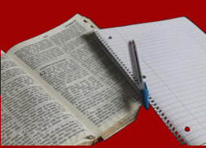
Critical Reading/Writing
English 7
Instructor Name
Las Positas College

