Slide 2
Imagine No Line
Black Art in the Hour of Chaos
The Social Construction of Social Reality
African American Cultural Construction
A Theory of Reconstruction(s)

Slide 3
Black Steele In the Hour of Chaos (Public Enemy)
The song is about a prison break.
The subject’s objection to war is one of the reasons he’s in prison.
This is a values based, self-determined decision.
The prison/prism that Black Folk find themselves in less external (forces allied against us) and more internal (a reliance on our cultural values to direct our activities).
Historically, we have broken out of the prisons and prisms of slavery and segregation by our cultural beliefs and actions.
Today we are faced with similar prisons/prisms & Black art and culture have the keys to set us free.

Slide 4
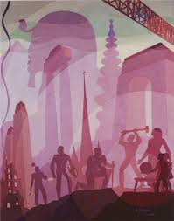
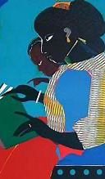
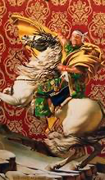

Slide 5
We Are The Dreams of Our Ancestors
What Were Those Dreams?
How Did They Bring Them To Fruition?
What Are Our Dreams?

Slide 6
Those Dreams Did Not Start With Slavery. They Go Back to Antiquity.
Notes:
Constructed in the 26th and 25th centuries B.C. (roughly 2600 B.C.–2400 B.C.), the Egyptian pyramids of Khufu, Khafre and Menkaure, built in that order, are a testament to ancient planning and engineering.

Slide 7
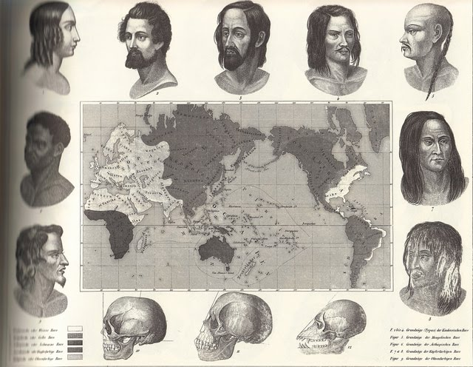
But As American Slavery & Scientific Racism Emerged, Erasing Black History Was A Priority.
THEORY OF OIDS:
3 Races:
Caucusoid,
Mongoloid,
Negroid,
the later being the
lowest and the only
category without a
geographic location.
Notes:
Late 1700s: It is during this period that the scientific community in Europe is creating the “oids” theory – a race theory relying heavily upon craniometry (measurement of the brain and skull) to develop four distinct races.
The archaic science claims that the larger the brain, the higher the intelligence. Those determined to possess the largest brains--and thus the smartest, are the Caucasoids (where our racial designation of Caucasian comes from).
Next are the Mongoloids (people described by the antiquated science as “yellow” people and those of Asian descent), then Australoid (signifying “red or brown” people), and Negroid, the lowest and the only category without a geographic location.

Slide 8
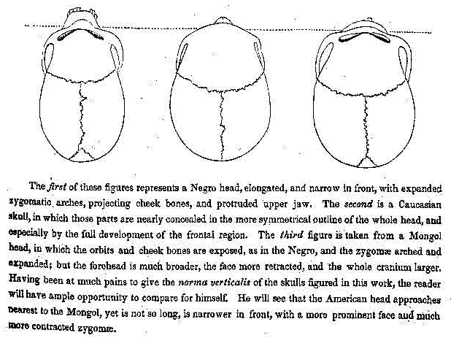
1830s
This.
Is
The
Hour
of
Chaos.
Notes:
1830s: Slavery advocates turn to archaic scientific and biblical arguments in attempts to “prove” that Negroes are distinct and inferior.
Samuel Morton, the first famous American scientist, possesses the largest skull collection in the world; using the OIDs theories developed in Europe, he claims the larger skulls of Caucasians gives them “decided and unquestioned superiority over all the nations of the earth.”

Slide 9
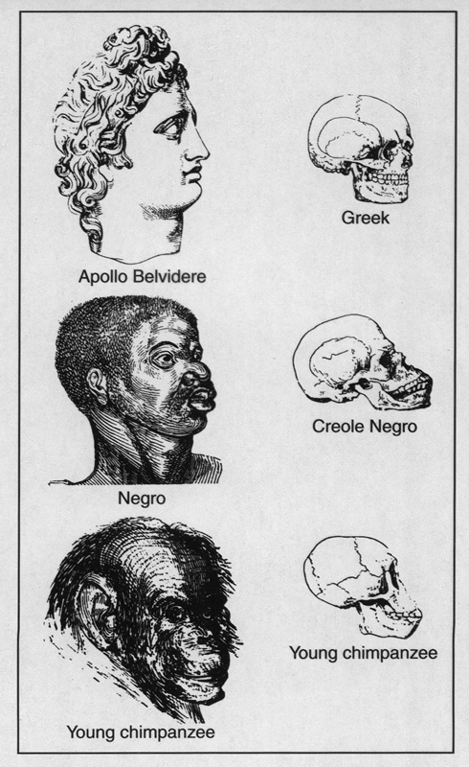
This.
Is
The
Hour
of
Chaos.
1830 - . . .
white
Japanese
Indian
Chinese
Arab
Latino/a
Indigenous
Black
Notes:
The 1830s and moving forward: What we’re seeing is how institutions of government, the courts, farming, industry, even the Church, are constructing race.
The construction places white at the top, Black at the bottom, with other people and communities of color moving up and down based on what’s happening historically.
Regardless, the line is always drawn to place white at the top.

Slide 10
Externalized Ideas Made Into Objects & Internalized
Create Social Realities Through Habitual Use
That We Forget* Were Ideas & Accept As Reality
Imagination Creates & Destroys Slavery

Slide 11
Society Beliefs, Values, Norms Beliefs & Values tell “Norms what to do.” Policies Public Policy, Laws Public Policy & Law Reflect Societal Values. Systems Institutions Institutions codify societal norms & laws.

Slide 12
So, What Is Black Culture? The Social Construction of Blackness
Tunde Adleke – “Slavocentric” – Culture constructed in resistance
Walker & Gilroy: Historiography, The Black Atlantic
Holloway & Asante: Africanisms and Afrocentricity, Negritude
DuBois: Double Consciousness – “Ever-twoness”
T. Coates:
The Black Body
Guiner: Race is a Canary in the Coal Mine, or an indicator not a pathology.
Herskovitz & Frazier : African Culture Survived?
Contemporary Narratives:
Toni Morrison: The Shadow of Whiteness of the ‘White Gaze’ - https://youtu.be/SHHHL31bFPA
bell hooks: On White Supremacy & the Million Man March - https://youtu.be/1ShWJf8BIqI
Kimberle Crenshaw – Intersectionality _ https://youtu.be/akOe5-UsQ2o
Still Black – Black Transmen - https://youtu.be/JAuBtcHDlcA

Slide 13
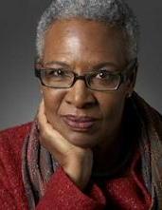
How Did Black Folk Create Black Folk?
Complexity – That African American identity is a complex construction of ideas about Africa and African Americans that have developed and changed over time. That African Americans incorporate multi-racial/ethnic identities, and differences in political, social, and cultural points of view into the overall context of Blackness.
Self-Determination – That self-determination has always been a key element in complexity and self definition. That the enslaved and those who were free made tremendous contributions to America that stand in contradiction to their overall treatment. That social institutions like the church, education, business and politics are arenas where black excellence and the reputation of being “hard working people” stood in opposition to Black stereotypes. That African Americans were not given their freedom, they, in fact, fought for it in large and small ways.
Self Definition – That African Americans continue to define, redefine, and refine their identity. One of these ways is through artistic representation of the African American experience and what it means to be “Black.” These images are complex and important to our understanding.

Slide 14
What Are The Pillars & Policy Concerns of Black Culture?
Pillars
Resistance
Education
Artistic Expression
Organization
Policy Concerns
Health
Justice
Education
Wealth

Slide 15
How Did Black Folk Reconstruct Their Culture?

Slide 16
Reconstruction(s)
“A Third Reconstruction will inevitably arise in the future, to fulfill the lost promises and broken dreams of the first and second social protest movements.” – Manning Marable
According to Marable (2007), the first (Pre/Post Civil War) and the second (Pre/Post Civil Rights Era) reconstructions were developed in (1) massive conflicts, (2) fruition of conflicts in policy changes and (3) backlash to the changes focused on the status of African Americans and other national minorities to establish a multi-ethnic democracy.

Slide 17
CONFLICT
CHANGE/ FRUITION
BACKLASH
REPEAT

Slide 18
Marable’s Conceptualization of Reconstruction(s)
Marable’s conceptualization is Informed by WEB DuBois’ Black Reconstruction (1935) (Black Reconstruction rewrites the history of Reconstruction to combat the “propaganda” of history that helps est Jim Crow)
R1 – “The first was developed in…”
Massive Conflicts: “Concerning the status of Blacks before [and including] the Civil War”(1861-65).
Fruition: “During the 12 yr. period of Reconstruction” (1865-77). Change in public policy related to Blacks (13-15th Amendments)
Backlash: Rise of the Klan, Establishment of Jim Crow*” (1877 -forward).
100 years later a 2nd Reconstruction (Civil Rights Movement) developed in…
Massive conflicts – Concerning the status of Blacks.
Fruition - Change in public policy related to Blacks.
Backlash – Public violence, changes to the public policy.
Race, Reform, Rebellion (Marable, 1986, 2007)

Slide 19
Reconstruction(s)
First Reconstruction
Conflict: Slavery
Fruition: Civil War, Reconstruction (13-15 Amd.)
Backlash: Violence vs Blacks, Construction of Jim Crow which becomes Sys of Segregation
Second Reconstruction
Conflict: Segregation
Third Reconstruction
Conflict: Rep Democracy
Fruition: Civil Rights, Civil Rights Bills
Backlash: Violence vs Blacks, Challenges to Representative Democracy
Fruition: Election of Obama, Obamacare, Prog. Leg.
Backlash: Violence vs Blacks, Challenges to Representative Democracy
R1-3: Rise of individuals in resistance, resistance movements, organizations, elected reps.

Slide 20
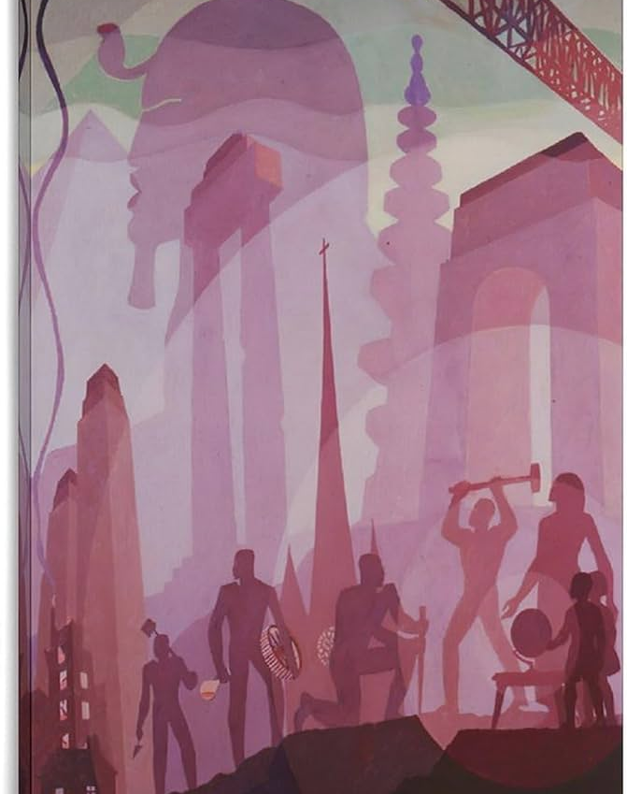
Reconstruction 1: Building More Stately Mansions (Aaron Douglas)
“The overall painting symbolizes the labor of black men and women in the creation of great architectural monuments, silhouetting their active figures against a utopian background. Concentric bands of muted color suggest waves of history and knowledge, linking the builders of pyramids, temples, and churches to the constructors of skyscrapers in the present time and anticipating their future intellectual and artistic achievements.”

Slide 21
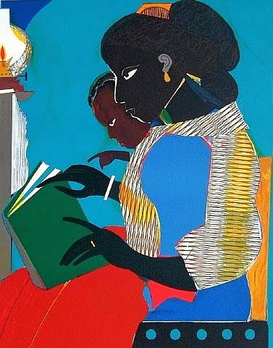
Reconstruction 2: The Lamp (Romare Bearden)
The Lamp was chosen for the NAACP Legal Defense and Educational Fund poster celebrating the 30th anniversary of Brown vs. Board of Education. The Image depicts a woman and girl reading a book together. Although its official title for display, "Brown v Board of Education- 30 Years Later: "The Politics of Excellence” Commemorating the 30th Anniversary of the Decision of The Supreme Court of The United States Ending Officially Imposed Segregation in Public Education,” focused on ending the legal barriers to education, the picture symbolizes a Black mother teaching her child to read in a non-school setting, at home which emphasizes the self determination of Black folk to educate themselves regardless of the law.

Slide 22
Reconstruction 3: Wiley's Napoleon Leading the Army Over the Alps (2005)
Wiley's Napoleon Leading the Army Over the Alps (2005) is based on Napoleon Crossing the Alps (1800) by Jacques-Louis David, often regarded as a "masterpiece", now restaged by Wiley with an African rider wearing modern army fatigues and a bandanna. Wiley "investigates the perception of blackness and creates a contemporary hybrid Olympus in which tradition is invested with a new street credibility".
https://smarthistory.org/kehinde-wiley-napoleon-leading-the-army-over-the-alps/

Slide 24
Notes on the Art/Artist
Kehinde Wiley (born February 28, 1977) is a New York City-based portrait painter who is known for his highly naturalistic paintings of African-Americans. The Columbus Museum of Art, which hosted an exhibition of his work in 2007, describes his work as follows: "Wiley has gained recent acclaim for his heroic portraits which address the image and status of young African-American men in contemporary culture.”
Wiley often references Old Masters paintings for the pose of the figure.[13] Wiley's paintings often blur the boundaries between traditional and contemporary modes of representation. Rendered in a realistic mode—while making references to specific Old Master paintings—Wiley creates a fusion of period styles, ranging from French Rococo, Islamic architecture and West African textile design to urban hip hop and the "Sea Foam Green" of a Martha Stewart Interiors color swatch. Wiley's slightly larger than life-size figures are depicted in a heroic manner, as their poses connote power and spiritual awakening. Wiley's portrayal of masculinity is filtered through these poses of power and spirituality.

Slide 25
Externalized Ideas Made Into Objects & Internalized
Create Social Realities Through Habitual Use
That We Forget* Were Ideas & Accept As Reality
Imagination Creates & Destroys Slavery

Slide 26
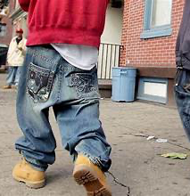
Black Culture As Resistance?

Slide 27
Painter’s Argument 1
History exists in two frames: past, present, but…
But when you think about how much happens –in individual lives, in the lives of people, and in nations (social interaction)-, you realize in order to make sense of what took place (the past), you need to select (in the present) what is important from all the other, trivial things that happened in the past.
No selection, no meaning.

Slide 28
Painter’s Argument 2
Making sense of the past is the work of historians (the epistemology of history – how history seeks to know the world; how? i.e the tools of historians: primary documents, historical review, ethnography etc.).
Making sense of the past is the work of historians, who create a historical narrative, objectively.
Historical narrative constructs a coherent story that makes sense to us now, and the story endows and denies “importance” to events and people(s).

Slide 29
Painter’s Argument 3
The writing of history continues to evolve in a cycle of (1) new issues, (2) new questions, (3) new answers.
In our “present” we ask different questions of the past. (Women, men, “everyday people.”)
ex. #MeToo – Reframed norms in the present, reframes the past.
ex. Black poetry (60’s) to Rap (70’s).

Slide 30
Painter’s Argument 4
Historians trained to view the past objectively.
Artists trained to view the past subjectively.
Art work created from personal experiences, not necessarily primary documents.
Black artists aim: To reveal the “unknown greatness…,” to battle vs. oppression (“Writing is Fighting” – Ishmael Reed)
African American art “recreates” a people and story that much of American history would obliterate and think not “important.”

Slide 31
Painter’s Argument 5
Black art is an example of African American “historical agency” which makes black people historical actors, not passive victims of history.
Visual arts help “create” African American history –present to past, past to present, creating (1) new issues, with (2) new questions, and providing (3) new answers.
Beauty, value, brilliance to counter Ugly, disposable, deplorable (biologically, intellectually).

Slide 32
Painter’s Argument 6
Invisible & silent, visible & actionable.
“This is meaningful; we need to pay attention.”
Black art history begins in the 1920’s (Harlem Renaissance).
Aaron Douglass, “Building More Stately Mansions.” 1944 – a 20th century artist’s image of Africa = Egypt.
Conceptualized black thought of the time period

Slide 33
Painter’s Argument 7
Black artists created two types of images repeatedly: “ordinary (everyday), working people (including family) and violence inflicted upon people of African descent (War not until the 1960’s)
Dates of the art do not coincide with the dates of actual historical events (objective), but more appropriately document the changing ways in which Africans Americans have conceived (subjective) of their history.

Slide 34
Externalized Ideas Made Into Objects & Internalized
Create Social Realities Through Habitual Use
That We Forget* Were Ideas & Accept As Reality
Imagination Creates & Destroys Slavery

Slide 35
How Watermelons Became a Racist Trope Before its subversion in the Jim Crow era, the fruit symbolized black self-sufficiency. https://www.theatlantic.com/national/archive/2014/12/how-watermelons-became-a-racist-trope/383529/
“But the stereotype that African Americans are excessively fond of watermelon emerged for a specific historical reason and served a specific political purpose.
The trope came into full force when slaves won their emancipation during the Civil War. Free black people grew, ate, and sold watermelons, and in doing so made the fruit a symbol of their freedom.
Southern whites, threatened by blacks’ newfound freedom, responded by making the fruit a symbol of black people’s perceived uncleanliness, laziness, childishness, and unwanted public presence. This racist trope then exploded in American popular culture, becoming so pervasive that its historical origin became obscure. Few Americans in 1900 would’ve guessed the stereotype was less than half a century old.”

Slide 36
Using Painter’s Point of View on History
You need to select (in the present) what is important from all the other, trivial things that happened in the past.
Example: “Free black people grew, ate, and sold watermelons, and in doing so made the fruit a symbol of their freedom.”
How does this change our understanding of the Watermelon stereotype, Blk Econ Dev.?

Slide 37
Using Painter, Marable
Painter – Black Americans create black Americans (Central contributors to American history, etc.)
“…the fruit a symbol of their freedom.”
Marable-– Conflict, Fruition, Backlash (Cycles based on changes in policy)
“Southern whites, threatened by blacks’ newfound freedom, responded by making the fruit a symbol of black people’s perceived uncleanliness, laziness, childishness, and unwanted public presence.”
Conflict – Over the status of African Americans
Fruition – Newfound freedom via 13-15 Amends (Policy)
Backlash – Creation of the Watermelon stereotype

Slide 38
Using Kendi, Coates
Kendi – Producers and Consumers of Racist Ideas (Producers create ideas w/ self interest in mind)
“Southern whites, threatened by blacks’ newfound freedom, responded by making the fruit a symbol of black people’s perceived uncleanliness, laziness, childishness, and unwanted public presence. This racist trope then exploded in American popular culture…”
Coates – The Black Body (To understand the condition of African Americans investigate the use/abuse of the black body)
The Black body working for itself not others is attacked by stereotype seeking to subdue it/control it.

Slide 39
Hard-Working People in the Depths of Segregation (1896-1919)
Palmer Hayden, “John Henry on the Right, Steam Drill on the Left,” 1944-1954
The legend / folklore/ /mythology of John Henry, created and forwarded by African Americans, exemplifies the ‘hard working’ nature of African Americans. Countered stereotypes
“In 1890, more than half of all Black Americans of all ages were working: 57.7 percent compared to 46.6 percent of whites.”

Slide 40
This.
Is
The Hour
Chaos

Slide 41
CONFLICT
CHANGE/ FRUITION
BACKLASH
REPEAT

Slide 42
Externalized Ideas Made Into Objects & Internalized
Create Social Realities Through Habitual Use
That We Forget* Were Ideas & Accept As Reality
Imagination Creates & Destroys Slavery

Slide 43
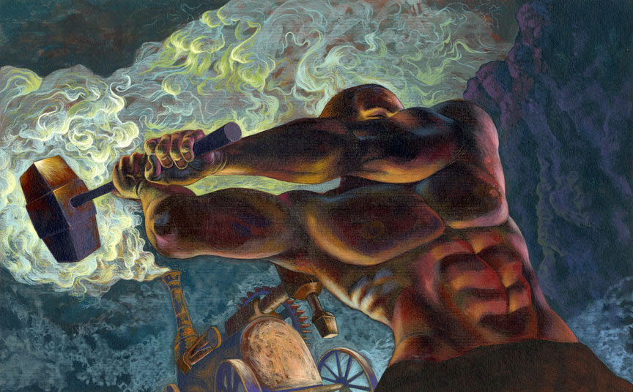
John Henry is the Icon or Avatar for Africans Americans resisting Segregation
Hard working people making gains ….
In education –Graduates & HBCU’s
As professionals – Inventors & Intellectuals
In Business – Companies & Prof Orgs
Constructing Black Towns & Churches
In Athletics – J. Johnson, Baseball, Negro Leagues
Countering Stereotypes – Newspapers & Artists
Battling White Supremacy – Lynching & Voting

Slide 44
The New Negro (1915-1932)
The New Negro disposition (“The negro fought back.”) creates transformational changes evidenced in…
The Great Migration – 6 million move (1916-1970)
WWI – International disposition
Jazz – International proliferation of Black Culture
Organizations – NAACP, UNIA, Pan African Congress
Harlem Renaissance – Literature, Arts, Scholarship

Slide 45
The New Negro (1915-1932)
*Jacob Lawrence, “Migration of the Negro, Panel 1: During the World War there was a Great Migration by Southern Negroes,” 1940-41
Lawrence shows the masses of black people of all ages crowding on to trains on their way to Chicago, New York, St. Louis.

Slide 46
The New Negro (1915-1932)
*Jacob Lawrence, “Migration of the Negro, Panel 1: During the World War there was a Great Migration by Southern Negroes,” 1940-41
‘They voted against segregation with their feet.’ New Negro disposition. Great Migration: 6 million move South to North (1916-1970)

Slide 48
Protest Makes A Civil Rights Revolution 1960-1967
Jeff Donaldson, “Aunt Jemima & The Pillsbury Doughboy,” 1963 is a double protest work of art. The figures, a black woman and a police officer, speak to police brutality (key during the Civil Rights movement and beyond) and, because Jemima & Doughboy are known American icons, is a larger critique on American history.
The Civil Rights Movement is a high water mark for the New Negro disposition. The Negro fights back in protest, through legal means in artistic representation.

Slide 49
Black Power 1966-1980
Jeff Donaldson’s, “Wives of Shango,” 1968 and Carroll Parrot Blue’s “Angela Davis in Los Angeles,” 1972 represents the often ignored reality of Black women leadership in the most dynamic movement of black politics since the New Negro movement, Black Power.
Both portraits represent the emergence of a new consciousness consequentially more politically urgent (“We want what’s ours, now.”) African (style of dress, hair, etc.) and still American though redefined by self-definition and determination aka Blackness.
Black Power is the New Negro intensified and self-defined.

Slide 50
We Are The Dreams of Our Ancestors
What Were Those Dreams?
Education Is Freedom

Slide 51
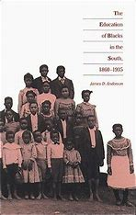
“…the movement by ex-slaves to develop
an educational system singularly appropriate
to defend and extend their emancipation.
Within this movement the basic form,
philosophy, and subject matter of black education
reflected the ex-slaves’ intent to restructure and control their lives.”
Anderson, James D.. The Education of Blacks in the South, 1860-1935 (p. 3). The University of North Carolina Press.

Slide 52
This.
Is
The Hour
Chaos

Slide 53
CONFLICT
CHANGE/ FRUITION
BACKLASH
REPEAT

Slide 54
Externalized Ideas Made Into Objects & Internalized
Create Social Realities Through Habitual Use
That We Forget* Were Ideas & Accept As Reality
Imagination Creates & Destroys Slavery

Slide 55
Context for Anderson’s Work
History exists in two frames (past/present) BUT unexamined details have the power to create a new historical narrative.
Dr. Anderson’s work reveals new details and recreates the historical narrative about African Americans and education.
“Black art is an example of African American “historical agency” which makes Black people historical actors, not passive victims of history.”
Nell Irving Painter (2006), Creating Black Americans

Slide 56
A Repeat of History?
Seemingly intractable problems, especially in Education for African Americans? When wasn’t there an Achievement Gap?
Society creates Policy. Policy creates Systems. Systems never die.
The “Gap” is a by product of Society, Policies & Systems, AND
Dr. Anderson’s work reveals an African American cultural and social ethic, effort and experiences that have been lost to the historical record.
Anderson’s Work = TOTAL RECALL

Slide 57
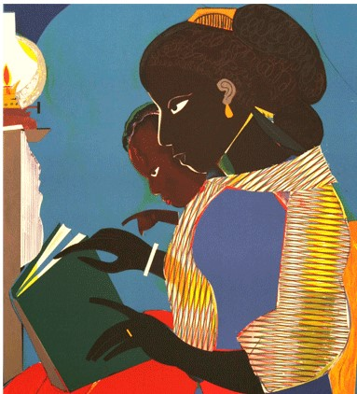
In a Nutshell…
Conventional wisdom says those enslaved were given their freedom and their educational institutions.
The historical record describes enslaved African Americans as the central dynamic force emancipation and the progenitors of free public schools in the South for all.
The historical record describes the fight for African American education starting with secret literacy societies during slavery, the construction of their own schools before the Freedmen’s Bureau, and a constant battle against the slaverhoder’s version of education.
This is why Bearden’s “The Lamp” is so important. Self determination, Self definition. Education is a cultural pillar.

Slide 58
“There is one sin
that slavery committed against me,”
professed one ex-slave,
“which I will never forgive.
It robbed me of my education.”

Slide 59
What Did They Dream, What Did They Do?
Former slaves were the first among native southerners to depart from the planters’ ideology of education and society and to campaign for universal, state-supported public education.
Blacks emerged from slavery with a strong belief in the desirability of learning to read and write. This belief was expressed in the pride with which they talked of other ex-slaves who learned to read or write in slavery and in the esteem in which they held literate blacks.
It was expressed in the intensity and the frequency of their anger at slavery for keeping them illiterate. “There is one sin that slavery committed against me,” professed one ex-slave, “which I will never forgive. It robbed me of my education.”

Slide 60
Textual Evidence of Black Ideas & Actions
“They rushed not to the grog-shop but to the schoolroom—they cried for the spelling-book as bread, and pleaded for teachers as a necessity of life.” - Harriet Beecher Stowe (1879)
Journalist Charles Nordhoff reported that New Orleans’s ex-slaves were “almost universally … anxious to send their children to school.”
“Few people who were not right in the midst of the scenes can form any exact idea of the intense desire which the people of my race showed for education. It was a whole race trying to go to school. Few were too young, and none too old, to make the attempt to learn” (BT Washington).

Slide 61
Textual Evidence of Black Ideas & Actions
The foundation of the freedmen’s educational movement was their self-reliance and deep-seated desire to control and sustain schools for themselves and their children that started decades before the Civil War.
“They have a natural praiseworthy pride in keeping their educational institutions in their own hands. There is jealousy of the superintendence of the white man in this matter. What they desire is assistance without control.”
The values of self-help and self-determination underlay the ex-slaves’ educational movement. To be sure, they accepted support from northern missionary societies, the Freedmen’s Bureau, and some southern whites, but their own action—class self-activity informed by an ethic of mutuality—was the primary force that brought schools to the children of freed men and women.

Slide 62
Textual Evidence of Black Ideas & Actions
The South’s postbellum movement for universal education is best understood as an expression of the ex-slaves’ beliefs and behavior.
W. E. B. DuBois was on the mark when he said: “Public education for all at public expense was, in the South, a Negro idea.” Such a view of postbellum southern education acknowledges the important contributions of northerners but recognizes the ex-slaves as the principal challenge to the region’s long-standing resistance to free schooling.
“Throughout the entire South,” Alvord reported, “an effort is being made by the colored people to educate themselves.” “In the absence of other teaching they are determined to be self-taught; and everywhere some elementary text-book, or the fragment of one, may be seen in the hands of negroes.” Not only were individuals found teaching themselves to read and write, but Alvord also discovered a system of what he chose to call “native schools,” – 1866 Freedmen’s Bureau Report

Slide 63
Textual Evidence of Black Ideas & Actions
Two of Alvord’s findings must be heavily emphasized. First, he found “native schools,” in his own words, “throughout the entire South.”
Second, he discovered many of them in places that had not been visited by the Freedmen’s Bureau or northern benevolent societies. Alvord, realizing that his findings did not square with existing perceptions of “the character of the Negro,” took “special pains” to ascertain the facts on native schools. Such schools were found in “all the large places I visited,” and they were “making their appearance through the interior of the entire South.”
Alvord had little doubt about the significance of his findings: “This educational movement among the freedmen has in it a self-sustaining element.” This “self-sustaining” activity was rooted firmly in the slave experience and began to surface before the war’s end.
[The growth in Black education and schools] has been wrongly used to attribute the freed-men’s school movement to Yankee benevolence or federal largesse.

Slide 64
Textual Evidence of Black Ideas & Actions
“The consternation of the colored population was intense. … They could not consent to have their children sent away from study, and at once expressed willingness to be assessed for the whole expense.” Black leaders petitioned Yankee military officers to levy an added tax upon their community to replenish the bureau’s school fund. Petitions demanding the continuation of universal schooling poured in from all over Louisiana.
In 1865 Afro-American leaders formed the Georgia Educational Association…by the fall of 1866, they financed entirely or in part 96 of the 123 day and evening schools. They also owned 57 of the school buildings. Such accomplishments fulfilled the primary purpose of the Georgia Educational Association, “that the freedmen shall establish schools in their own counties and neighborhoods, to be supported entirely by the colored people.”

Slide 65
Textual Evidence of Black Ideas & Actions
In Savannah, … 28 schools in 1866, and 16 of them, reported the black Loyal Georgian, were “under the control of an Educational Board of Colored Men, taught by colored teachers, and sustained by the freed people.”
These beliefs and behavior were consistent with the activities of ex-slaves in Virginia, South Carolina, and Louisiana. In 1867, for instance, the Freedmen’s Record complained about the tendency of ex-slaves to prefer sending their children to black-controlled private schools rather than supporting the less expensive northern white-dominated “free” schools.
The ex-slaves’ educational movement became a test of their capacity to restructure their lives, to establish their freedom. Although they appreciated northern support, they resisted infringements that threatened to undermine their own initiative and self-reliance….ex-slaves initiated and sustained schools whether or not northern aid was available.

Slide 66
Textual Evidence of Black Ideas & Actions
The “Sabbath” school system, about which little is known, operated largely on the strength of the ex-slave community. Frequently, Sabbath schools were established before “free” or “public” schools. These church-sponsored schools, operated mainly in evenings and on weekends…“They reached thousands not able to attend weekday schools.”
Sabbath schools among freedmen have opened throughout the entire South...”one of the most thrilling spectacles [in the South], and often upon the plantations, is the large schools gathered upon the Sabbath day, sometimes of many hundreds, dressed in clean Sunday garments, with eyes sparkling, intent upon elementary and Christian instruction”
In some areas [Sabbath schools] constituted the only viable system of free instruction. T. K. Noble, Freedmen’s Bureau superintendent of education in Kentucky, said in 1867: “The places of worship owned by the colored people are almost the only available school houses in the State.”

Slide 67
Textual Evidence of Black Ideas & Actions
The Sabbath schools represent yet another remarkable example of ex-slaves seeking, establishing, and supporting their own schools. Conservative estimates: 1,512 schools, 6,146 teachers, 107,109 pupils. Sabbath schools continued to grow in the black community long after Reconstruction.
In 1868 the African Methodist Episcopal church (AME), for example, enrolled 40,000 pupils in its Sabbath schools. By 1885, the AME church reported having “200,000 children in Sunday schools” for “intellectual and moral” instruction.
In the 19th century, the AME Church of Ohio collaborated with the Methodist Episcopal Church, a predominantly white denomination, in sponsoring the second independent historically black college (HBCU), Wilberforce University in Ohio.

Slide 68
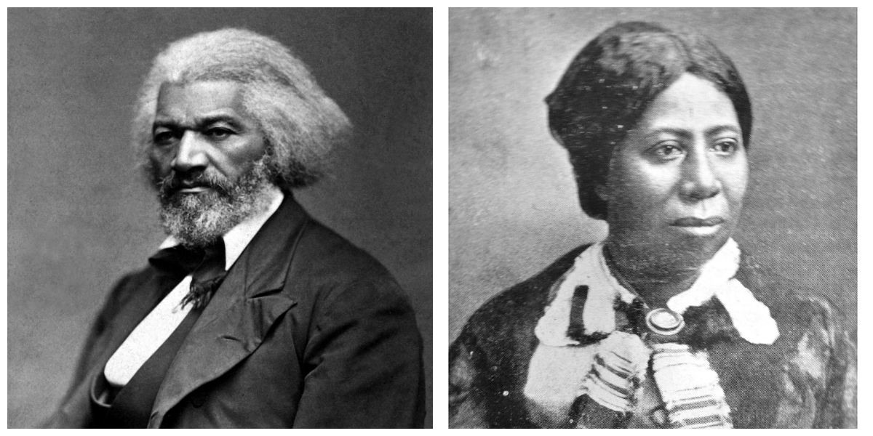
Rebel Literates, Stealin’ A Meeting
By 1860 5 percent of the slaves had learned to read. Many paid a high price for their literacy. “It seemed to me that if I could learn to read and write...I really thought it would point out to me the way to freedom…I knew if my book was discovered that all was lost, and I felt prepared for any hazard or suffering rather than give up my book and my hopes of improvement.” Thomas H. Jones, North Carolina.
Elizabeth Sparks was part of a group of rebel slaves who held secret literacy sessions in the slave quarters. The gatherings, known among slaves as “stealin’ a meetin’.
After slavery many of the leading black educators emerged from among the rebel literates, those slaves who had sustained their own learning process in defiance of the slave owners’ authority. They viewed literacy and formal education as means to liberation and freedom. Frederick Douglass, Bishop Henry M. Turner, Bishop Isaac Lane, Bishop Lucius H. Holsey, and P. B. S. Pinchback, etc.

Slide 69
A Coda
An aged black woman was asked why she was so determined to learn to read and write, she replied, “so that the Rebs can’t cheat me.”
Universal education was certain to become a reality in black society, not because ex-slaves were motivated by childlike, irrational, and primitive drives, but because they were a responsible and politically self-conscious social class.
Ultimately, the formation and development of the ex-slaves’ beliefs and behavior regarding universal education in the postwar South will have to be understood as part of a process that started decades before the Civil War.
Education for the freedmen could serve as a safeguard against fraud and manipulation.

Slide 70
BACKLASH:
Freedmen's schoolhouse burned, Memphis riots of 1866, as illustrated in Harper's Weekly.
This. Is The Hour of Chaos

Slide 71
Culture eats Strategy for Breakfast (Values) Public Ed In the South “A Negro Idea” (Philosophy) Dual Strategies: Self definition + Control Ex.: Change the Law, Keep Control. Vote & Run.

Slide 72
Reconstruction(s)
First Reconstruction
Conflict: Slavery
Fruition: Civil War, Reconstruction (13-15 Amd)
Backlash: Violence vs Blacks, Construction of Jim Crow which becomes Sys of Segregation
Second Reconstruction
Conflict: Segregation
Third Reconstruction
Conflict: Rep Democracy
Fruition: Civil Rights, Civil Rights Bills
Backlash: Violence vs Blacks, Challenges to Representative Democracy
Fruition: Election of Obama, Obamacare, Prog. Leg.
Backlash: Violence vs Blacks, Challenges to Representative Democracy
R1-3: Rise of individuals in resistance, resistance movements, organizations, elected reps.

Slide 73
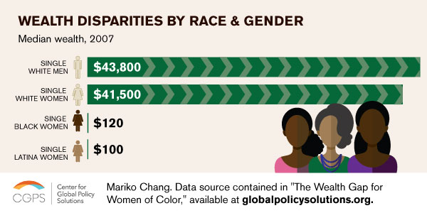
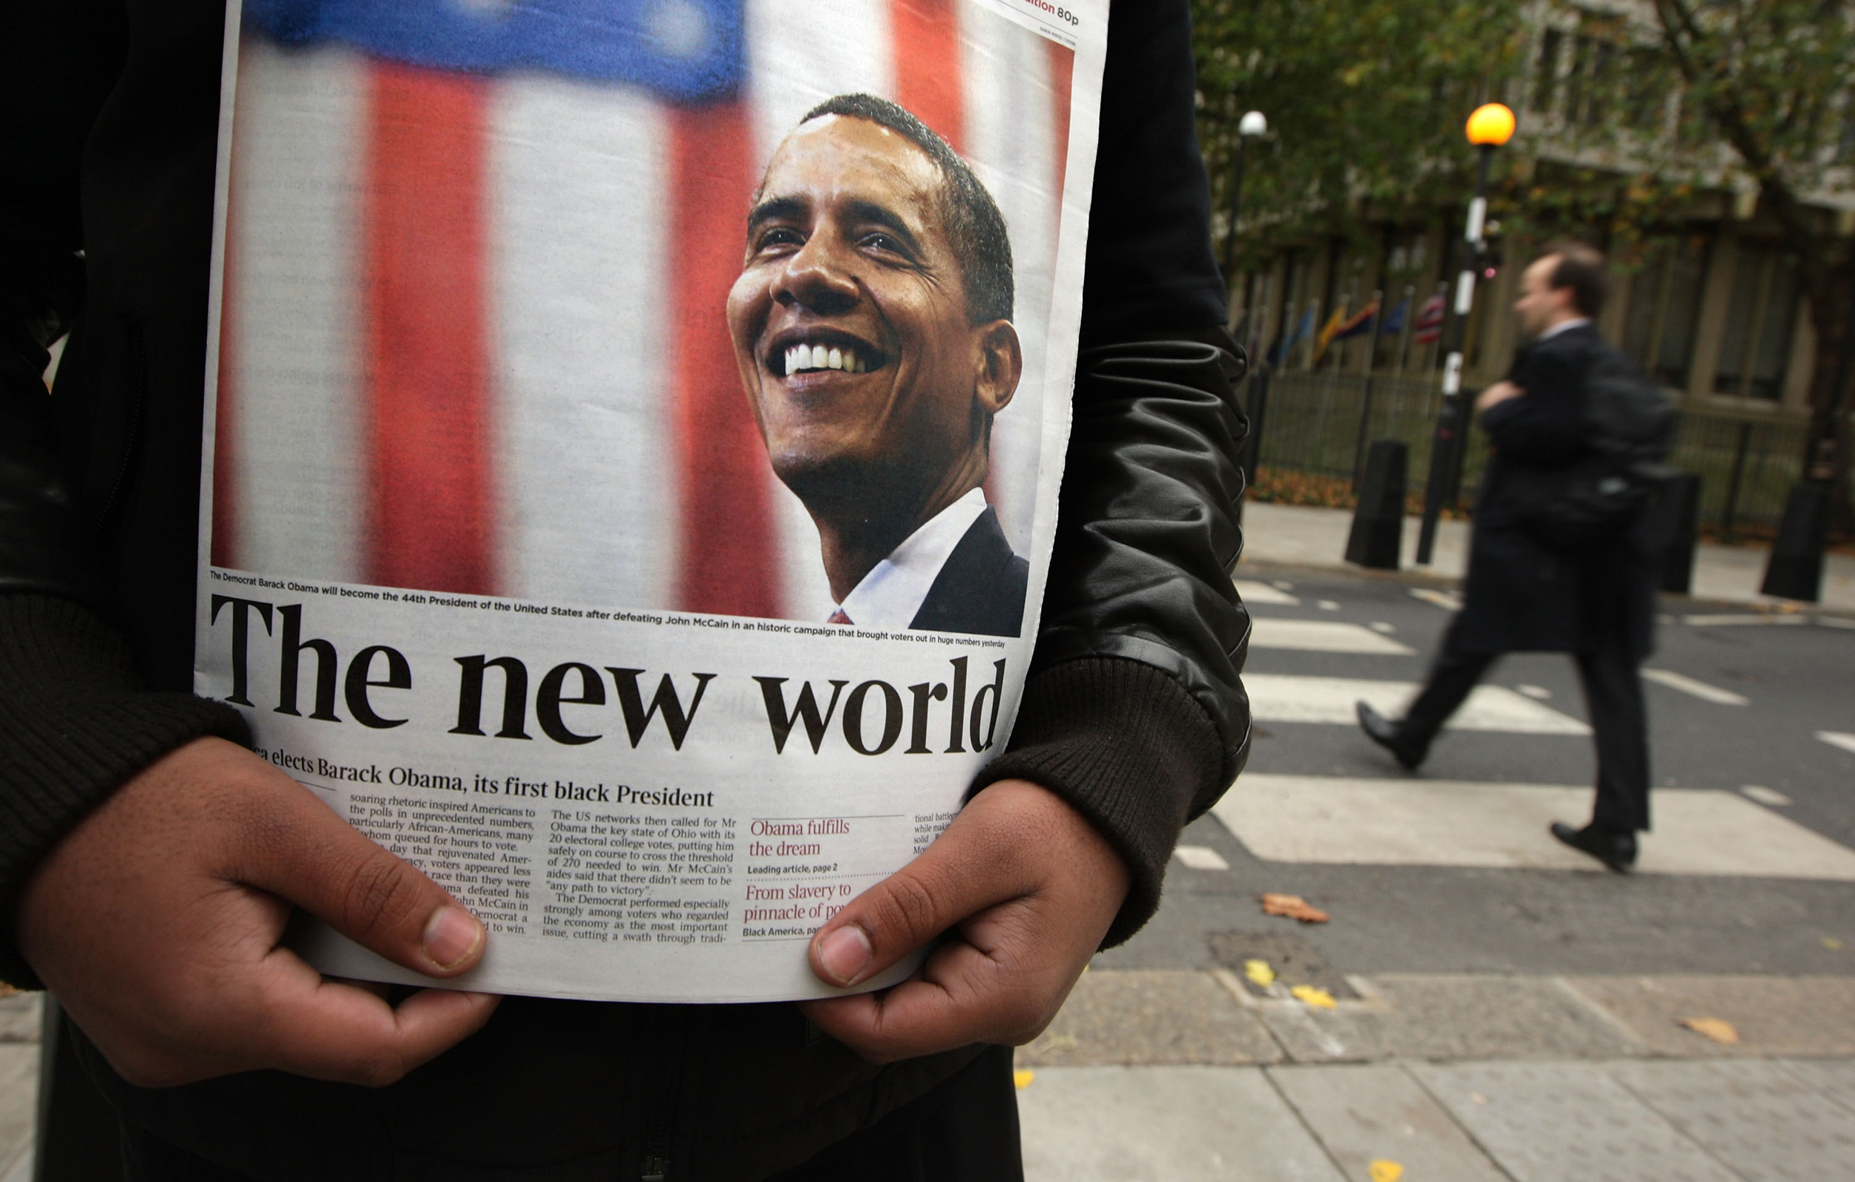
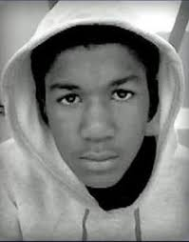
A Third Reconstruction
Massive Conflict
Fruition
Backlash?

Slide 74
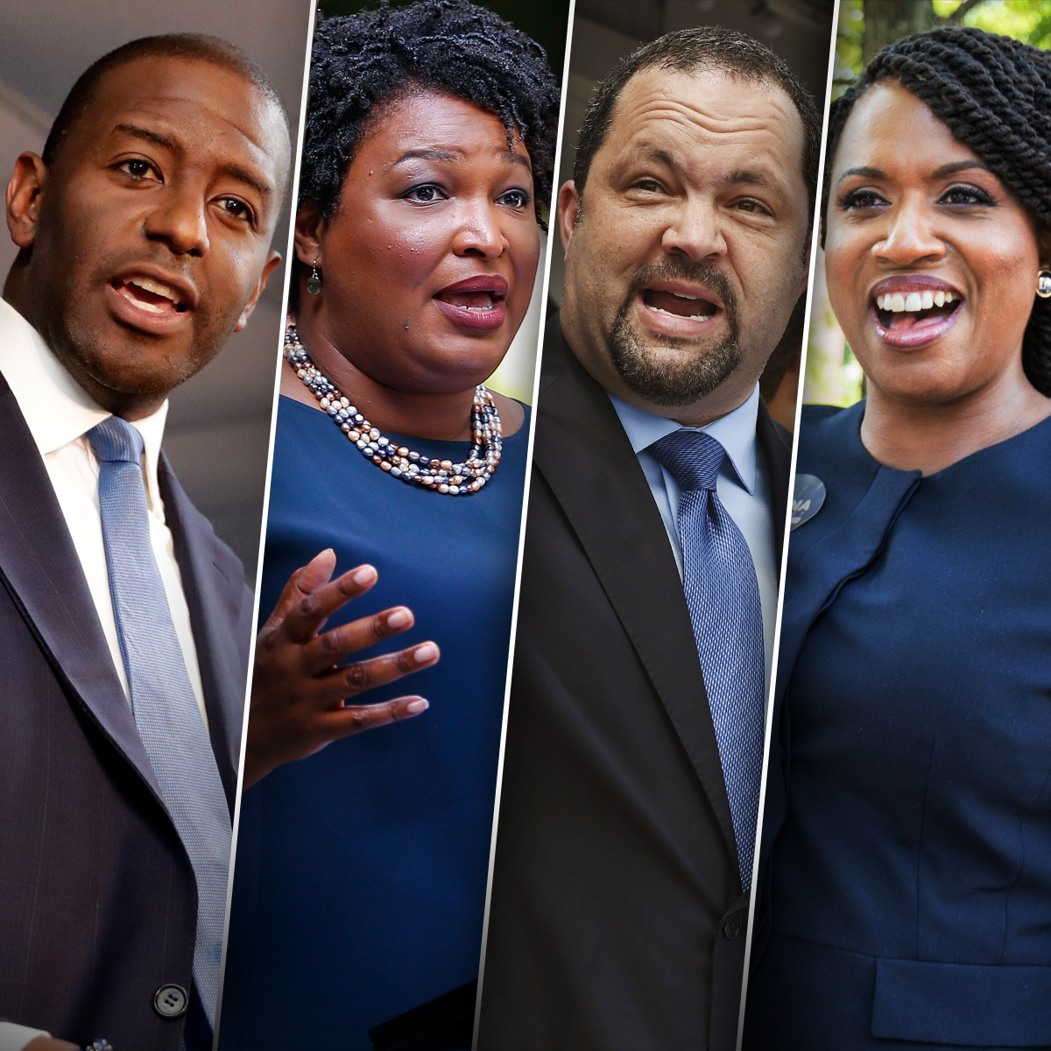
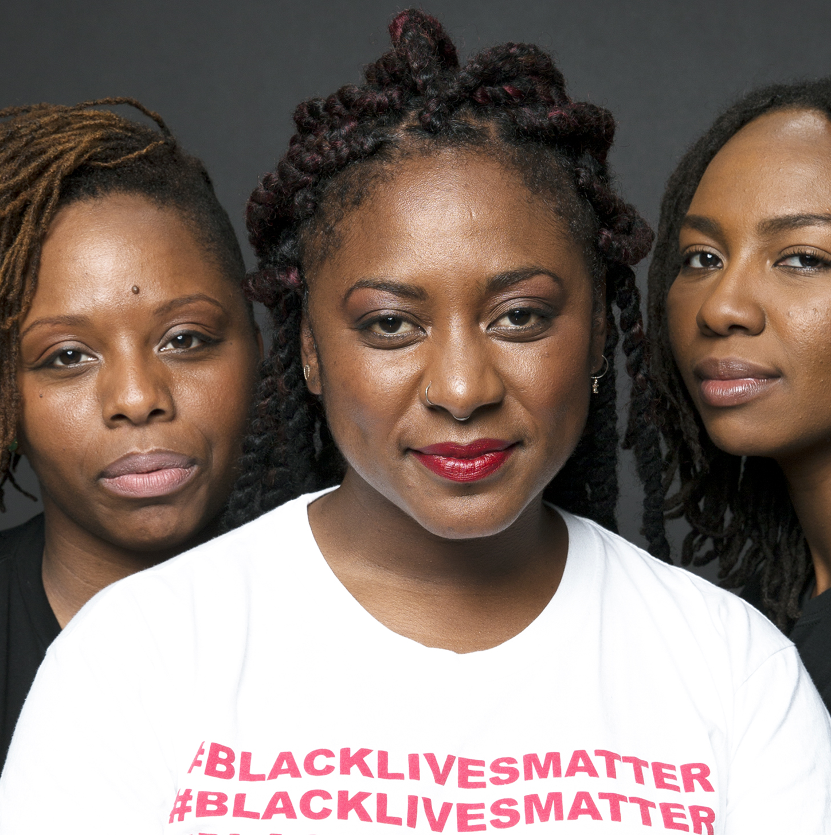
A 3rd Reconstruction

Slide 75
This.
Is
The Hour
Chaos

Slide 76
CONFLICT
CHANGE/ FRUITION
BACKLASH
REPEAT

Slide 77
Externalized Ideas Made Into Objects & Internalized
Create Social Realities Through Habitual Use
That We Forget* Were Ideas & Accept As Reality
Imagination Creates & Destroys Slavery

Slide 78
Repetitive Themes in African American History : Fight for the Vote and Electoral Representation
The Rise of the Black Vote in R3, R2, R1
R3 – What Black Voters Want - https://www.theatlantic.com/politics/archive/2018/05/what-black-voters-want/559775/
R1 – Rise of the Black Vote 1868-1920 - http://umich.edu/~lawrace/votetour3.htm
Election of Progressives After Conflict/Backlash
R3 – Black, progressive, insurgent: Is this the future of the Democratic Party? - https://www.nbcnews.com/politics/elections/black-progressive-insurgent-future-democratic-party-n906841
R1 – (Eric Foner, 2008) - Rooted in Reconstruction: The First Wave of Black Congressmen - https://www.thenation.com/article/rooted-reconstruction-first-wave-black-congressmen/

Slide 79
Repetitive Themes in African American History: Criminal Justice System
Kalief Browder & the Scottsboro Boys
R3 – The Case of Kalief Browder - https://www.pbs.org/wgbh/americanexperience/features/scottsboro-boys-who-were-the-boys/
R2 – Scottsboro Boys - https://www.pbs.org/wgbh/americanexperience/features/scottsboro-boys-who-were-the-boys/
Emmet Till & Michael Brown
R2 - How Emmet Till’s Murder Changed the World http://time.com/4008545/emmett-till-history/
R3 - How Michael Brown’s Murder Awakened A Nation to Police Brutality https://www.teenvogue.com/story/michael-brown-death-anniversary-police-brutality-black-lives-matter

Slide 80
So, What Is Black Culture? The Social Construction of Blackness
Tunde Adleke – “Slavocentric” – Culture constructed in resistance
Walker & Gilroy: Historiography, The Black Atlantic
Holloway & Asante: Africanisms and Afrocentricity, Negritude
DuBois: Double Consciousness – “Ever-twoness”
T. Coates:
The Black Body
Guiner: Race is a Canary in the Coal Mine, or an indicator not a pathology.
Herskovitz & Frazier : African Culture Survived?
Contemporary Narratives:
Toni Morrison: The Shadow of Whiteness of the ‘White Gaze’ - https://youtu.be/SHHHL31bFPA
bell hooks: On White Supremacy & the Million Man March - https://youtu.be/1ShWJf8BIqI
Kimberle Crenshaw – Intersectionality _ https://youtu.be/akOe5-UsQ2o
Still Black – Black Transmen - https://youtu.be/JAuBtcHDlcA

Slide 81
How Did Black Folk Create Black Folk?
Complexity – That African American identity is a complex construction of ideas about Africa and African Americans that have developed and changed over time. That African Americans incorporate multi-racial/ethnic identities, and differences in political, social, and cultural points of view into the overall context of Blackness.
Self-Determination – That self-determination has always been a key element in complexity and self definition. That the enslaved and those who were free made tremendous contributions to America that stand in contradiction to their overall treatment. That social institutions like the church, education, business and politics are arenas where black excellence and the reputation of being “hard working people” stood in opposition to Black stereotypes. That African Americans were not given their freedom, they, in fact, fought for it in large and small ways.
Self Definition – That African Americans continue to define, redefine, and refine their identity. One of these ways is through artistic representation of the African American experience and what it means to be “Black.” These images are complex and important to our understanding.

Slide 82
What Are The Pillars & Policy Concerns of Black Culture?
Pillars
Resistance
Education
Artistic Expression
Organization
Policy Concerns
Health
Justice
Education
Wealth

Slide 83
Society Beliefs, Values, Norms Beliefs & Values tell “Norms what to do.” Policies Public Policy, Laws Public Policy & Law Reflect Societal Values. Systems Institutions Institutions codify societal norms & laws.

Slide 84
Repetitive Themes in African American History: Resistance to Oppression
Ida B. Wells - https://escholarship.org/content/qt1kc308xf/qt1kc308xf.pdf
Alicia Garza, Patrisse Cullors, Opal Tometi, Brittnay Packnett https://www.newyorker.com/magazine/2016/03/14/where-is-black-lives-matter-headed
Timeline: Black Lives Matter - http://www.abc.net.au/news/2016-07-14/black-lives-matter-timeline/7585856
Black Lives Matter in 80 images - https://www.newsweek.com/black-lives-matter-five-turbulent-years-80-iconic-images-1017971

Slide 85
What Are Our Ideas/Dreams?
Life = Discovery + Construction
What Objects Will We Create?
How Will We Internalize Them?
What New Reality Will We Create?

